Slide 1
Unit2 Spring is Coming!
第1课时
WWW.PPT818.COM

Slide 2
>>Lead-in
Free talk
How many days are there in a week?
How many months are there in a year?
How many seasons are there in a year?

Slide 3
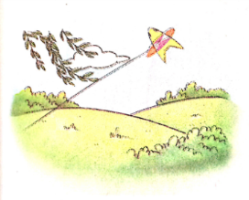
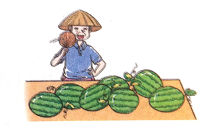
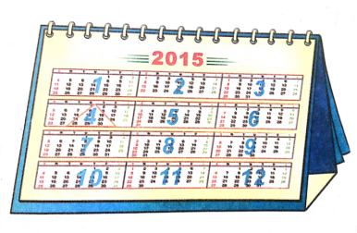
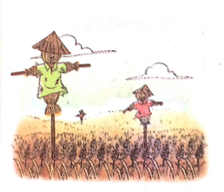
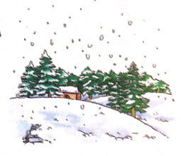
>>Lead-in
Think and group

Slide 4
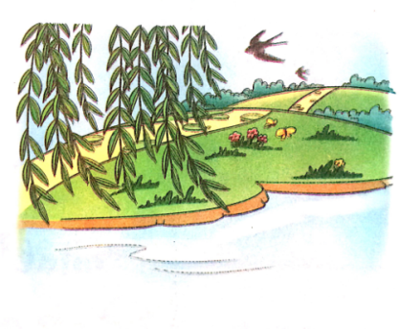
>>Presentation
Let’s learn
spring

Slide 5
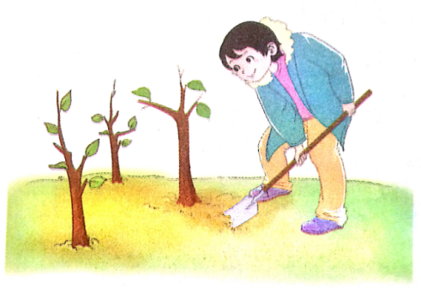
>>Presentation
Let’s learn
plant trees
We can plant trees in spring.

Slide 6
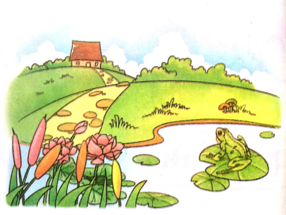
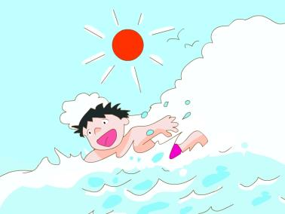
>>Presentation
Let’s learn
summer

Slide 7
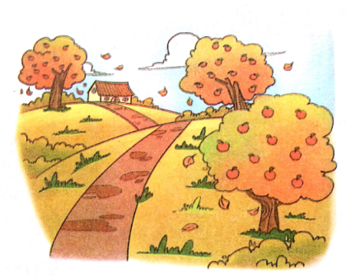
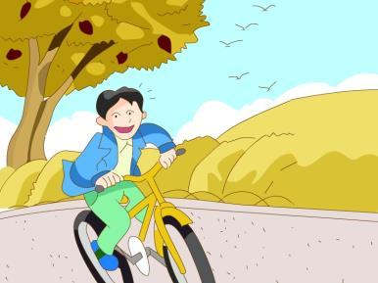
>>Presentation
Let’s learn
autumn
au-/ɔ/

Slide 8
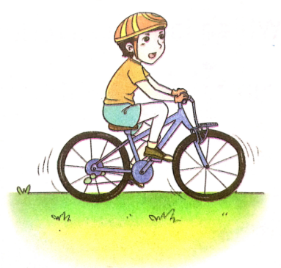
>>Presentation
Let’s learn
ride a bike
I can ride a bike in autumn.

Slide 9
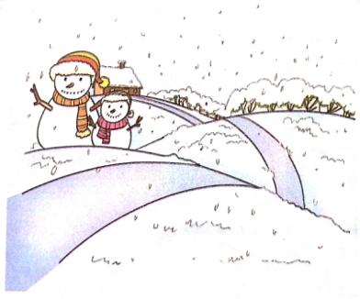
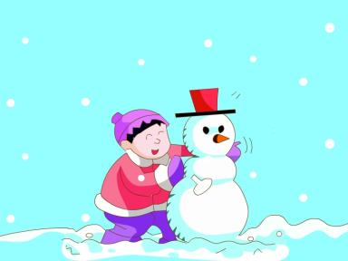
>>Presentation
Let’s learn
winter

Slide 10
>>Practice
Look and match
1
2
3
4
summer
winter
spring
autumn

Slide 11
>>Practice
Play a game
autumn
winter
summer
spring

Slide 12
>>Presentation
season
Let’s learn

Slide 13
>>Presentation
Ask and answer
What’s your favourite season?
What can you do in spring/summer/autumn/winter?

Slide 14
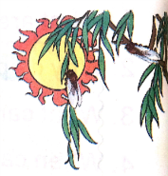
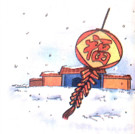
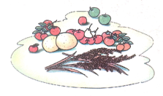
>>Presentation
Let’s chant
Seasons
Spring is gay with flower and song.
Summer is hot and the days are long.
Autumn is rich with fruit and grain.
Winter brings snow and a new year again.

Slide 15
>>Summary
1. 词组：
summer
winter
spring
autumn
plant trees/ride a bike

Slide 16
>>Homework
1.观看课文动画，按照正确的语音、语调朗读课文对话。
2.将“ Let’s chant”部分唱给你的朋友听。
3.预习“Let’s learn”。
close

