Slide 1
My day
第三课时
WWW.PPT818.COM

Slide 2
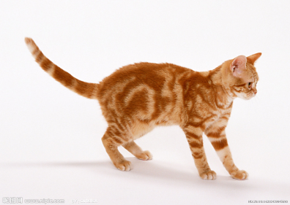
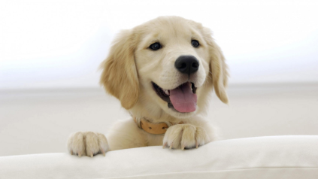
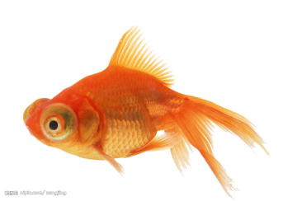
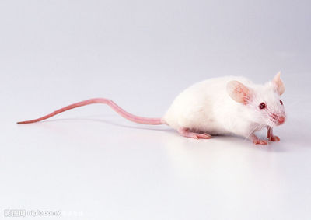
Guessing Game
2
1
cat
dog
4
3
fish
mouse

Slide 3
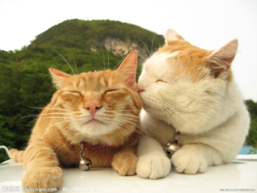
Do you like cats? Why?
Min and Mog

Slide 4




Quick Response
Matching Game
get up
have dinner
start to work
go to bed

Slide 5
Matching Game
get up
have dinner
start to work
go to bed

Slide 6



Fill in blanks
Min
Hello,everyone. I'm ____.
seven o'clock
I get up at ____________ in the evening.
half past seven
I have dinner at _________.
eight o'clock
At _____________ ,I start to work.
I catch a mouse.
six o'clock
I go to bed at _________ in the morning. I'm tired.

Slide 7
a mouse
m
ice
two mice
many mice
a lot of mice

Slide 8
Min's friend
I have a good friend. His name is Mog.
He gets up at seven o'clock in the evening.
He has dinner at half past seven.
At eight o'clock, He starts to work.
He catches a mouse.
He gets up at six o'clock in the morning.
We are good friends!

Slide 9
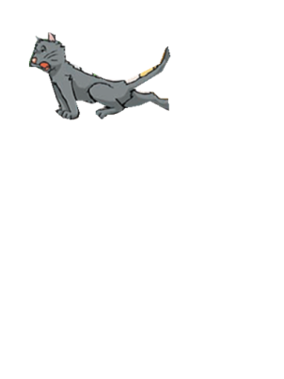
Who What When
at
gets up
seven o'clock
has dinner
half past seven
Mog
starts to work
eight o'clock
goes to bed
six o'clock

Slide 10


Listen and write
He catches a lot of _____ at eight o' clock.
He ____________
at six o'clock in the morning.
We often eat and work together.
We are good friends!
My friend
I have a good friend.
His name is Mog.
He is black.
He _______ at seven o'clock in the evening.
He __________ at half past seven.
mice
goes to bed
gets up
has dinner

Slide 11

Liten and answer
Good evening, Min!
Good evening, Mog!
What time is it?
It's seven o'clock.
Oh, I'm hungry.
Let's have dinner together.
What time do they get up?

Slide 12
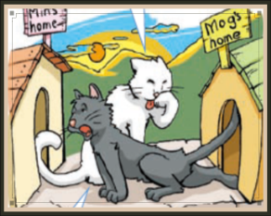

Min
Mog
What time do they get up?
Min and Mog _____ at _________ in the evening.
get up
seven o'clock
Fill in blanks

Slide 13
PAIR WORK
Good evening, Min!
Good evening, Mog!
What time is it?
It's seven o'clock.
Oh, I'm hungry.
Let's have dinner together.

Slide 14
Listen and answer
Would you like some fish?
Here you are.
Thank you.
How's the fish?
It's wonderful!
What do they eat for dinner?

Slide 15
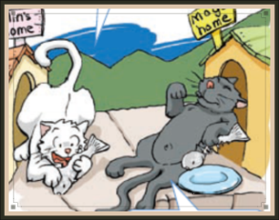
Min
Mog
What time do they have dinner?
They __________ at __________ in the evening.
have dinner
half past seven
Fill in blanks

Slide 16

Listen and answer
What time is it, Min?
It's eight o'clock.
Oh! What's that?
It's a mouse.
Catch the mouse!
Go!
Don't run!
Stop!
What time do they catch the mouse?

Slide 17
Listen and answer
What time is it, Min?
It's eight o'clock.
Oh! What's that?
It's a mouse.
Catch the mouse!
Go!
Don't run!
Stop!
What time do they catch the mouse?

Slide 18
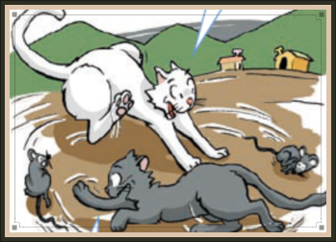
Min
Mog
What time do they start to work?
At _________ ,they __________ .
eight o'clock
start to work
Fill in blanks

Slide 19
pair work
What time is it, Min?
It's eight o'clock.
Oh! What's that?
It's a mouse.
Catch the mouse!
Go!
Don't run!
Stop!

Slide 20
Listen and answer
How are you, Min?
I'm tired.What time is it?
It's six o'clock in the
morning.Let's go to bed.
Turn off the light, please.
Ok!
What time do they go to bed?

Slide 21
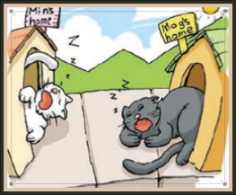

Min
Mog
What time do they go to bed?
They ________ at ________ in the morning.
go to bed
six o'clock
Fill in blanks

Slide 22
How are you, Min?
I'm tired.What time is it?
It's six o'clock in the
morning.Let's go to bed.
Turn off the light, please.
Ok!

Slide 23
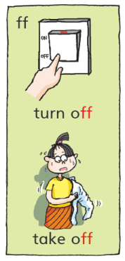
Turn off the light, please.
o
ff
turn off
take off
Turn off the light.
Take off the coat.

Slide 24
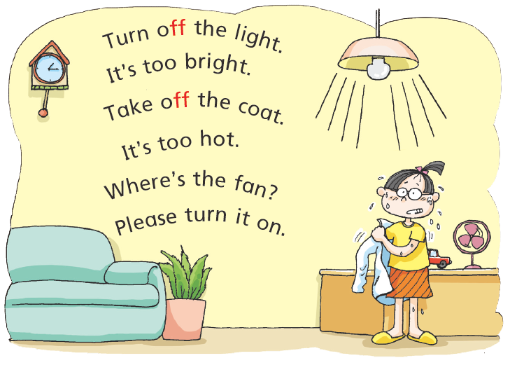
Let's chant

Slide 25
True or False
( ) 1. Min and Mog get up at half past seven.
( ) 2. They start to work at eight o'clock .
( ) 3. They have dinner at six o'clock.
( ) 4. They go to bed at six o'clock in the
morning.
F
seven o'clock
T
F
half past seven
T

Slide 26

Min and Mog
Min and Mog get up
at seven o'clock
in the evening.

Slide 27
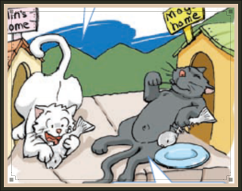
Min and Mog
They have dinner
at half past seven.

Slide 28

Min and Mog
At eight o'clock,
they start to work.
They catch a lot of
mice.

Slide 29

Min and Mog
Min and Mog go to
bed at six o'clock in
the morning. They
are tired.

Slide 30
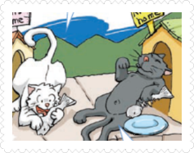
Retell the story
Min and Mog are good friends.
They ____ at ______ in the evening.
They ________ at ___________ .
At _________, they start to work.
They catch ___________ .
They ________ at ______ in the
morning.
They are ___________ .

Slide 31
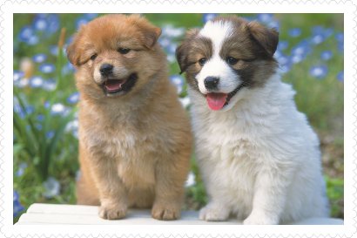
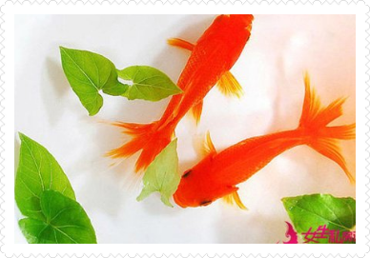
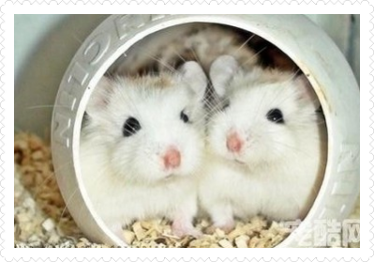
Create a new story

Slide 32
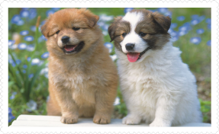
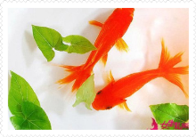
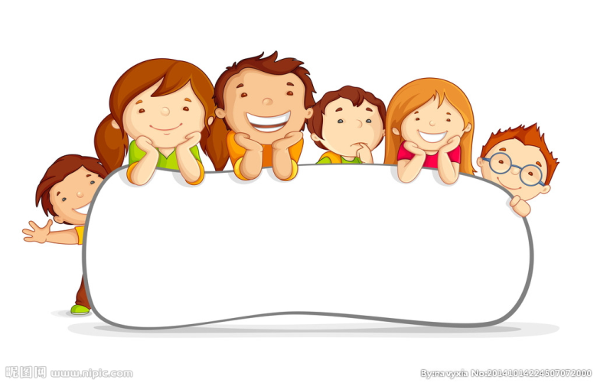
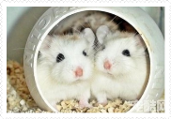
Summary
Do you have a friend?

Slide 33

Summary
Love our friends!

Slide 34
Summary 1
a mouse
two mice
How to remember them easily?
mouse的复数是mice，小朋友，你有什么好方法记住它们吗？

Slide 35
Summary 2
What do you learn from the story?
同学们，从Min and Mog的故事里你们学到了什么？懂得了什么道理？

Slide 36
Homework
1.Share the story Min and Mog with your parents.
2. Finish the exercise.

Slide 37
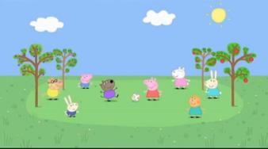
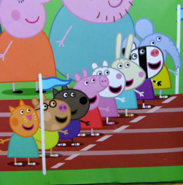
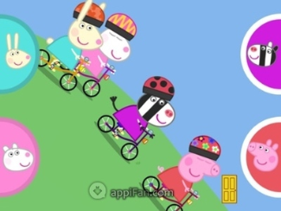
play football
run
ride bicycles

Slide 38
Peppa's friends
Peppa has a lot of friends.
They ___ at _______ in the ______.
They ________ at ___________ .
They ________ at ___________ .
They ________ at ___________ .
They are ___________ .

