Slide 1
Section Ⅰ Starting out & Understanding ideas
WWW.PPT818.COM

Slide 12
教材原句
What do you think is the most unusual pet in the video?
在这段视频中，你认为最不寻常的宠物是什么？
句式解构
do you think 作插入语。
佳句背诵
What do you think the future will be like?
你认为未来会是什么样子？

Slide 13
教材原句
However, until recently no one knew how they do this.然而，直到最近仍没有人知道它们是怎么做到的。
句式解构
until“直到……为止”，句中用延续性谓语动词。
佳句背诵
I will wait until the last minute.
我会等到最后一刻。
教材原句
Unfortunately, human activity is the main reason why the monarch numbers are falling.
不幸的是，人类活动是帝王斑蝶数目下降的主要原因。
句式解构
the reason why“……的原因”，why引导定语从句，修饰先行词the reason。
佳句背诵
That's the reason why he was late for school.
那就是他上学迟到的原因。

Slide 14
教材原句
Volunteers have been working together to record their migration and make sure that there are enough plants for them to feed on.
志愿者们一直协同工作记录帝王斑蝶的迁徙以保证它们有足够的植物可以食用。
句式解构
there be enough ... for sb. to do ...“对某人来说有足够的……可以做……”。
佳句背诵
There are enough life jackets for all the passengers to wear in the boat.
船上有足够的救生衣以供所有的乘客穿着。

Slide 15
教材原句
If this work is successful, there may come a time when monarch numbers increase once again.如果这项工作成功，帝王斑蝶数量再次回升的时期就可能到来。
句式解构
when引导定语从句，修饰先行词a time。
佳句背诵
He came at a time when we needed him most.
在我们最需要他的时候，他来了。

Slide 16
教材原句
The more we know about these delicate creatures, the greater the chance they will survive.
对于这些精致的生物，我们了解得越多，它们生存的机会就越大。
句式解构
“the ＋比较级(＋主语＋谓语)，the ＋比较级(＋主语＋谓语)”句型表示后者随着前者的变化而变化，意为“越……就越……”。
佳句背诵
The harder he worked, the more he got.
他工作越努力，得到的就越多。

Slide 19
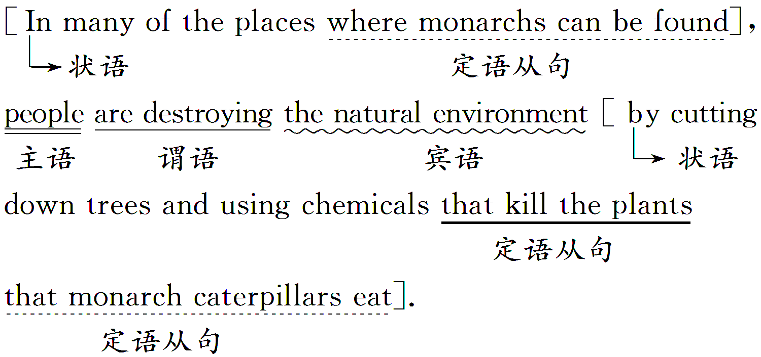

Slide 20
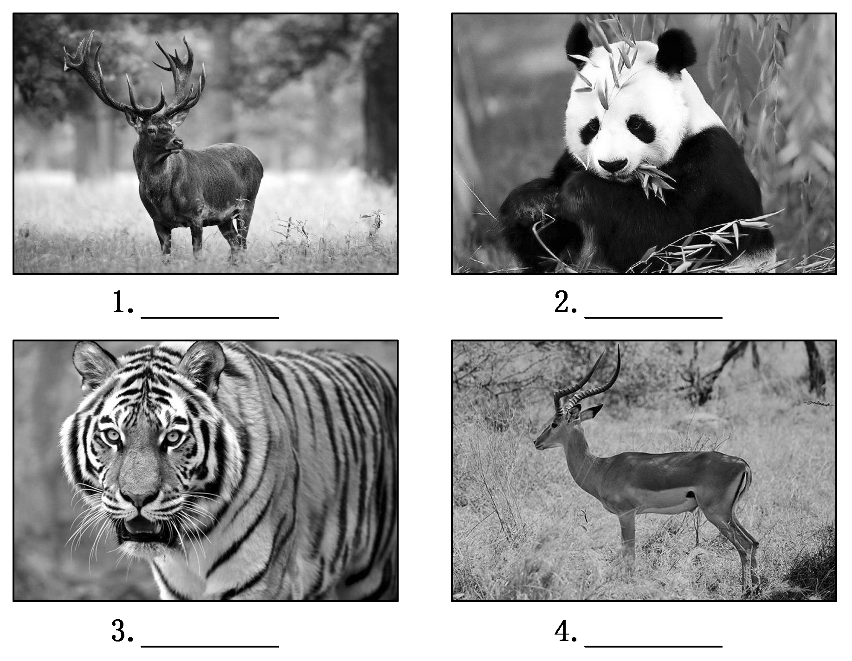

Slide 28
The Monarch's Journey
The purpose of animal migration | They 1._______ to find food, a partner or search of warmer weather.
Monarchs' hard migration | Every autumn, they begin a long and difficult journey, and manage to travel around 4,000 kilometres 2._____ to find their way to places 3.______ they will spend the winter.
The way of monarchs' migration | The monarch is able to tell the time of day, and use its eyes 4.__________ the position of the sun. So, it can 5._________ which way it needs to go and change its 6.________ when necessary.
migrate
south
where
to measure
determine
direction

Slide 29
The reason why the monarch numbers are falling | People are destroying the natural environment by 7.____________ trees and using 8._________ that kill the plants that monarch caterpillars eat.
How to protect the monarchs | ·Volunteers have been working together to record their migration and make sure that there are enough plants for them to 9.______. ·The more we know about these delicate creatures, 10.__________ the chance they will survive.
cutting down
chemicals
feed on
the greater

Slide 67
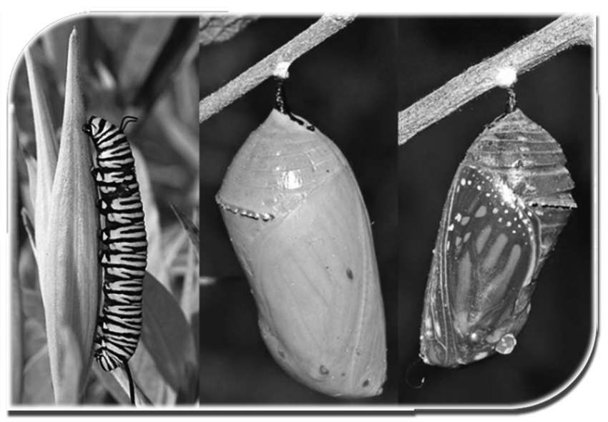

Slide 69
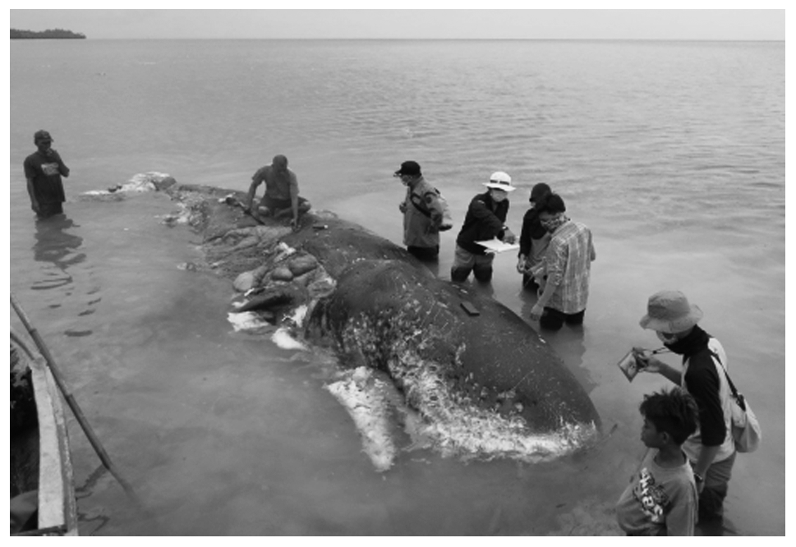

Slide 70
