Slide 1
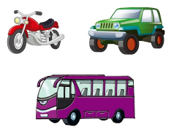
Unit2 Can I help you?
人教精通版五年级下册
WWW.PPT818.COM

Slide 2
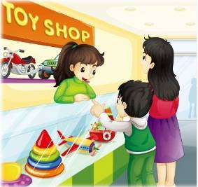
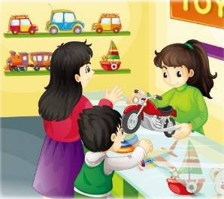
>>Review
Think and say
What does Yang Ming want to buy?
How much is it?

Slide 3
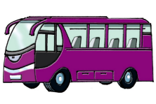
>>Lead-in
Free talk
There are so many kinds of toys. Do you know them? Which do you like?

Slide 4
>>Presentation
Look and say
I like …
motorbike
jeep
coach

Slide 5
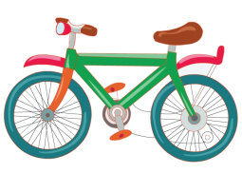
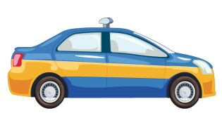
>>Presentation
Look and say
I like …
bike
car
taxi
bus

Slide 6
>>Presentation
Look and say
What can I do for you?
I want to buy a motorbike.
￥85
How much is it?
It’s eighty-five yuan.

Slide 7
>>Presentation
Look and say
What can I do for you?
I want to buy a jeep.
￥79
How much is it?
It’s seventy-nine yuan.

Slide 8
>>Presentation
Look and say
What can I do for you?
I want to buy a coach.
￥98
How much is it?
It’s ninety-eight yuan.

Slide 9
>>Practice
Game 1
魔法手指
motorbike
coach
jeep
bike
taxi
car
bus

Slide 10
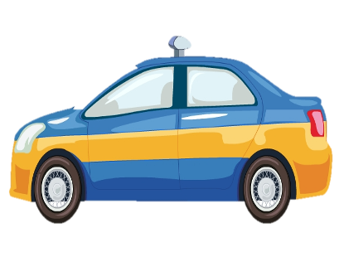
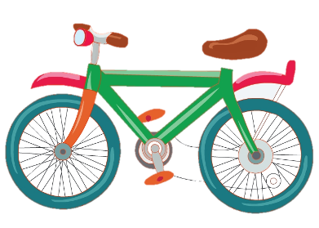
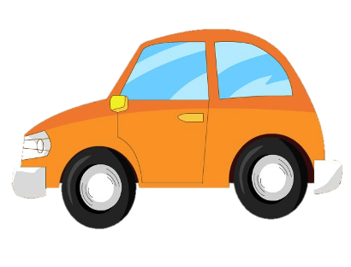
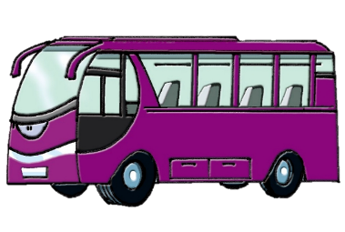
>>Practice
Game 2
眼力与记忆力

Slide 11
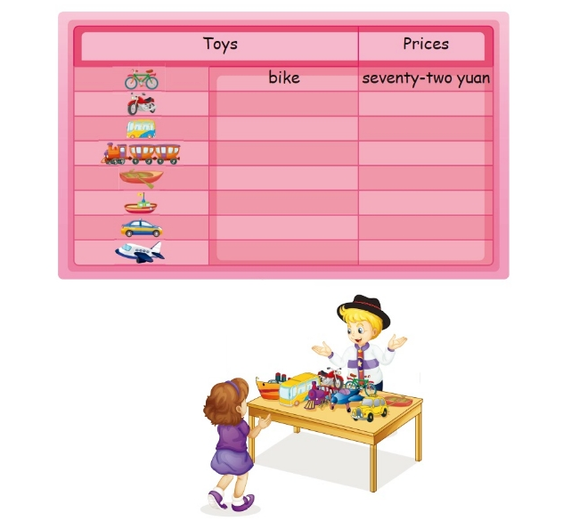
>>Practice
Let’s talk
What can I do for you?
It’s seventy-two yuan.
1
3
I want to buy a bike. How much is it?
2

Slide 12
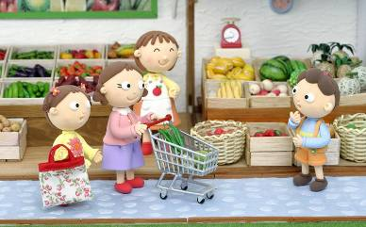
>>Practice
Write and Act
A: What can I do for you? /
Can I help you?
B: I want to buy ...
How much is it?
A: It’s ... yuan.
B: OK. I’ll take it.

Slide 13
>>Practice
Let’s chant

Slide 14
>>Summary
1.本课的重点单词：
motorbike
jeep
coach
bike
car
bus
taxi
2.本课的重点句型：
—What can I do for you?
—I want …
—How much is it?
—It’s … yuan.

Slide 15
>>Homework
1.观看课文动画，按照正确的语音、语调朗读课文对话。 2.在四线三格中正确抄写本课的新单词，不少于5遍。
3.预习 Lesson11。

