Slide 1
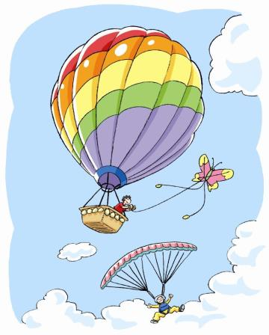
Air
10
WWW.PPT818.COM

Slide 2
Read and complete
Air has no ______ or _______.
Air has no _______ or _______.
We cannot ____ it, but we can ____ it.
colour
shape
smell
taste
see
feel

Slide 3
Read and complete
Air is __________.
It is important to all ______.
It is also important to ______ and _____.
We all need it to keep us ____.
everywhere
people
animals
plants
alive

Slide 4
Read and complete
Look at the _____ and the ______.
Look at the _____ and the _____.
They all need it too.
It keeps them _____ in the sky.
kite
balloon
plane
bird
high

Slide 5
It has no colour or shape.
It has no smell or taste.
We cannot see it, but we can feel it.
It is everywhere.
It is important to all people.
It is also important to animals and plants.
We all need it to keep us alive.
Look at the kite and the balloon.
Look at the plane and the bird.
They all need it too.
It keeps them high in the sky.
What is it?
It is air.

Slide 6
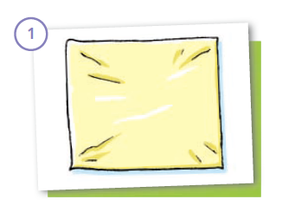
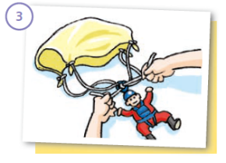
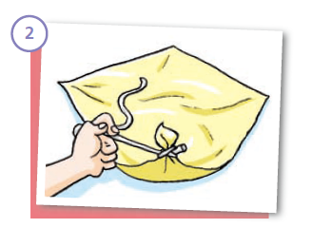
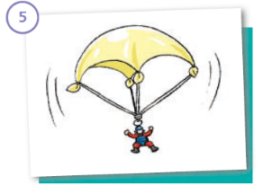
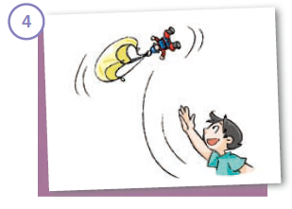
Think and say
How to make a parachute?

Slide 7
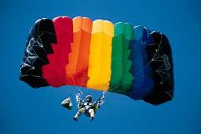
Read and say
1. The parachute falls down slowly.
2. The parachute is open.
3. The parachute hits the ground gently.
4. There is air in the parachute.

Slide 8
Think and say
Air is very important!
Why?

Slide 9
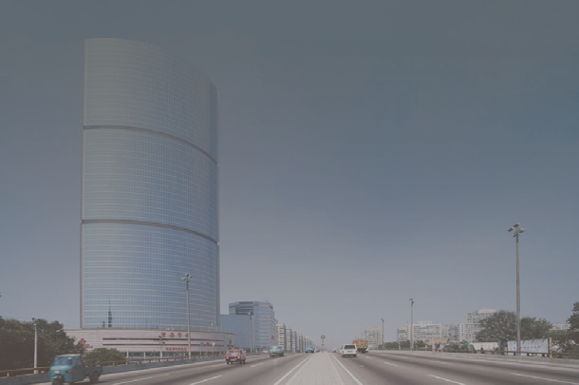
Look and read
The air is dirty in some places.
We call this air pollution.

Slide 10
Air pollution is harmful!
1 It’s harmful to the health of people
2 It’s harmful to the nature.
3 Air pollution spreads easily.
4 Air pollution is a global problem.
5 People should stop using coal.

Slide 11
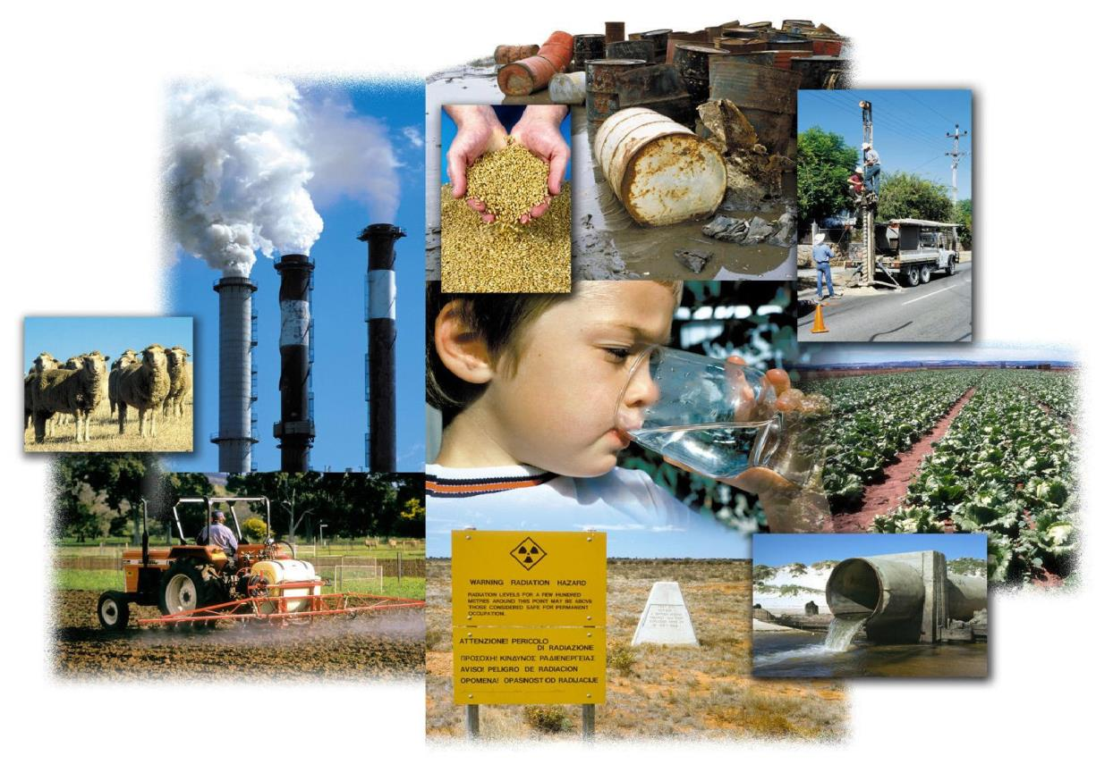
What’s the matter?

Slide 12
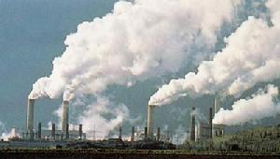
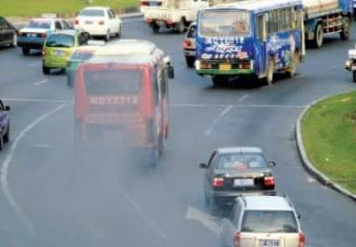
air pollution

Slide 13
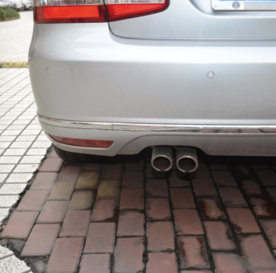
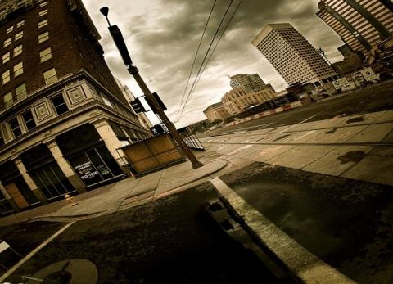
Air pollution
Air keeps us alive.
We get sick if the air is too dirty.

Slide 14
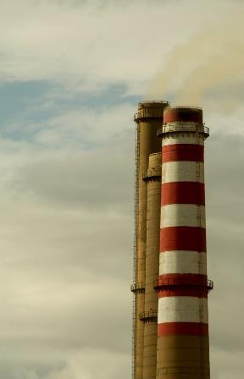
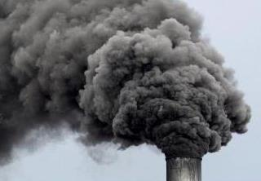
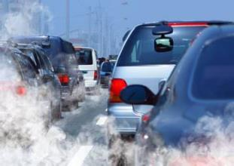
Ask and answer
Where does air pollution come from?

Slide 15
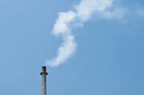
smoke

Slide 16
Ask and answer
Where does air pollution come from?
It comes from the smoke.

Slide 17
Ask and answer
Where is the smoke from?
It comes from cars, buses
and factories.

Slide 18
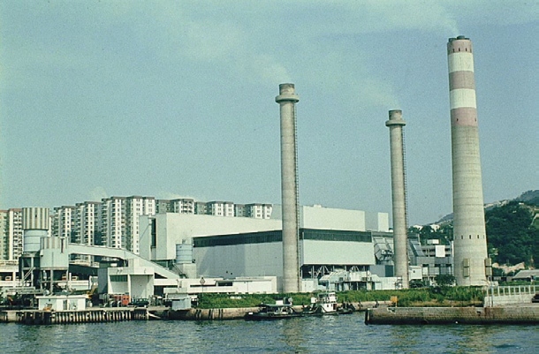
factory

Slide 19
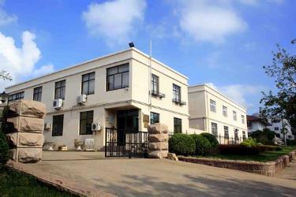
factory
factories

Slide 20
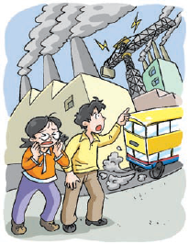

Slide 21
What’s the matter with Kitty?
Her eyes hurt.
What hurts her eyes?
It’s the smoke.
Where is the smoke from?
It’s from cars, buses and the factory.

Slide 22
What’s the matter, Kitty? Are you crying?
I’m not crying. My eyes hurt.
It’s the smoke.
Where is the smoke from?
It’s from the cars and buses.
Look at the black smoke from the factory.
It makes the air dirty.
Let’s go to the park, Ben.
The air is clean there.
OK.

Slide 24
The air is so fresh here.
Yes. There are a lot of trees in the park. Trees keep the air clean.
We should plant more trees and keep the air clean.
Yes! We should keep our city clean.

Slide 25
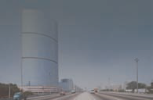
How is the air?

Slide 26
dirty

Slide 27
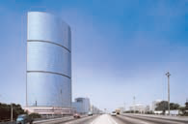
How is the air in the picture?
It’s dirty.
How is the air in the picture?

Slide 28
clean

Slide 29
How is the air in the factory?
It’s dirty.
How is the air in the factory?
It’s clean.

Slide 30
Read and spell
factory
smoke
dirty
clean

Slide 32
API and Health Implications (Daily Targets)
API Air Pollution
Level：
0 - 50 Excellent
51 -100 Good
101-150 Slightly Polluted
151-200 Lightly Polluted
201-250 Moderately Polluted
251-300 Heavily Polluted
300+ Severely Polluted

Slide 33
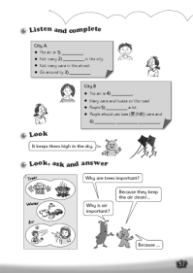
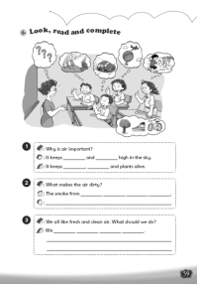
Homework
1. Listen to and read Student’s Book page 70.
2. Read, copy and spell the words:
factory, factories, smoke, dirty, clean
3. Think about how to keep the air clean.
4. Finish Workbook pages 57 and 59.

