Slide 1
Module 3 Life now and then
Unit 2 I think life is better today.
WWW.PPT818.COM

Slide 2
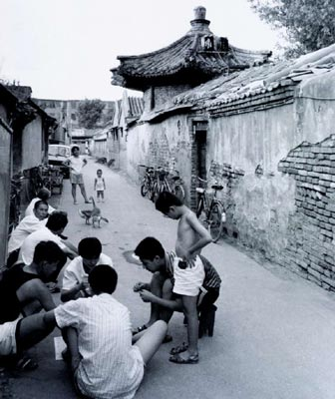
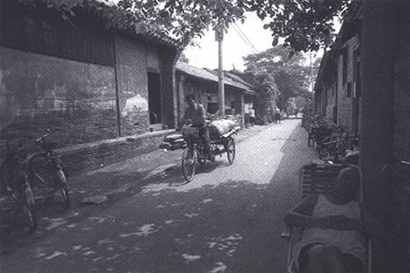
Look at these Beijing’s pictures. Say what life was like in the past and what life is like today.

Slide 3
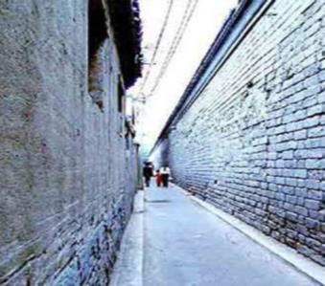
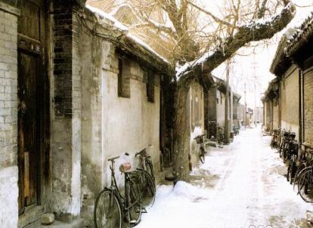
roads --- narrow
houses --- small, crowded

Slide 4
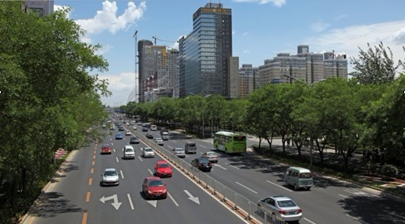
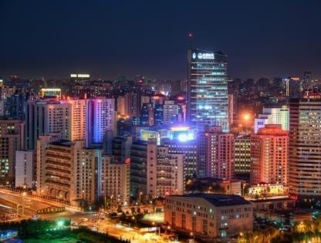
ring roads --- wide
buildings --- tall, bright

Slide 5
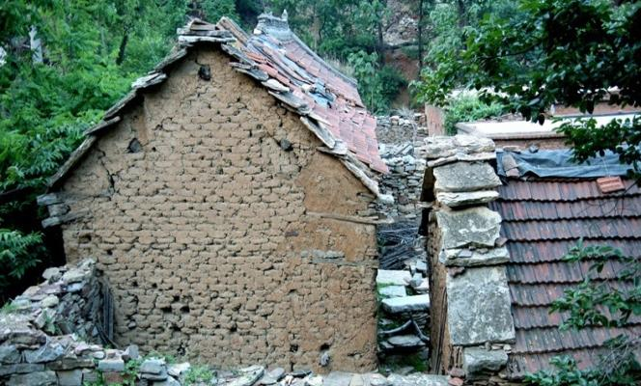
living conditions --- hard

Slide 6
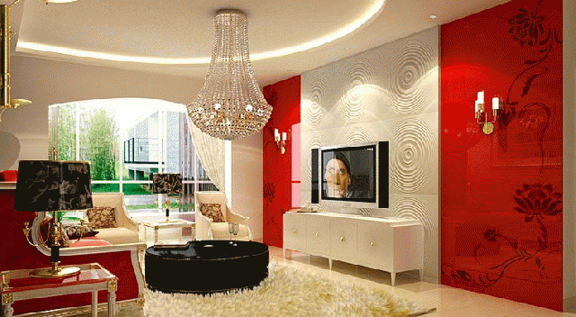
living conditions --- comfortable

Slide 7
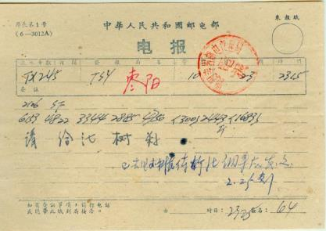
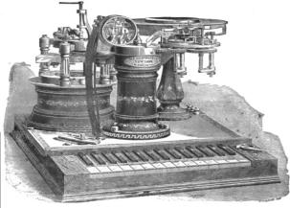
in the past
communications --- simple, slow

Slide 8
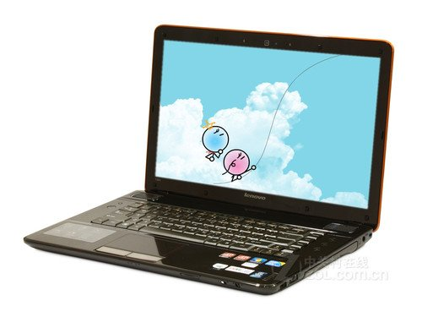
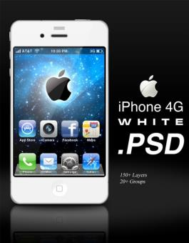
at present
communications --- various, quick, easy

Slide 9
learning objectives
To get information from the passage
about life now and then
2.To learn some key words and useful expressions
3. To learn to write a passage about the advantages and disadvantages of life today

Slide 10
Words review
tiny
electric
light
candle
postman
cold
adj. 微小的；极小的
adj. 用电的；电动的
n. 电灯
n. 蜡烛
n. 邮递员
n. 寒冷；冷空气

Slide 11
Words review
heat
full-time
role
education
transport
n. 高温；热度
adj.专职的；全日制的
n. 作用；职责；角色
n. (个人的)教育；学
业
n. 运输业；交通

Slide 12
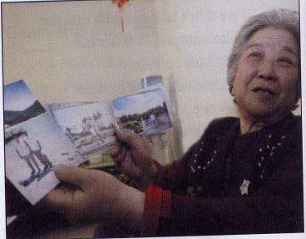
P20
Task 1
1
Look at he woman in the photo. How do you think she feels? Think about what she will talk about:
family
work
health
education

Slide 13
Task 2
P20
2
Listen to the passage and take notes on what Mrs Li says about the points in Activity 1.
family work health education

Slide 14
Life in the past
___________________
___________________
___________________
___________________
___________________
___________________
___________________
___________________
____________________
____________________
____________________
____________________
Life now
____________________
____________________
________________________________________________________________________________________________________________________________________________________________________________________________________
1 Family: bigger; five children
2 Food:
3 Work:
4 Education:
1 Family: smaller; one child
2
3
4
simple, eat meat once or twice a year
Food: more meat
father goes to work and mother stays at home
Work: both men and women can go to work
boys can go to school and most girls have no chance to go to school
Education: both boys and girls can get good education
5 Transport: on foot; by bike
5 Transport: take the bus/ underground/ plane
Now complete the notes and add more points of your own.
6 Entertainment: nearly no entertainment
6 Entertainment: watch TV

Slide 15
Read the second and third paragraph and answer the following questions.
Where did Mrs. Li’s family live?
2. What was her father?
3. How long did her father work a day?
4. Why didn’t she go to school?
In a tiny house .
He was a postman.
12 hours a day.
Because her family was too poor. What’s more, she was a girl.

Slide 16
paragraph 4: read and fill in:
Families have got ________than they were in the past. Today people only have one______! The role of women has _________,too. My daughter is really lucky. She has a good __________, and she goes to work even after getting married. I’m happy to see she’s busy __________every day, but sometimes I feel lonely because she can’t come to see me often.
smaller
child
changed
education
working

Slide 17
Read paragraph 5-7and say T or F:
1. Transport and travel are easier today than in the past.
2. Now people go to everywhere on foot or by bike.
3. There’s less traffic on the road .
4. Mrs Li likes watching Beijing Opera and old films.
5. Life is better today than in the past.
T
F
F
T
T

Slide 18
candles cold generally speaking postman tiny traffic
Task 3
P21
Mrs Li’s father was a (1) _________ . He often worked outside for twelve hours a day in the summer heat or in the winter (2) _________. They lived in a (3) ___________ house and used (4) __________ for light. Mrs Li says that (5) ___________, life is better today. But not everything is satisfying. There are some thing that she is not happy with, for example, the (6) ___________.
postman
3
Complete the passage with the words and expression in the box.
cold
tiny
candles
generally speaking
traffic

Slide 19
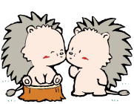
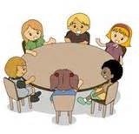
Task 4
Work in pairs and talk about the advantages and disadvantages of life for Mrs Li.

Slide 20
Phrases
某人的一生
问某人关于某事
出去工作
全职工作
而且，更重要的是
得到好的教育
结婚
忙于做某事
感到孤独
乘公共汽车
如此多的交通
享受做某事
总体来说
all one’s life
ask sb about sth
go out to work
a full-time job
what’s more
have a good education
get married
be busy doing
feel lonely
take a bus
so much traffic
enjoy doing
generally speaking

Slide 21
Language points
1. …looking after us was more than a full-time job.
…照料我们比做一份全职工作还要辛苦.
这句话的主语是动名词短语looking after us。单个v-ing形式短语在句中作主语时，谓语动词要用单数。句中more than表示“不只是，多于”。例如：
He is more than a coach. He is a friend.
他不只是教练，更是朋友。

Slide 22
2. …what’s more, because I was a girl.
而且，我是个女孩。
what’s more表示递进，“然而/还有…… ”的意思，独立使用，既可以放句首，也可以放句中，what’s more后面加逗号。
你应该记住它，更重要的是，应该正确理解它。
You should remember it, and what’s more, you should get it right.

Slide 23
3. Generally speaking, I think life is better today.
总的说来，我认为今天的生活更好了。
generally speaking表示“一般而言，总的说来”。in general也可以表达同样的意思。例如：
Generally speaking, we enjoyed the trip.
总的说来，我们这次旅行很愉快。
In general, women live longer than men.
总的说来，女性比男性更长寿。

Slide 24
4. …and she goes to work even after getting married.
结婚后她也依然去工作。
get married意为“结婚”，表示短暂行为，不能与表示一段时间的状语连用。表示结婚多长时间，要用be married。
布朗夫妇结婚已50年了。
__________________________________
The Browns have been married for fifty years.

Slide 25
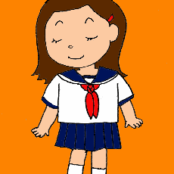
The advantages of life for Mrs. Li
Disadvantages of life for Mrs. Li
family: bigger family, less money, less room at home
Notes:
25

Slide 26
Writing

Slide 27
P21
4
Write a passage about the advantages and disadvantages of life today.
☺Choose two or three points from the notes in Activity 2 to write about.
Families are smaller…
☺Give examples or reasons to support those points.
Most people only have one child today.

Slide 28
☺ For each of the points you choose, write about an advantage and/or a disadvantage. Use the words however, but, although or used to where appropriate.
Families are smaller because most people only one child today. As a result, families have more money to spend on their child. However, an only child may feel lonely…
☺ Finish the passage with your conclusion.
Generally speaking, I think…
P21
5
Present your passage to the class.

Slide 29
总结回顾
本课时主要短语和句型
1. more than
2. what’s more
3. generally speaking
4. I wasn’t sent to school because my family couldn’t afford it.
5. Families have got smaller than they were in the past.
6. The only thing I don’t like, though, is that there’s so much more traffic.

Slide 30
Homework
请根据下表所列的内容要点以Changes in my hometown为题目, 用英语写一篇短文。
过去 | 1. 生活贫困，房屋破旧； 2. 污染严重，垃圾遍地； 3. 交通不便，游客稀少。
现在 | 1. 住房宽敞、明亮, 许多人有私家车; 2. 山更绿, 水更清，天更蓝； 3. 每年有成千上万来自世界各地的游客。

Slide 31
提示词: convenient 便利的
要求:
1. 短文须包括所有内容要点, 可适当发挥, 使短文连贯、通顺；
2. 80词左右，开头已给出, 不计入总词数。
Changes in my hometown
In the past, my hometown was very small. ____________________________________________________________________

Slide 32
One possible version:
Changes in my hometown
In the past, my hometown was very small. People lived a poor life. The houses were old and small. The pollution was very serious, and there was rubbish everywhere. Travelling around the town wasn’t convenient, so few visitors came here.
谈谈家乡过去的情况，用过去时态。

Slide 33
Now great changes have taken place. People are living a better life. Their houses are large and bright. Many people have their own cars. The mountains are greener, the rivers are clearer and the sky is bluer. Every year, thousands of people from all over the world visit here.
I’m sure my hometown will become better and better.
谈谈家乡现在的情况，用现在时态。

