Slide 1
Unit4 I have a ball.
人教新版三年级上册
WWW.PPT818.COM

Slide 2
Review
Let’s chant
I have a new bike.
Nice, nice, nice!
I have a new taxi.
Cool, cool, cool!
I have a new train.
Super, super, super!

Slide 3
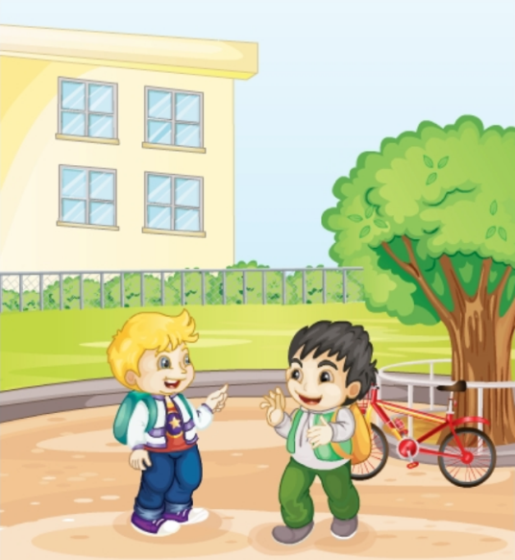
Review
Look and say
Hi, Yang Ming! I have a new bike.
Really? _________?
Can I see it
____!
Sure

Slide 4
Presentation
Just learn
ship

Slide 5
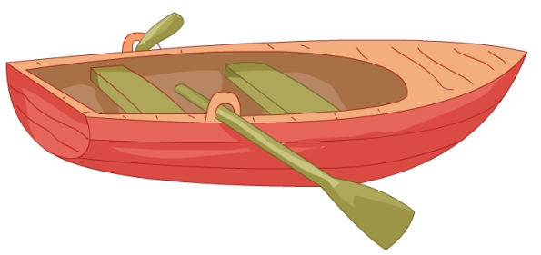
Presentation
Just learn
boat

Slide 6
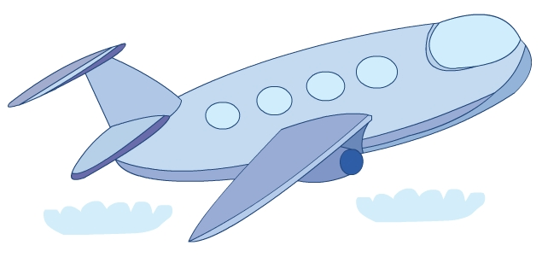
Presentation
Just learn
plane

Slide 7
Practice
Game 1
大小声
ship
boat
plane

Slide 8
Practice
Game 2
找朋友
train plane bike boat ship taxi

Slide 9
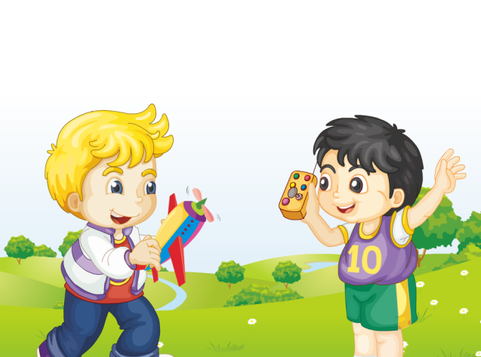
Presentation
Look and say
Look! What are they talking about?

Slide 10
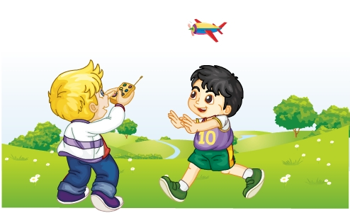
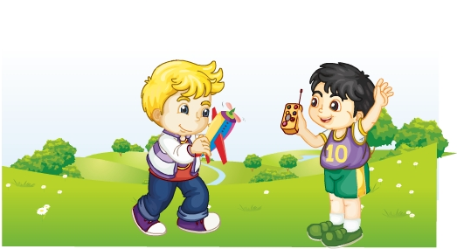
Presentation
Listen and imitate
Look! I have a plane.
Can I see it?
Sure! Here you are.
Thank you!
You’re welcome.

Slide 11
Practice
Let’s read
1
2
3
Read together.
(齐读)
Read in roles.
（分角色读）
Read in groups.
(分组读）

Slide 12
Show time
两人一组试着来表演，其他同学评价。
 | 模仿录音中的语音语调，有感情地朗读。
 | 可以脱离课本，适当改动其中部分，语音地道。
 | 适当添加内容，意思完整，有创新，表演生动。
Good
Great
Excellent

Slide 13
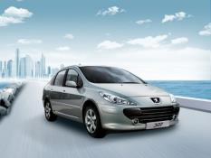
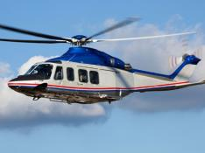
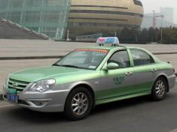
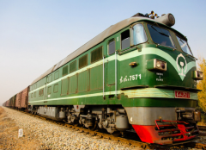
Practice
Play a game
快速抢答
I have a …

Slide 14
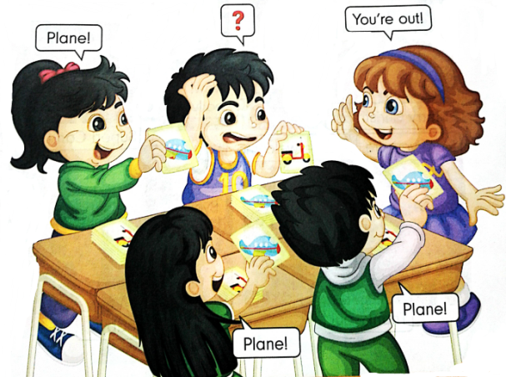
Practice
Let’s play
Show me your plane.
小组活动，选一个学生做发令员，说：Show me your … 其他组员在事先准备好的各种卡片中迅速找到正确的一个，快速举起，同时说出正确的单词。说错或举错卡的学生出局。
You’re out!
Plane!
Plane!
Plane!

Slide 15
Summary
本课学习的单词有:
boat
ship
plane

Slide 16
Summary
本课新学习的句子有哪些？
—Here you are. Thank you!
—You’re welcome.

Slide 17
Homework
1.跟读Just talk部分的课文录音，并注意语音、语调。
2.制作本课的单词卡片，并将对应的英文写在卡片背面。
3.预习Lesson24。
Close

