Slide 1
Unit 6
When was it invented?
第3课时
WWW.PPT818.COM

Slide 2
A 教材要点回归
Ⅰ. 用所给单词的适当形式填空
1. If you put too much salt in the dishes, they will be ________(salt).
2. I think this restaurant serves all the _____________ (custom) well.
3. The delicious food was _____________(cook) by my mother at the party.
4. It's _____________(real) important for you to watch more English movies.
5. Many things _____________(invent) years ago are still used today.
salty
customers
cooked
really
invented

Slide 3
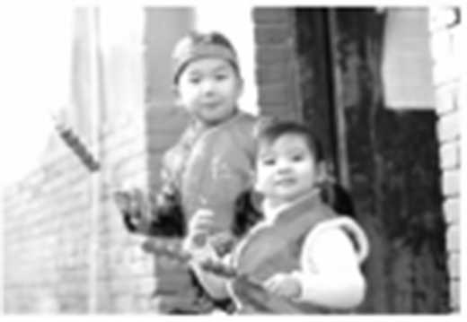
B 知识综合运用
Ⅱ. (2017·六盘水)任务型阅读
Tanghulu, is fruit covered with sugar on a stick, a traditional snack from northern China. It's also a necessary snack during the Chinese New Year season. Recently, in northern China, people welcome the return of spring by holding the Tanghulu Fair(庙会).

Slide 4
Many Chinese still remember eating Tanghulu when they were young. It is said that the fair has a 500­year­old history. Nowadays, Tanghulu is not only a kind of snack, but it is also a sweet memory of our childhood. Every year, a large number of Tanghulu sellers get together to start delicious Tanghulu Competition during the Spring Festival holidays. In the past, this traditional snack only used haws(山楂), but now it also uses grapes, oranges, strawberries and so on. But people like Haw Tanghulu best. They are rich in Vitamin (维生素) C and E. Do you know how to make Haw Tanghulu? First, wash the large haws clean, dig the seeds(籽) out, and

Slide 5
pierce(串) ten haws on a stick. Then heat the sugar, put the sticks of haws into heated sugar and quickly pull them out. When the sugar on the haws cools down and becomes a candy coat, the Tanghulu is done. Tanghulu is very popular in China, especially in Beijing. It also makes many foreigners want to taste it.
We hope Tanghulu will become one of the most popular snacks in the world.

Slide 6
根据短文内容，回答下列问题。
1. Where is Tanghulu from?
__________________________________________________________________
2. How do people welcome the return of spring in northern China?
__________________________________________________________________
3. What do the Tanghulu sellers get together to do during the Spring Festival holidays every year?
__________________________________________________________________
It's from northern China. /Northern China. /China.
By holding the Tanghulu Fair.
They get together to start delicious Tanghulu Competition.

Slide 7
4. What kind of Vitamin is the Haw Tanghulu rich in?
__________________________________________________________________
5. What is the passage mainly about?
__________________________________________________________________
It is rich in Vitamin C and E.
It is mainly about Tanghulu. /Something about Tanghulu. /Tanghulu.

Slide 8
Ⅲ. 从方框中选单词并用其适当形式完成短文
tea, time, way, also, idea, meal, country, thing, usually, when
Tea is a popular drink around the world. But tea does not mean the same 1. ________ to everyone. In different countries people have different 2. ________ about drinking tea.
In China, for example, tea is always served 3. ________ people get together. The Chinese drink it at any 4. ________ of the day at home or in the teahouse. They prefer their tea with nothing else in it.
thing
ideas
when
time

Slide 9
Tea is also important in Japan. The Japanese have a special way of serving 5. ________. It is very old and full of meanings. Everything must be done in a special 6. ________. There is even a special room for it in Japan.
Another tea­drinking 7. ________ is Britain. In Britain, the late afternoon is “teatime”. Almost everyone has a cup of tea at that time. The British people 8. ________ make tea in a teapot and drink it with milk and sugar. They 9. ________ eat cakes, cookies and little sandwiches at teatime.
tea
way
country
usually
also

Slide 10
In the United States people drink tea mostly for breakfast or after 10. ________. Americans usually use tea bags to make their tea. Tea bags are faster and easier than making tea in teapots. In summer, many Americans drink cold tea—“iced tea”.
meals

