Slide 1
Unit2 What’s your hobby?
人教精通版六年级上册
WWW.PPT818.COM

Slide 2
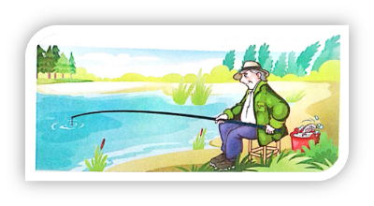
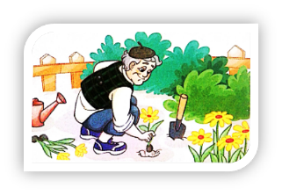
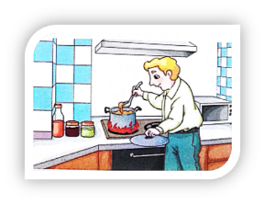
>>Warm-up
Let’s review
—What’s your grandpa’s hobby?
—His hobby is …
going fishing
planting flowers
cooking meals

Slide 3
>>Lead-in
Guessing game
Look at my grandpa. He likes cameras. He is interested in traveling. Guess, what’s his hobby?
is interested in
ing
His hobby is taking photos.

Slide 4
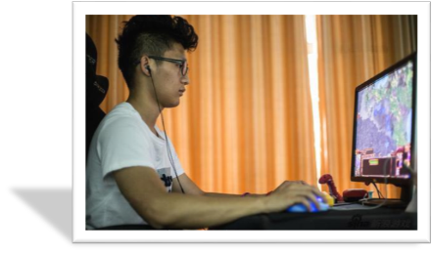
>>Lead-in
Guessing game
I have a brother. He likes computers. He
is interested in playing games. Guess, what’s his hobby?
is interested in
ing
His hobby is playing computer games.

Slide 5
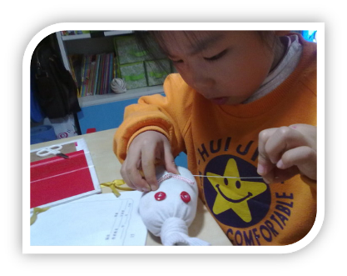
>>Lead-in
Guessing game
I have a little sister. She likes dolls. She is interested in making things. Guess, what’s
her hobby?
is
interested in
ing
Her hobby is making dolls.

Slide 6
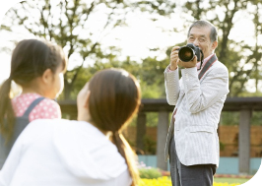
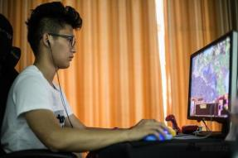
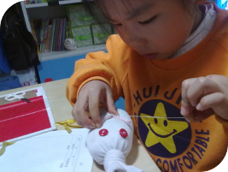
>>Presentation
Let’s learn
take photo
play computer games
make dolls

Slide 7
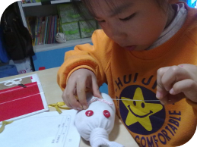
>>Presentation
Think and say
Are you interested in them?
What are you interested in?

Slide 8
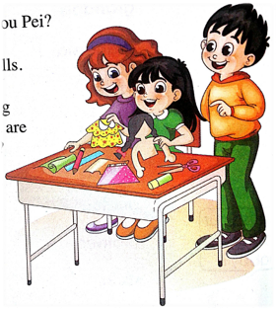
>>Presentation
Just read and talk
Look, listen, and say
Look! Who are they?
What’s the girl doing?
They are Yang Ming, Zhou Pei and Lisa.
She is making a doll.

Slide 9
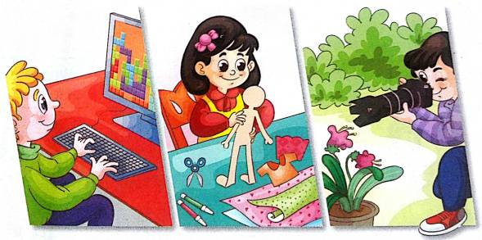
>>Presentation
Just read and talk
Listen and match
What are they interested in?
Zhou Pei
Yang Ming
Lisa

Slide 10
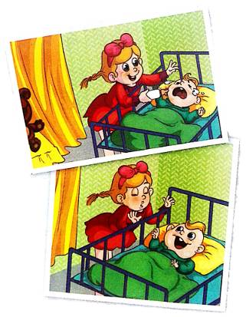
>>Presentation
Just read and talk
Look, listen, and say
The kid is feeding the _____.
The baby is ______.
He is ______.
baby
hungry
crying
smiling
The baby is ______.
She takes good care of the
baby.
takes good care of
（照顾好，好好照看）

Slide 11
>>Presentation
Just talk
Listen and imitate
Yang Ming: What are you doing, Zhou Pei?
Zhou Pei: I’m making a doll. I’m interested in making
dolls. How about you?
Yang Ming: I’m interested in playing computer games.
What are you interested in, Lisa?
Lisa: I’m interested in taking photos.

Slide 12
>>Presentation
Just talk
Listen and imitate
Yang Ming: Really?
Lisa: Yes, I have two photos here. Look at this one!
Yang Ming: How cute! The kid is feeding the baby.
Lisa: Yes, the baby is hungry. He’s crying.
Lisa: And now look at this photo. The baby is smiling.
Yang Ming: What a super kid! She takes good care of
the baby.

Slide 13
>>Practice
Read it by yourself for one minute .
自读对话一分钟。
一分钟倒计时
60
Learning tip :
10
10
50
当你自己朗读时，遇到不会读或不明白意思的单词或句子，可以把它圈起来，请教同学或老师！
20
20
40
30
30

Slide 14
>>Practice
Show time
小组合作，练习对话并表演，其他同学评价。
Pronunciation (语音) |  | Fluency (流利) | Cooperation (合作)
OK!
Great!
Super!

Slide 15
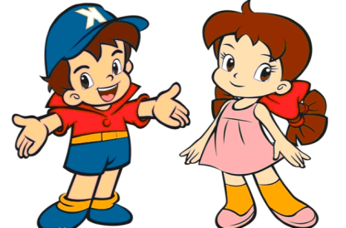
>>Practice
Pair work
What are you interested in?
I’m interested in…
Are you interested
in …?
…

Slide 16
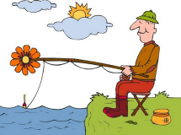
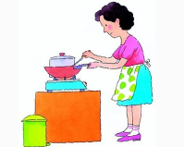
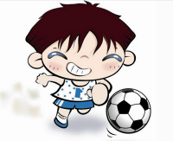
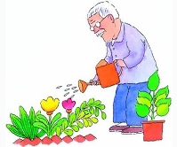
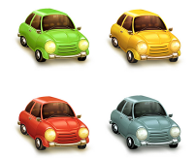
>>Practice
Bingo game
游戏规则：
先观看屏幕上的九宫格图片，然后在自己事先准备好的九宫格纸上写出对应的短语；随后老师开始随机说短语，学生在自己的纸上圈出老师念的短语，当圈出的短语成横行，竖行或斜行时，学生快速说：Bingo!

Slide 17
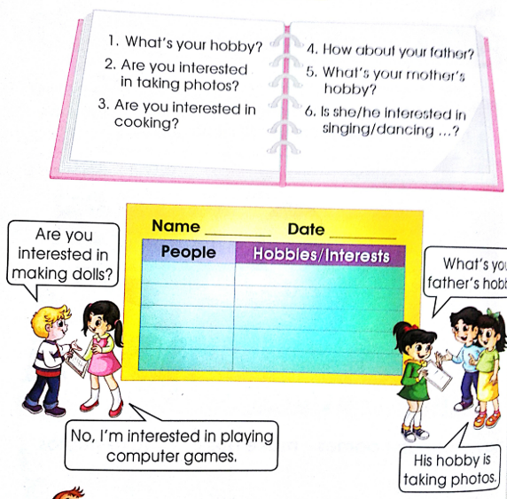
>>Practice
Let’s interview
Are you interested in making dolls?
What’s your father’s hobby?
No, I’m interested in playing computer games.
His hobby is taking photos.

Slide 18
>>Summary
如何询问和介绍兴趣爱好呢？
—What are you interested in?
—I’m interested in….
例句
—What are you interested in?
—I’m interested in taking photos.

Slide 19
>>Homework
1.跟读课文录音，按照正确的语音、语调朗读课文对话。 2.用绘图加简单文字的方式给自己的父母介绍与自己兴趣相关的故事。
3.预习 Lesson12。

