Slide 1
陕旅版小学英语三年级上册
Unit6 Look at My Toys! 第2课时
WWW.PPT818.COM

Slide 2
Let’s sing: Ring those bells

Slide 3
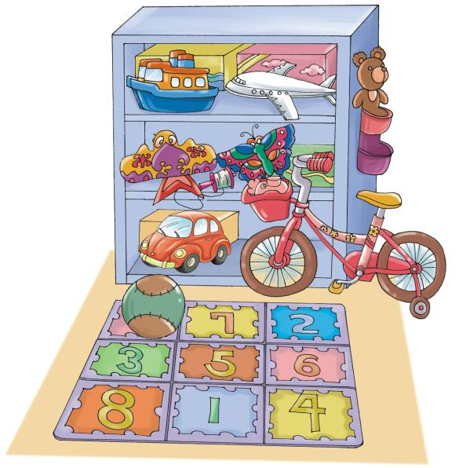
Review—找一找学过的单词

Slide 4
同学们，我有很多玩具，你们想知道我都有什么玩具吗？那就先向我介绍你们有什么玩具吧！

Slide 5
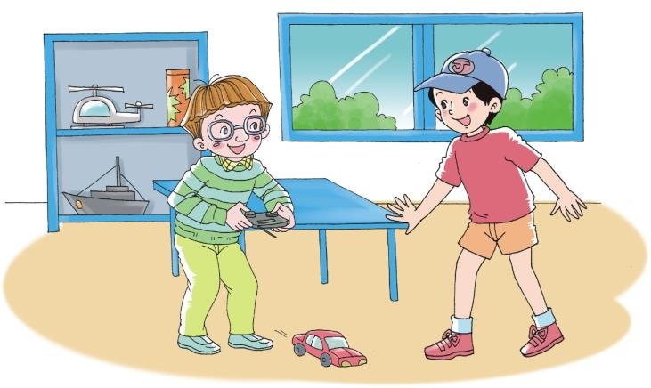
Let’s talk
Hi, Liu Zhaoyang! I have a toy. Look! It’s a car.
How nice!

Slide 6
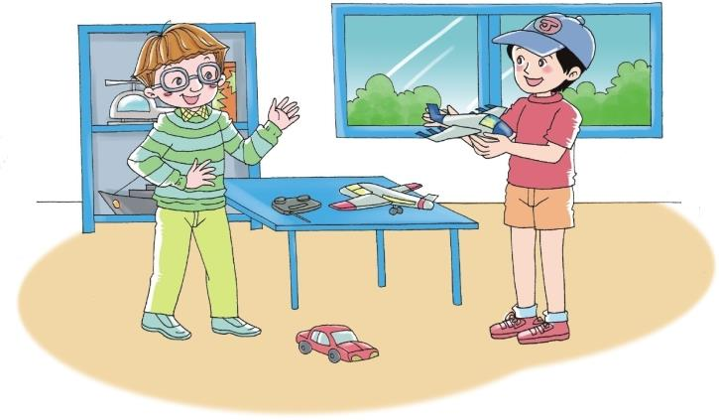
Look at my toys, Kevin! I have planes.
Let’s talk
They are nice.

Slide 7
Role play
同桌之间互相用英语介绍自己的玩具, 例如：
I have a toy. Look! It’s a car.
How nice!
Look at my toys, I have planes.
They are nice.

Slide 8
Summary
向别人展示自己的物品时用以下句型：
Look at my toys! I have…
看我的玩具！我有……
（答语）夸赞别人的东西用：
They are nice. / How nice!好漂亮！

Slide 9
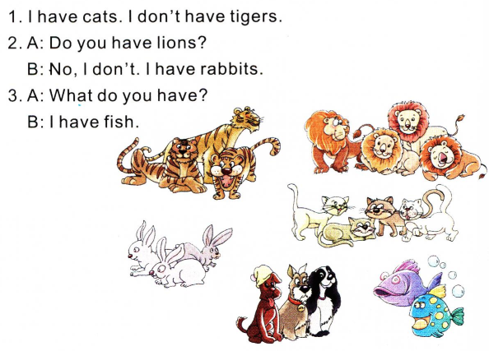
Read and circle

Slide 10
Play a game—句子接龙
例如：
A: Look at my toy, B! I have a car.
B: Look at my toys, C! I have a car and a kite.
C: Look at my toys, D! I have a car, a kite and a ball.

