Slide 1
Unit 9
I like music that I can dance to.
Section A Period 2 3a-4c
WWW.PPT818.COM
Notes:
1
1

Slide 2
Pair Work
What kind of music do you like?
/ What’s your favorite music?
make me calm
I like music that makes me calm.

Slide 3
Free Talk
Do you like watching movies?
What kinds of movies do you prefer? Why?
Notes:
3

Slide 4
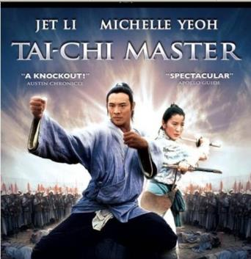
science fiction film
comedy
action movie

Slide 5
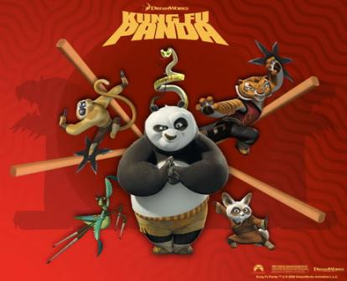
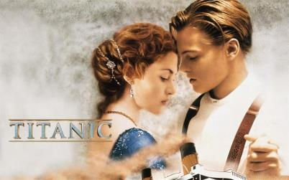
cartoon
thriller
drama

Slide 6
detective film
tragedy
documentary

Slide 7
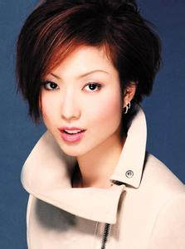
pop music
I like the music.
It is exciting.
I like music that/which is exciting.

Slide 8
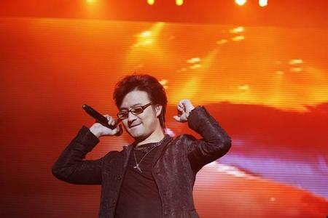
The music is loud and energetic. I like it.
I like music that/which is loud and energetic.
Notes:
8

Slide 9
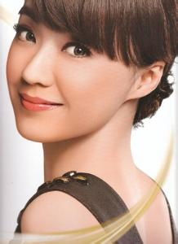
I can sing along with the music. I like it.
sing along with
I like music that/which I can_______________.
Notes:
9

Slide 10
I can dance to the music. I prefer it.
伴随着…跳舞
I prefer music that/which I can dance to.
Notes:
10

Slide 11
Reading strategy
. 快速阅读全文，注意每段话的首句，
有利于理解每段的段落大意。
把含有定语从句的句子划出来，
帮助你理解并完成阅读任务。

Slide 12
3b
3b Read the passage again and answer
the questions.
How does the writer describe each kind of movie?
Comedies and cartoons have funny dialogs, happy endings, imperfect characters who try to solve their own problems. Dramas are sad.
Documentaries provide a lot of information about a certain subject, and are interesting. Action movies are exciting and do not require thinking. Movies that are scary can be fun but too scared to watch alone.

Slide 13
2. What kinds of movies does the writer prefer to watch when he or she is sad or tired?
3. How does the writer feel after watching these movies?
Action movies.
Relaxed.

Slide 14
4. Does the writer like scary movies? When does he or she watch them?
Yes, he / she does.
He / She watches them once in a while when he / she can bring a friend who isn’t afraid of watching scary movies.

Slide 15
3c
What kind of movies do you like to watch?
I like / prefer to watch movies that/ which…
Examples:
(movie names)
When I’m…
happy
sad
tired
bored

Slide 16
Language Points
1. feel like watching movies
feel like 想要……
feel like doing = want to do = would like to do
Do you feel like a walk?
你想去散散步吗？
I feel like having some dumplings.
我很想吃饺子。
I don’t feel like eating.
我不想吃东西。

Slide 17
2. While some people only stick to one kind of movie, I like to watch different kinds depending on how I feel that day.
stick to 坚持；遵守；粘附在…上；紧随
I stick to what I said yesterday.
我坚持我昨天说的话。
Now we've made a decision, let's stick to it.
既然我们已经作出了决定，那就让我们遵照它行事吧。
His five-year-old son stuck to him.
他五岁的儿子总缠着他。

Slide 18
3.depend on 在这里的意思是“取决于；随 ... 而定”
Whether the game will be played depends on the weather.
比赛是否举行要看天气而定。
That depends (on) what he will do next.
这要看他下一步会做什么。
depend on还有“依赖； 相信； 信赖”的意思

Slide 19
4. When I’m down or tired, …
down adj. 沮丧的；消沉的
We felt very down after the party was over.
聚会结束后我们甚感沮丧。
He felt down about his failure.
他对自己的失败感到沮丧。
He was so down that he didn't want to live any longer.
他情绪特别低落，都不想活了。

Slide 20
5. plenty of information
plenty of 大量；充足
There is plenty of space here to move about.
这里有很大的活动空间。
A growing child needs plenty of sleep.
正发育的孩子必须睡眠充足。
Don't hurry; there's plenty of time.
别忙，有的是时间。
There are plenty of eggs in the market.
市场上有很多鸡蛋。

Slide 21
6. … shut off my brain, sit back and enjoy watching …
shut off 停止； 关掉； 隔绝
They shut off the gas before going on holiday.
他们出发度假之前关闭了煤气。
I wish someone would shut off that car alarm.
我希望有人去把汽车警报器关掉。

Slide 22
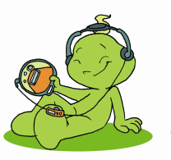
Grammar Focus
What kind of music do you like? | I like music that/which I can sing along with.
What kind of group does Xu Fei like? | He prefers groups that/which play quiet and slow songs.
What kind of movie do you like? | I prefer movies that/which give me something to think about.
What kind of musician does Carmen like? | She likes musicians who play different kinds of music.

Slide 23
4a
Choose words from the different columns to make sentences.
funny/
comfortable/
inexpensive/
slow/sweet/
salty/loud/
interesting/
intelligent
I/
you/
he/
she/
we/
they
food/
clothes/
people/
music/
singers/
movies
like(s)/
love(s)/
prefer(s)
that/
which
/who
is/
are

Slide 24
1 I like food that is salty.
2 he loves actors that are intelligent.
3 she loves clothes that are inexpensive.
4 they prefer movies that are funny.
... ...

Slide 25
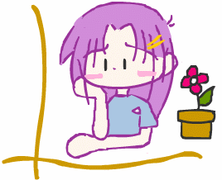
Read Jennifer’s CD review. Then complete the sentences using that, which or who.
4b
1. It’s the kind of music________________________.
2. It’s a CD_________________________.
3. She likes musicians__________________________.
4. She doesn’t like the songs____________________.
5. She likes singers_______________________.
that/which you can dance to
that/which you can take to a party
who write their own lyrics
that/which are too long
who sing the words clearly

Slide 26
Make conversations about the kind of things you like and dislike.
4c
What kind of food do you enjoy?
I enjoy food that is sweet!

Slide 27
HOMEWORK
1. Make a survey
调查你的家庭成员他们对电影，CD 食物，歌曲， 音乐制作人等的喜好，并写成一个小报告，向你的同学们汇报一下。
2. Recite the text in 3a.
Notes:
27
27

Slide 28
Thank you!

