Slide 1
Unit 3 The Internet
Section Ⅳ Discovering Useful Structures
WWW.PPT818.COM

Slide 2
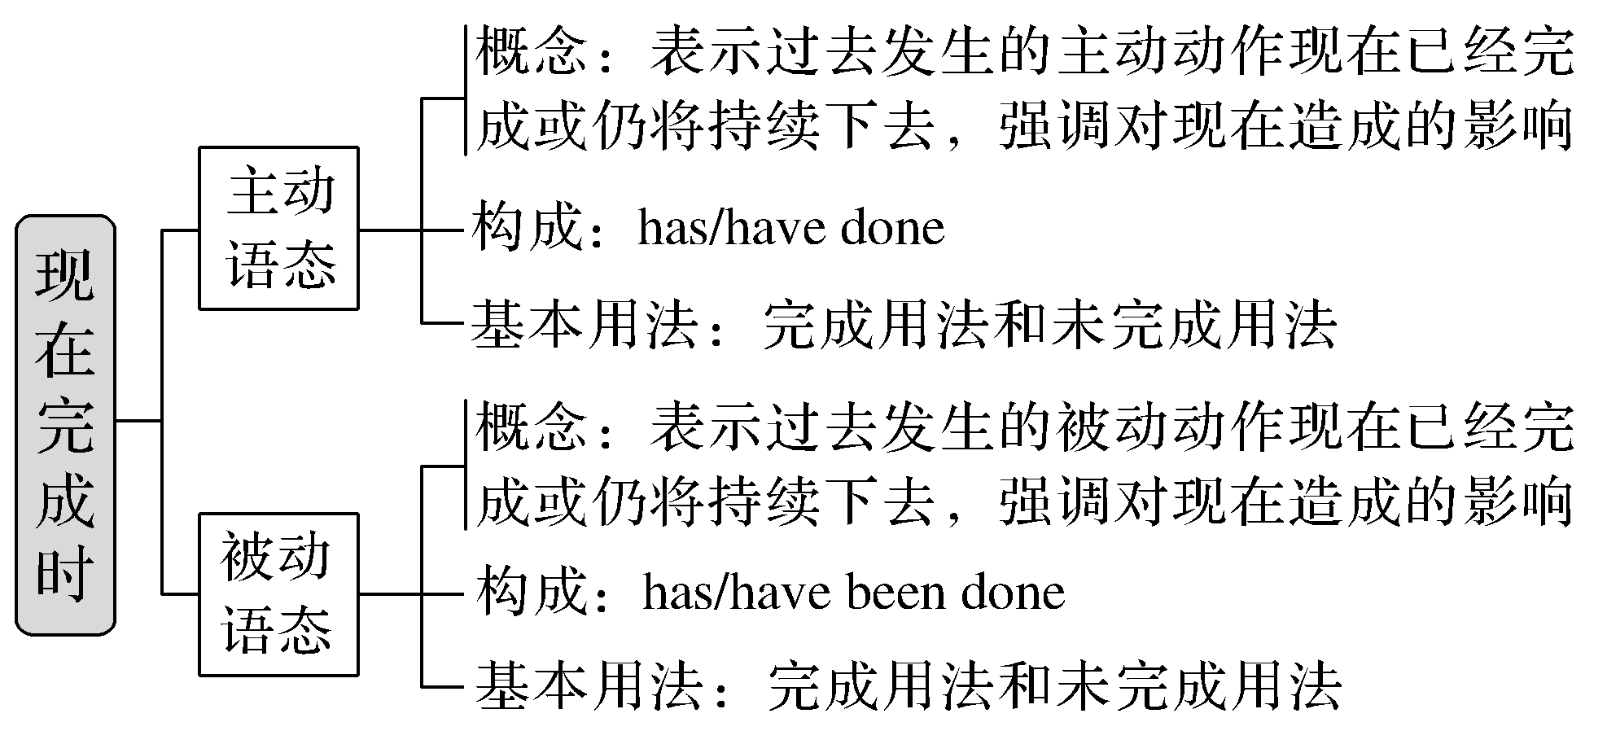
现在完成时的被动语态

Slide 3
现在完成时是一种现在的时态。它可表现为现在完成时的主动语态和现在完成时的被动语态两种形式。
There are countless articles telling us how the Internet has made our lives more convenient.有无数的文章告诉我们互联网如何使我们的生活更方便了。
Much has been written about the wonders of the World Wide Web.
关于万维网的奇迹已经写了很多。
一、概念
[合作探究]

Slide 4
[自主发现1] 现在完成时态表示________发生的动作或存在的状态到现在已经完成或者仍将持续下去。它强调对________造成的结果或影响。它有主动语态和被动语态两种形式。
过去
现在

Slide 5
二、构成
[合作探究]
I have heard nothing from him up to now.到目前为止我没有他的任何消息。
I haven’t seen him recently.我已经很久没有看到他了。
The experiment has been done successfully.这个实验做得很成功。
The blackboard has not been cleaned yet.还没有擦黑板。
[自主发现2]
(1)现在完成时的主动语态：________________ (肯定式); has/have not done(否定式)
(2)现在完成时的被动语态：__________________ (肯定式); ____________________
(否定式)
has/have done
has/have been done
has/have not been done

Slide 6
三、基本用法
1.完成用法
[合作探究]
He has turned off the light.他已把灯关了。
He has already obtained a scholarship.他已经获得了一份奖学金。
This book has been translated into many languages.这本书已被译成多国语言。
These flowers have been watered，so you can go home.
这些花已经浇水了，所以你可以回家了。

Slide 7
[自主发现3]
(1)现在完成时的“完成用法”是指发生在过去的动作到现在为止已经结束，并且对现在产生了________，与现在有________关系。其特点是动作已经________，不再延续。
(2)该时态常与already, yet, before, recently, never, this morning等时间状语连用。
影响
因果
结束

Slide 8
2.未完成用法
[合作探究]
He has lived here since 1978.自从1978年以来，他一直住在这儿。
This machine has been repaired for two hours.
这台机器已经修理了两个小时了。
The child has been taken care of by grandma all these years.
这些年来，孩子一直由奶奶照看。

Slide 9
[自主发现4]
(1)现在完成时的“未完成用法”指的是过去发生的动作一直________到现在并有可能还要继续下去。该动作虽然对现在产生了影响，但可能____________结束。
(2)现在完成时的“未完成用法”经常与for/since＋时间点， in the last/over＋时间段， all these years等表示一段时间的时间状语连用。
延续
并未/没有

Slide 10
四、现在完成时的主动语态与被动语态的转换
[合作探究]
We have bought a new house recently.
→A new house has been bought recently by us.
They have just cleaned and repaired the watch.
→The watch has just been cleaned and repaired (by them).

Slide 11
[自主发现5] 现在完成时的主动语态在变成被动语态时，要注意以下几点：
(1)把主动语态中的宾语变成被动语态的________，助动词has或have要与被动语态的主语在人称和数上保持一致，且要在助动词后加上________。
(2)主动语态的主语在变成被动语态时一般用________引出，有时可以省略。
主语
been
by

Slide 12
[巩固内化1]
指出下列时态是主动语态还是被动语态
①Much useful information about these planets has been collected since 1971.____________
②I haven’t repaired my computer.____________
被动语态
主动语态

Slide 13
[巩固内化2] 单句语法填空
①He ____________ (teach) English since he came to the Junior High School.
②Much parking space in this city ______________ (save) by using small cars.
has taught
has been saved

Slide 14
[巩固内化3] 补全句子
has not been painted for many years
①You can see the house _____________________________________ (多年未上漆).
②My homework ______________________________ (还没有写完) yet.
③My parents ___________________________ (已经住了) in Shandong for ten years.
④____________________________ (取得了很大进展) in cultural and educational fields.
hasn’t been finished
have lived
Big progress has been made

Slide 15
[巩固内化4] 把下列变为被动语态
①He hasn’t removed the ink from his clothes.
→_____________________________________________________________________
②We have already told the good news to the children.
→_____________________________________________________________________
③My mother has given me a new shirt.
→_____________________________________________________________________
→_____________________________________________________________________
The ink hasn’t been removed from his clothes.
The children have already been told the good news by us.
I have been given a new shirt by my mother.
A new shirt has been given to me by my mother.

