Slide 1
Unit 5 Shopping
How much is this shirt?
WWW.PPT818.COM

Slide 2
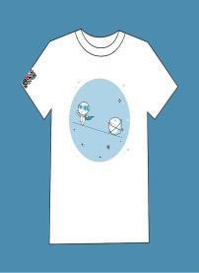
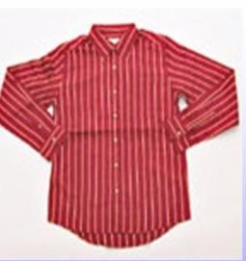
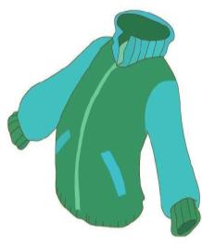
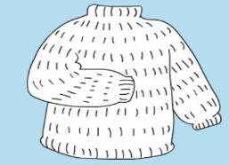
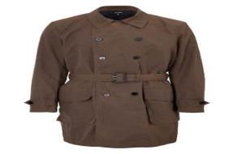
T-shirt
Shirt
Jacket
Sweater
Coat

Slide 4
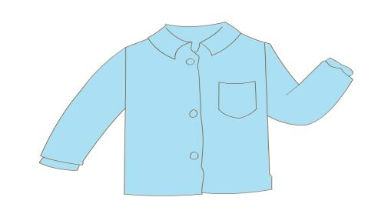
Guessing game.
fifty
50元
---How much is this shirt?
---It’s... yuan.

Slide 5
Let’s chant.
How much, how much,
how much is this shirt?
Fifty, fifty, It’s fifty Yuan.

Slide 6
---How much is this shirt? ---A. It’s one hundred Yuan. B. It’s eighty Yuan.

Slide 7
10 20 30 40 50 60 70 80 90 100
one hundred
Sixty 60
Seventy 70
Eighty 80
Ninety 90

Slide 8
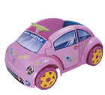
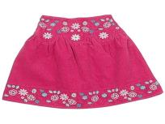
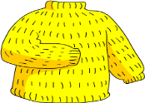
Pair work （同桌对话）
￥12
￥10
￥15
￥60
￥20
--- How much is the…?
--- It’s… Yuan.

Slide 9
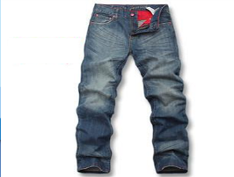
---How much are the ? ---They are fifty-eight Yuan.
trousers

Slide 10
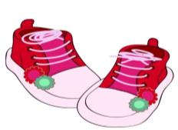
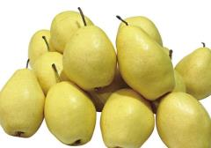
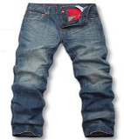
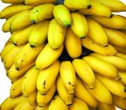
Pair work（同桌对话）
---How much are the…? ---They are… Yuan.
￥82
￥21
￥55
￥98

Slide 11
Let’s chant.
How much, how much,
how much is this shirt?
One hundred, one hundred,
It’s one hundred Yuan.
How much, how much,
how much are they?
Fifty-eight, fifty-eight,
They’re fifty-eight Yuan.

Slide 12
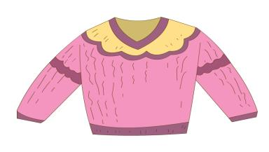
Guess
Guess
（猜价格）
30
￥
76
￥
￥
￥
87
45
-- How much is the sweater ?
…
-- It’s Yuan.
76

Slide 13
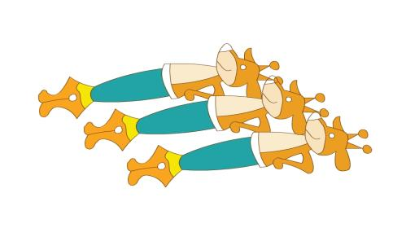
Guess
（猜价格）
30
￥
15
￥
￥
￥
60
45
--How much are the pens?
…
30
--They are yuan.

Slide 14
Group work. （四人一组，模拟购物）
---Do you have…?
---Yes, we do.
---How much is…? / How much are…?
---It’s… Yuan. / They’re …Yuan.

Slide 15
Saving money is a good quality.
节约是一种好品质！

Slide 16
Summary
---How much is…? / How much are…?
---It’s… yuan. / They’re… yuan.

Slide 17
Homework
A. 听读对话3遍。
B. 调查商品价格并与朋友谈论。

