Slide 1
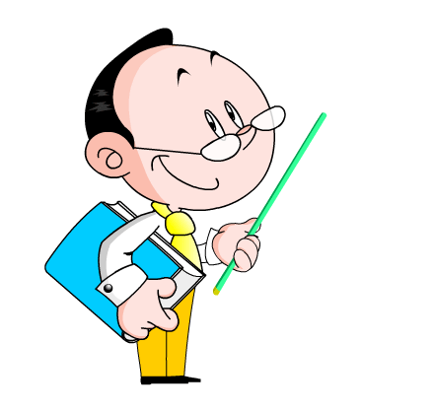
Unit 6 Go with Transportation
How Do You Travel?
WWW.PPT818.COM

Slide 2
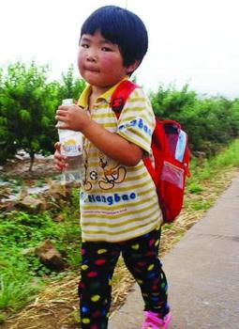
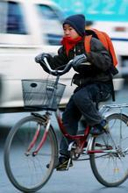
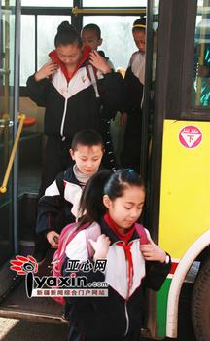
A guessing game （猜谜游戏）
How does he/she go to school ?
Notes:
2

Slide 3
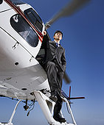
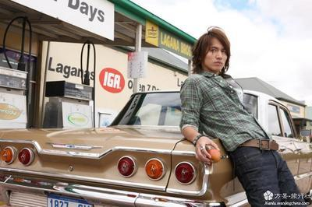
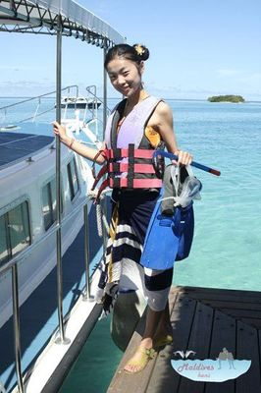
A guessing game （猜谜游戏）
How does he/she travel?

Slide 4
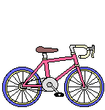
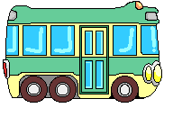
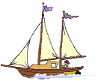
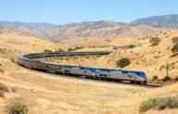
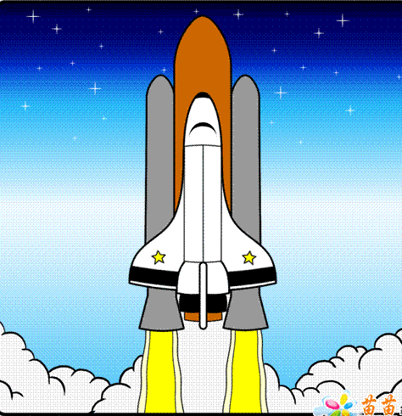
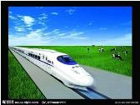
walk/ on foot
take a bus
ride a bicycle
by plane
ride a motorbike
take a train
take a ship
by car
take the high-speed rail
take a spaceship

Slide 5
一、认知学习目标
1.知识目标 ：
识记单词: transportation; hometown; Britain;
seldom; rapid
掌握句型短语：go to…on foot/walk to…;
of course / sure/ certainly/of course not
take a train to / go to …by train / go to… on a train; What about…?/How about…?;
across the ocean; travel by plane;
2. 能力目标：
通过学习，能用英语表达出行方式，并能与同学交流。

Slide 6
二、预习成果展示
词型转换:
1. almost(同义词) _______
2. type（同义词）_______
3. city(复数) _________
4.cross(介词) __________(名词) ____________
5.travel(现在分词) ____________
6.bake(名词) _________
7.rapid(副词) ___________(同义词) ____________
nearly
kind
cities
across
crossing
travelling
bakery
rapidly
quick /fast

Slide 7
B.阅读课文,翻译并在课文中划出下列短语：
1.花费某人一段时间做某 _________________________
2.步行去学校 _________________
3.在大洋彼岸__________________
4.当然不行____________________
5.take a ship __________________
6.twice a year_________________
7.strong enough_______________
8.What about doing sth ___________________
It takes sb. some time to do sth.
walk to school
across the ocean
of course not
乘轮船
一年两次
足够强壮
做某事怎么样

Slide 8
活动二：Read the dialogue loudly and finish Let’s Do It 1(Write T or F)
Danny likes to travel on foot.( )
Brian would like to take a train to London.( )
Jenny likes to travel by plane.( )
It would take Brain a long time to take a ship to his hometown.( )
T
F
F
T

Slide 9
活动三：Lanuage Points
1.walk to… / go to …on foot 步行去……
take a bus to…/ go to …by bus 乘公交车去……
take a car to… /go to …by car 乘小汽车去……
take a train to… / go to … by train 乘坐火车去…..
ride a bike to… /go to … by bike 骑自行车去……
拓展连接：表示交通方式的动词短语也可以用介词短语替换。 in a car , on a bike , in a train , in a bus...

Slide 10
(1) 我们步行去操场.
We walk to the playground.
We go to the playground on foot.
(2)我们乘坐火车去北京
We take a train to Beijing.
We go to Beijing by train.
(3) 我乘坐公交车去滏阳公园
I take a bus to FuYang park.
I go to Fuyang park by bus.

Slide 11
四、反馈展示升华
A: Do you like to travel ?
B: Yes ,I do.
A: Where do you like to travel?
B: I like to go to _________.
A: How will you go there ?
B: I will ________. (I will go there by……)
A:Why ?
B: Because it’s my favourite type of transportation.
fast / rapid
cheap
comfortable(舒适的)
I think it’s ___ exciting
funny
good for our health
A:Thank you.
B: You’re welcome.
Beijing
Canada
3.the moon ……

Slide 12
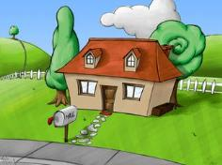
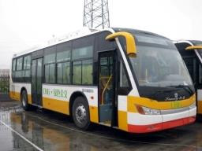
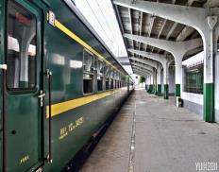
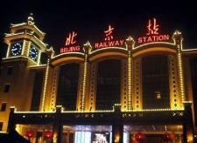
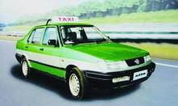
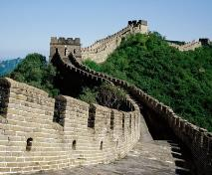
Writing：How do you travel to the Great Wall?
First
then
Bus stop
Baoji station
walk
next
Finally
train station
take a taxi to
the Great Wall
I live in .... I like travelling , …want to .... First, …walk…
Bus stop， then … … Next, take a taxi…, … Finally,…
Notes:
12
12

Slide 13
五、当堂训练检测
( )1.---_____do you like travel ?
---I like to take the bus.
A、What B、How C、When D、Where
( )2.I usually walk to school, but __bus when it rains .
A、in B、by C、with D、at
( )3. Look! Your coat is not _____.It’s too small. A、enough big B、big enough
C、new enough D、enough new
( )4. It takes us __hour to go there by __ bus.
A、an; a B、a; an C、an; / D、a; /

Slide 14
5. It takes my mother all day_______ (clean) my house.
6. What about ___________ (drink) some water?
7.我姐姐步行去上班。
My sisiter goes to work _______ ________.
My sister _________to work.
8.Tim takes the subway to school. (划线部分提问) ________ ________Tim ________ to school?
to clean
drinking
on foot
walks
How does go

Slide 15
.
Thank You Very Much!

