Slide 1
Module2 My family
Unit2 These are my parents
WWW.PPT818.COM

Slide 2
My family name is Xiao(肖)
You can call me
Miss Xiao
2

Slide 3
Teaching aims:
1.Learn to introduce family members.
2.To be able to talk about jobs.
3.To write personal information, using full stops and capital letters correctly.
2023-01-17

Slide 4
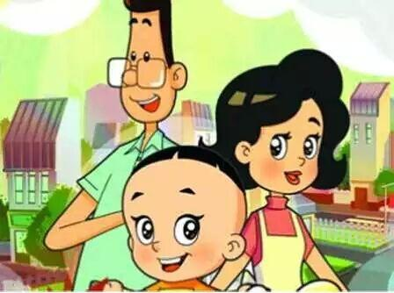
Let's enjoy some pictures.
2023-01-17

Slide 5
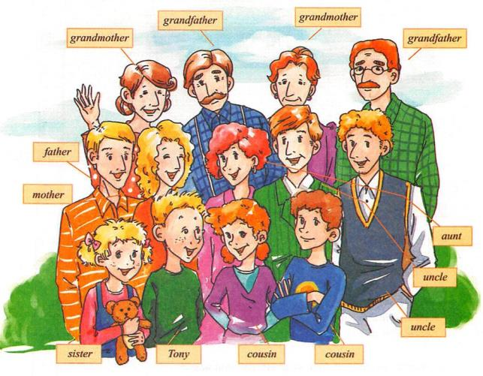
Tony has a big
family.
What a big family!
2023-01-17

Slide 6
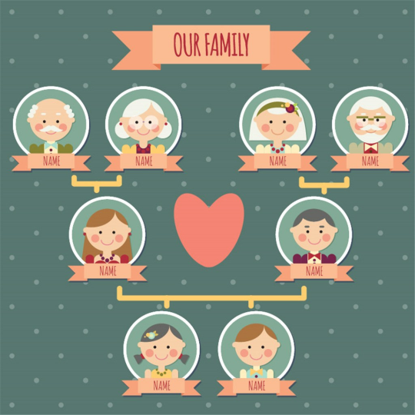
family
tree
2023-01-17

Slide 7
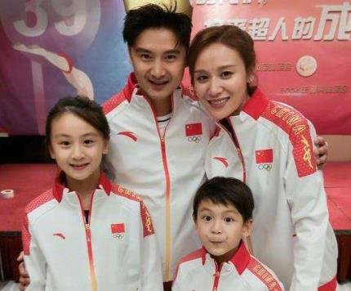
What does he do?
sportsman
2023-01-17

Slide 8
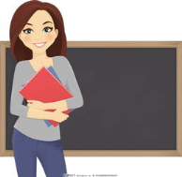
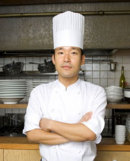
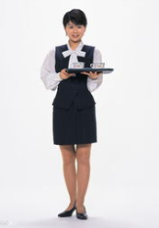
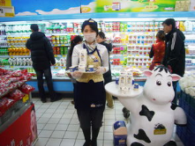
career职业
teacher
saleswoman
waitress
cook
doctor

Slide 9
waiter
服务员
postman
邮递员
police
警察
lawyer
律师
actor
演员
lifeguard
救生员
astronaut
宇航员
judge
法官
writer
作家
nurse
护士
2023-01-17

Slide 10
Words preparation
词汇准备
bus station hospital hotel police station school theatre
[bʌs ˈsteiʃən]
[pəˈli:s ˈsteiʃən]
[ˈθiətə]
actor bus driver manager nurses policeman teacher
[ˈdraɪvə(r)]
[ˈmænɪdʒə(r)]
[nɜ:s]
2023-01-17

Slide 11
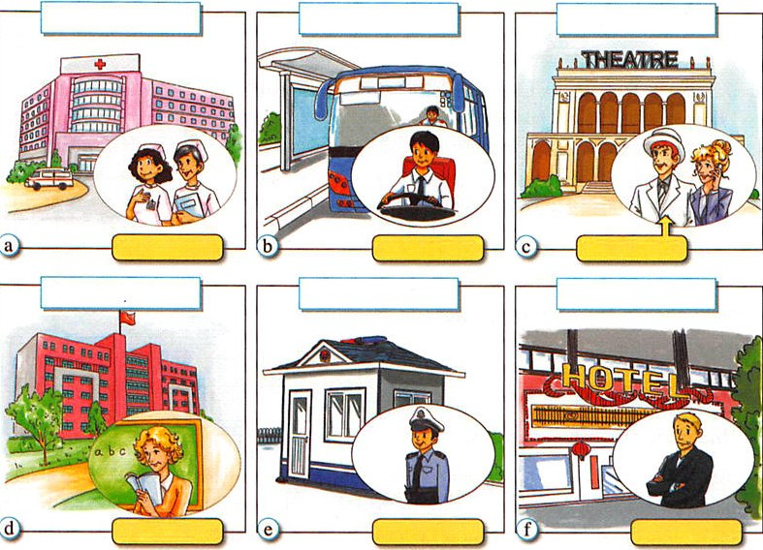
hospital
bus station
theatre
They/He/She work(s) in the...
They are...
She/He is a/an...
nurses
bus driver
actor
school
police station
hotel
2023-01-17
teacher
policeman
manager

Slide 12
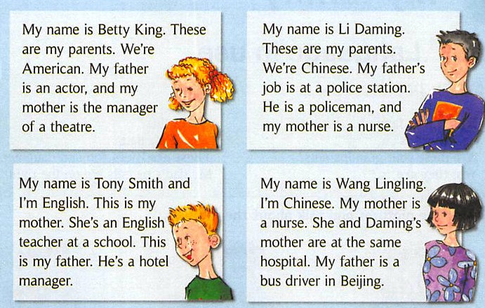
2023-01-17

Slide 13
This is...
This is my mother.
[ðɪs]
These are...
These are my parents.
[ði:z]
2023-01-17

Slide 14
This is a person.
This is a basketball.
These are some
persons.
These are some
basketballs.
This is a rabbit.
This is an apple.
These are some
rabbits.
These are some
apples.
2023-01-17

Slide 15
Writing
father
mother
Nationality
国籍
name
Example:
My name is XXX. These are my parents. We are Chinese. My father is a XXX. He works in XXX. My mother is XXX. She works ....
I love them very much.

Slide 16
My name is Tony Smith and I'm English.
capital letter
full stop
Show Time
2023-01-17

Slide 17
This is my family. My grandpa's name is Harry Green. My grandma's name is Jean Green. My father's
name is Jeff Green. My mother's name is Helen
Green. I have a sister. Her name is Kate Green.
My name is Jim Green.I am twelve,and my sister
is eight.
1. Harry Green is Jim's ________ .
2. Kate is Jim's _____ . 3. Jim is Jeff Green's ______ .
4. Jim is Kate's _______.
5. _____ _____ is Kate's grandmother.
6. Helen Green is Jeff's _____. 7. Jean is Jeff's _____ .
8. Jim and Kate are _______ and _______.
小
试
身
手
grandpa
sister
son
brother
Jean Green
wife
mother
brother
sister
2023-01-17

Slide 18
Homework
找出你最感兴趣的一种职业，思考如何努力实现，形成一小段English show，下节课上五分钟展示。
18

Slide 19
Best wishes!
19

