Slide 1
Unit 6 Topic 2
Who is your favorite character in literature?
Section B
WWW.PPT818.COM

Slide 2
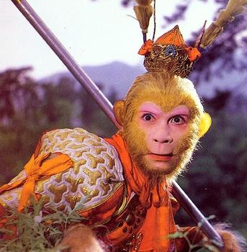
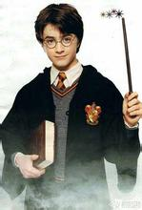
Can you describe the two characters with five words?

Slide 3
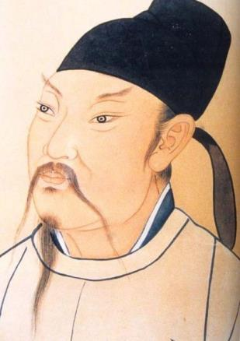
Li Bai (701-762 )
poet, Tang dynasty

Slide 4
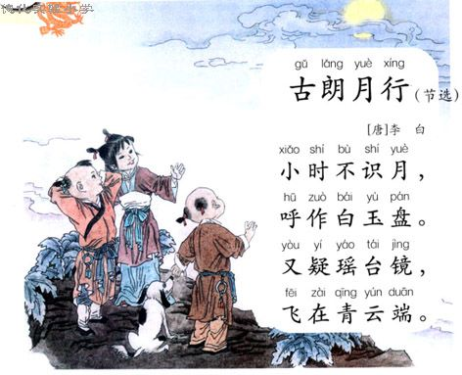

Slide 6
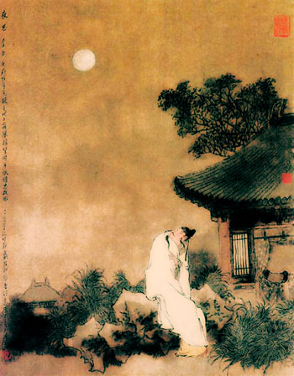
静夜思
李 白
床前明月光，
疑是地上霜。
举头望明月，
低头思故乡。

Slide 7
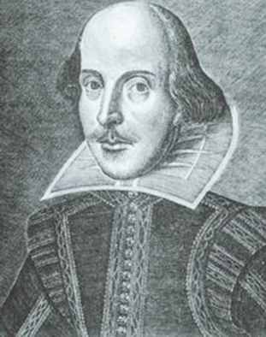
Shakespeare (1564-1616 )
poet，playwright, England

Slide 8
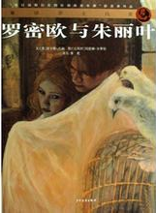

Slide 9
1b Listen to 1a and mark T (True) or F ( False) .
Li Bai is regarded as one of the best romantic poets in China.
( )
2. In Li Bai’s life, he wrote about 900 poems. ( )
3. Li Bai and Shakespeare are both poets and playwrights.( )
4. Many of Shakespeare’s plays were about British history.( )
5. Romeo and Juliet was a famous tragedy written by Shakespeare. ( )
T
F
F
T
T

Slide 11
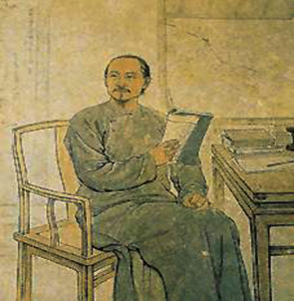
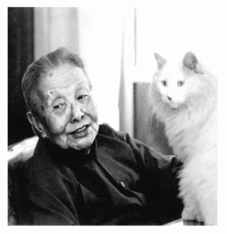
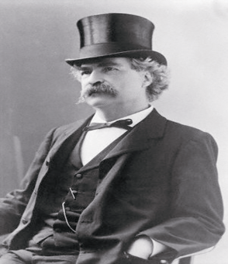
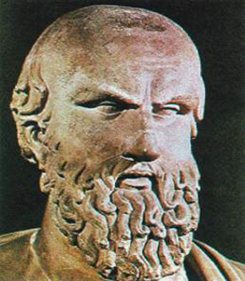

Slide 12
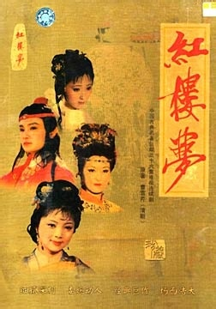
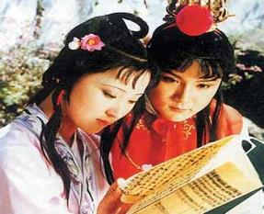
Cao Xueqin
( 1715-1763)
is known for the novel,
A Dream of Red Mansions.

Slide 13
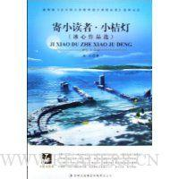
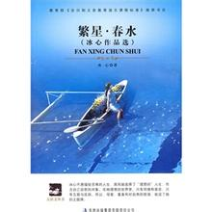
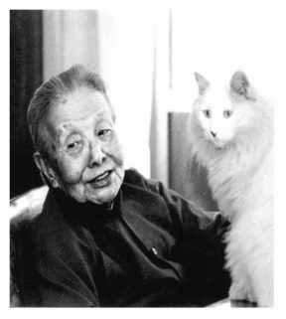
Bing Xin
(1900-1999)
is famous for children’s works.

Slide 14
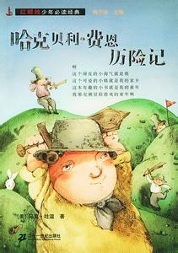
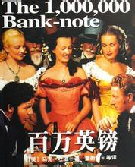
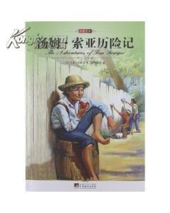
Mark Twain (1835-1910)
is famous for his novels such as The Adventures of Tom Sawyer and The Adventures of Huckleberry Finn.

Slide 15
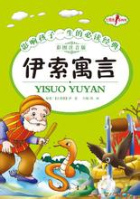
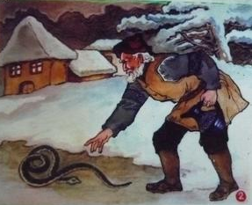
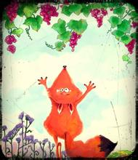
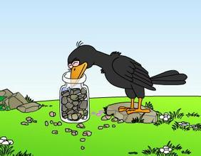
Aesop
(620B.C.-560B.C.)
is known for Aesop’s Fables.

Slide 16
2b Complete the following passage with the information
you have got.
Our favorite writer____________. His masterpiece is__________________________. In this work, he mainly tells us_________________________________, _____________________________________________ ____________________________. This work is so famous because________________________________, _____________________________________________,_____________________________.
is Mark Twain
The Adventures of Tom Sawyer
that Tom Sawyer, a lively and clever boy
runs into and lives through many exciting adventures with
his two friends—Huck Finn and Joe
the story is about children’s growing up
and it is really interesting and educational. What’s more
the conversations sound very good

Slide 17
2c The groups who have selected the same writer
work together to share what they have written.
Tip
It is helpful to exchange ideas with others in order to improve the contents of your writing.

Slide 18
Summary
1. society n.社会；社团 literary society 文学社
eg. Steve and his Chinese teacher, Miss Yang,
are now visiting a literary society.
2. He is considered to be one of the best romantic poets in China.
3. The passage I read about him said that he was as great as the British poet William Shakespeare.

Slide 19
Homework
Write down the key words of the conversation to introduce their favorite writers.
Search for more information about a famous
Chinese poet.

