Slide 1
Unit 7
Teenagers should be allowed to
choose their own clothes.
Section A (第1课时)
WWW.PPT818.COM

Slide 2
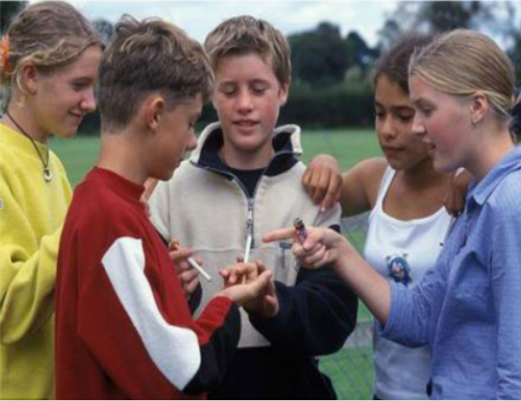
Warming up
CAN OR CAN'T?
smoke

Slide 3
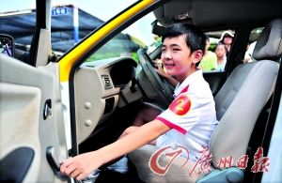
Warming up
CAN OR CAN'T?
driver's license
drive

Slide 4
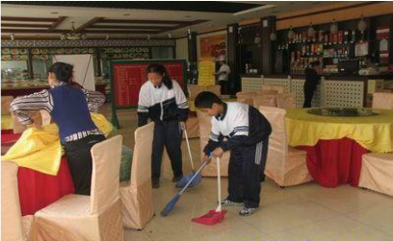
Warming up
CAN OR CAN'T?
have part-time jobs

Slide 5
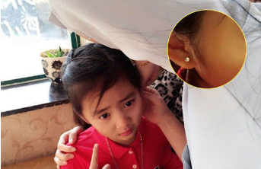
Warming up
CAN OR CAN'T?
get ears pierced

Slide 6
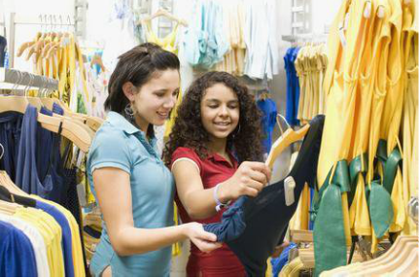
Warming up
CAN OR CAN'T?
choose their own clothes

Slide 7
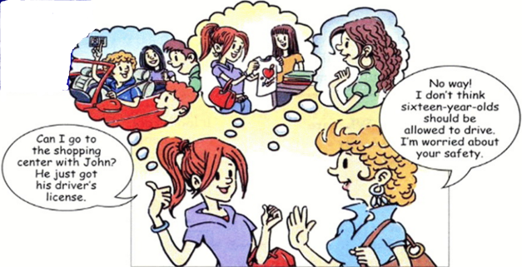
Read the statements below.Circle A for agree or D for disagree.
1a

Slide 8
1. Teenagers should not be allowed to smoke. A D
2. Sixteen-year-olds should be allowed to drive. A D
3. Students should not be allowed to have part-time jobs. A D
4. Sixteen-year-olds should be allowed to get their ears pierced. A D
5. Teenagers should be allowed to choose their own clothes. A D

Slide 9
1b
Listen and circle T for true or F for false.
1.Anna can go to the shopping center by bus. T F
2.Anna wants to get her ears pierced. T F
3.Ann wants to choose her own clothes. T F

Slide 10
1c
Look at the statements in 1a and make conversations.
A: I don’t think sixteen-year-olds should be
allowed to drive.
B: I agree. They aren’t serious enough.

Slide 11
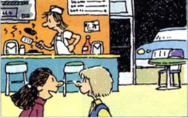
2a
What does Molly think of Kathy’s statements?Listen and circle A for Agree,D for Disagree or DK for Don’t Know.
Kathy | Molly
1. Sixteen-year-olds should not be allowed to work at night. 2. Larry shouldn’t work every night. 3. He should cut his hair. 4. He should stop wearing that silly earring. 5. He doesn’t seem to have many friends. | A D DK A D DK A D DK A D DK A D DK

Slide 12
Listen again. What are Kathy’s and Molly’s reasons?Number their reasons in the correct order.
2b
______ It looks cool.
______ Young people need to sleep.
______ He needs to spend time with friends.
______ He needs time to do homework.
______ It doesn't look clean.
4
1
5
2
3

Slide 13
2c
Make a list of things teenagers should and should not be allowed to do. Discuss your list with your partner.
A: Do you think teenagers should ...?
B: Yes, I .../No, I ...

Slide 14
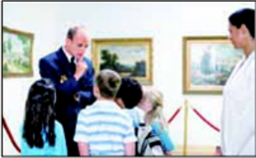
2d
Role-play the conversation.
Sandy:I’m really excited about seeing the famous paintings by Picasso.
Wu Lan: Me, too! I’m glad Mr. Smith chose the art museum for our school
trip this year.
Sandy: I’m going to bring my new camera to take lots of photos!
Wu Lan: Oh, no. Mr. Smith says we must not take photos. It’s not allowed in
the museum.
Sandy: That’s too bad! Do you think we may be allowed to take photos if we
don’t use a flash?
Wu Lan: Hmm ... I think they just want to
protect the paintings. So if you don’t
use a flash, then it may be OK.
Sandy: Yeah. I think we should be allowed to
do that. I’ll bring my camera anyway.

Slide 15
Language Points
1.allow 的用法
v.允许，准许，其用法为：
（1）allow doing sth.“允许做某事”。相当于be allowed to do sth.。
e.g.:We don't allow smoking.=We aren't allowed to smoke.
（2）allow sb. to do sth.允许某人做某事。
（3）be allowed to do sth.被允许做某事。

Slide 16
2.safety
safety n.安全
e.g.:You should pay attention to the students' safty in this trip.
【拓展】safe adj. 安全的；safely adv.安全地
3.get/have sth.done（动词的过去分词）请别人做某事/使某事完成
①get their ears pierced 打耳洞（让别人做）
②get my hair cut理发（让别人剪掉我的头发）

Slide 17
4.I don't think sixteen-year-olds should be allowed to drive. 我不认为十六岁的青少年们该被允许开车。（教材第49页）
（1）句型“I don't think +(that)从句”表示“我认为……不……”，从形式上看don't 是在否定主句的谓语动词think，但意义上却是否定宾语从句。英语中，这种现象叫否定转移。具有类似用法的动词还有believe,expect,suppose等。注意此句式的反意疑问句。
（2）sixteen-year-olds是由连字符连接而成的合成名词，意为“十六岁的青少年们”。

Slide 18
5.其他重点短语
（1）no way 没门，不行
（2）be worried about 担心
（3）take photos of ... 给……拍照
（4）be excited about 对……感到兴奋

Slide 19
Exercise
一、根据汉语提示填空。
1.Teenagers should not be _______(允许) to drive.
2.You aren't allowed to _______(吸烟) here.
3.You should pay attention to _______(安全) while you walk on the
street.
4.No _______ (没门) ! Teenagers aren't allowed to drink.
5.The policeman asked the driver to show his driver's _______(执照).
allowed
smoke
safety
way
license

Slide 20
二、单项选择。
( )1.—Excuse me,sir,smoking in the gas station _____.
—Oh,I’m really sorry.
A.doesn’t smoke B.isn’t allowed
C.aren’t allowed
( )2._____ shouldn’t be allowed to have long hair.
A.Sixteen years old B.Sixteen-year-olds
C.Sixteen-years-olds D.Sixteen-years-old
( )3.You must stop _____ the paintings because it is bad for the paintings.
A.take photos B.to take photos of
C.taking photos of D.taking photos
B
B
C

Slide 21
Homework
1.Listen and read after the tape at home.
2.Read and recite 2d.

Slide 22
Thank you！

