Slide 1
Module 9
WY 六年级下册
Unit 1 Best wishes to you!
WWW.PPT818.COM

Slide 2
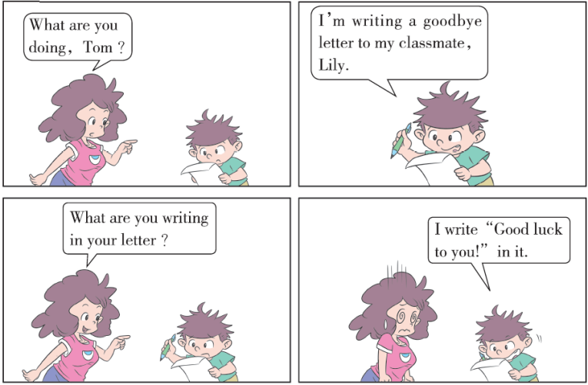

Slide 3
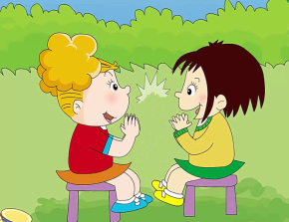
1. Listen and chant.
Best wishes to you!
Good luck to you!
You are a great friend.
And I will miss you.

Slide 4
知识点 1
Best wishes to you! 向你致以最美好的祝愿！
Best wishes to you!
用法：
这是常见的祝福语，表示最衷心的祝愿。
拓展
其他常见的祝福语： Good luck to you! 祝你好运！ Good luck for the future!（祝你）未来好运！Congratulations! 恭喜！

Slide 5
wish /wɪʃ/ n. ( 名词) 愿望，希望；祝愿
字母组合sh 的发音是/ʃ/。
发音：
例句：
Her wish came true. 她的愿望实现了。
wishes
复数：
best wishes 最美好的祝愿 make a wish 许愿
短语：
wash 洗
形近词：

Slide 6
整体记忆法：
魔法记忆：
心中wish（愿望），钓到fish（鱼），做成dish（菜）。

Slide 7
2. Listen and read.
Daming 12 years old China
Dear friends,
We’re going to say good bye to our primary school soon. I enjoyed our time together. I want to remember you all. Please write a message in this book. I’ll keep it forever. Thank you!
Daming
Lingling 13 years old China
Daming,
You’re a naughty but lovely boy. You helped me in sport.You brought us lots
of joy. Good luck for the future!
Lingling

Slide 8
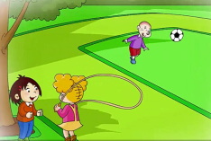
2. Listen and read.
Amy 13 years old UK
Daming,
We had a happy time at school. You taught me Chinese. Thank you very much. You’re a wonderful friend. I will miss you!
Amy
Sam 12 years old UK
You’re my best friend, Daming. I’ ll
never forget our time together. Best wishes to you ！Come to the UK to watch football games with me ！
Sam

Slide 9
知识点 2
message /΄mesɪdʒ/ n. ( 名词) 留言
例句：
Can I take a message? 要我传个话吗？
短语：
leave a message 留言
加法记忆法：
mess（脏乱）+age（年龄）= message（信息）

Slide 10
知识点 3
keep / kiːp / v. ( 动词) 保留
例句：
I’ll keep the stamp. 我将保留这张邮票。
整体记忆法：

Slide 11
知识点 4
future /΄fjuːtʃə(r)/ n. ( 名词) 将来，未来
We need to plan for the future.我们需要为将来做好打算。
例句：
in the future 在将来
for the future 为将来
短语：

Slide 12
知识点 5
wonderful /΄wʌndəfl/ adj. 了不起的，出色的
例句：
The Great Wall is wonderful. 长城很了不起。
词形变化：
wonder n. 奇迹
短语：
a wonderful day 愉快的一天 have a wonderful time 玩得愉快
近义词记忆法：
wonderful 出色的 excellent 棒极了
great 好极了

Slide 13
3. Listen and say.
You brought us lots of joy.
Good luck for the future!
You’ re a wonderful friend. I will miss you!
You’ re my best friend. Best wishes to you!

Slide 14
趣味活动：记忆力大比拼。
六人一组，小组成员轮流用英语说祝福语，在规定的时间内说得最多最正确的获胜！

Slide 15
4. Practise.
Say good wishes to your friends.
Good luck for the future.
Thank you.
And best wishes to you.
Thank you.

Slide 16
一、单项选择。
1. I will _______ you!
A. missing B. misses C. miss
2. _______Li is a young woman.
A. Mr B. Miss C. miss
C
B

Slide 17
二、根据括号中的汉语提示补全句子。
She wants to be a doctor _____ _____ _____（在将来）．
2. Good luck _____ _____ _____ （为将来）．
in the future
for the future

Slide 18
三、用所给单词的适当形式填空。
1. I’ll ______（keep） it forever.
2. He jumped with _____（joy）when he heard the good news.
3. It was a very ____________（wonder） football game.
keep
joy
wonderful

Slide 19
本节课我们学习了以下知识，请同学们一定加强巩固，以便能和同学们进行灵活交流哦！
重点词汇：wonderful, wish, message, joy, remember, forget
重点短语：best wishes, keep future
重点句式：Best wishes to you!

Slide 20
1 熟记本节课所学的句型、短语和单词，必须会听、说、读、写。
2 将Listen and read的内容朗读流利。
3 完成配套的课后作业。

Slide 21
Thank you!

