Slide 1
Online tours
Grammar
WWW.PPT818.COM

Slide 2
Revision
1.Who designed ‘Around the world in eight hours’?
It is designed by Nancy Jackson.
2.What is the main character called?
He is called Itchy Feet.
3.In what color are the places you have visited marked?
They are marked in bright purple.

Slide 3
a bookshelf,
a wood bookshelf,
store books
What’s this called in English?
It _______ a bookshelf in English.
What’s it made of ?
It is made of _____.
What’s it used for?
It is used for _______books.
is called
wood
storing

Slide 4
a key, a metal key, open and lock a door
What’s this called in English?
It _______ a key in English.
What is it made of ?
It is made of ______.
What is it used for?
It is used for _________________ a door.
is called
metal
opening and locking

Slide 5
a stamp,
a paper stamp,
send a letter
It’s called a ______ in English.
It’s ________ paper.
It’s _______ sending a letter.
stamp
made of
used for

Slide 6
What do we use this
CD-ROM for?
We use it for playing.
=It is used for playing.
Who designed it ?
It was designed by Nancy Jackson

Slide 7
Students talk about the things around them.
such as:
books (be made of paper/ written in
English )
knives (be made of metal/in
China/used for/to)

Slide 8
desks ( be made of wood/ painted
yellow)
windows
blackboards
pens…

Slide 9
语 态 分 类
英语动词有两种语态, 主动语态和被动语态。主动语态表示主语是动作的执行者,如:
They built a new bridge over the river.
被动语态表示主语是动作的承受者,如:
A new bridge was built over the river.

Slide 10
当主语是动作的执行者时,随后的动词用主动态;当主语是动作的承受者时,随后的动词用被动态。英语动词的主动态是没有标记的，而被动态则是有标记的，通常由助动词be + 及物动词的过去分词构成。
Many people speak English. (主动)
English is spoken by many people. (被动)

Slide 11
We can use the passive voice when
it is obvious who performs the action.
e.g. Word processing skills are taught
in our computer lessons.
(It is obvious that the person who
teaches word processing skills is
the Computer Studies teacher.)

Slide 12
we do not know or do not want to
know who performs the action.
e.g. The printer was sold already.
(We do not want to know who sold
the printer.)

Slide 13
we think the action is more important
than the person who performs the action.
e.g. Educational CD-ROMs are sold in
many countries.
(The fact that educational CD-ROMs
are sold in many countries is more
important than knowing who is
responsible for selling the CD-ROMs)

Slide 14
被动语态
am/is/are+动词的过去分词
一般现在时
结构
一般过去时
was/were+动词的过去分词
主动语态和被动语态的对比和转换:
主:
+
+
I
learn
English
被:
English
+
is learned
by
me

Slide 15
被动语态
主动语态和被动语态的转换:
Nancy Jackson designed this CD-ROM .
This CD-ROM was designed by Nancy Jackson.
+
+
主:
主语
谓语
宾语
+
+
by
被:
宾语
谓语
主语

Slide 16
写出下列动词的过去式和过去分词:
visit
visited visited
verb＋ed
move
moved moved
以e结尾＋d
study
studied
studied
以辅音字母加y结尾的词,去y＋ied.
clap
clapped
clapped
以一个辅音字母结尾的重读闭音节词,双写最后一个辅音字母＋ed

Slide 17
写出下列动词的过去式和过去分词:
be
give
see
make
put
come
write
was/were been
gave given
saw seen
made made
put put
came come
wrote written
注:不规则动词见书上121页不规则动词表.

Slide 18
Underline the passive voice in the following
sentences:
The cake was eaten by Daniel.
2. The book was taken by Nancy.
3. The little dog is looked after very well by Simon.
4. His house was sold by his son.
5. The computer is bought by my uncle .
6. I am woken up by my father every morning.

Slide 19
1.用动词的被动语态填空:
English ____________(speak) by many people.
The trees _______________(plant) by them last year.
That building _________(build) two years ago.
This kind of computer ________(make) in China.
_________ flowers _______ (sell) in this shop?
is spoken
were planted
was built
is made
Are sold

Slide 20
6.That picture ___________ (draw) by a little girl.
7.Lei Feng _________________ (remember) by us.
8.Japanese ______________ ( not teach) in our school.
9.---When _______ this hotel ________ (build) ?
---Three years ago.
is drawn
is remembered
isn’t taught
was built

Slide 21
Exercise 1
Millie’s new computer
A1 Millie wants to buy a new computer. Now she is at Sunnyside Shopping Mall. Complete the conversation using the passive voice in the simple present tense.
Shopkeeper: Good morning. What can I do for you?
Millie: Good morning. I’d like to buy a computer.

Slide 22
Shopkeeper: We’ve got many kinds of personal computers. This green one (1) ________ (call) Kiwi, and it (2)____ ________(design) especially for students.
Millie: Where(3) ___ it ______(make)?
is called
is
designed
is made

Slide 23
Shopkeeper: It (4)________ (make) in Shenzhen.
Millie: (5) ___ it _____ (use) widely?
Shopkeeper: Of course, very widely in Beijing.
Millie: OK. I’ll think about it.
is made
Is used

Slide 24
A2 Millie has just bought a computer like Simon’s. However, she does not know how to open her e-dictionary on the computer. She calls Simon and asks for help. Complete their conversation. Fill in the blanks using the passive voice in the simple past tense.

Slide 25
Millie: Hi, Simon. I can’t open my new e-dictionary on my computer. Can you help me?
Simon: Yes, of course. Did you close all the windows?
Millie: Yes, all the windows(1)__________.
Simon: Then restart the computer.
Millie: It (2)_____________.
were closed
was restarted

Slide 26
Simon: Did you check the settings?
Millie: Yes, the settings (3) ___________.
Simon: Did you connect the keyboard to the computer properly?
Millie: Yes, the keyboard (4)_______
_________________.
Simon: Did you double- click on the ‘auto-run’ icon after you put in the CD-ROM?
were checked
was
connect properly

Slide 27
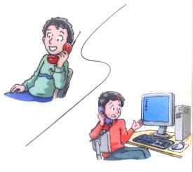
Millie: Yes. The icon (5)___________ _______,but it still isn’t working.
Simon: That’s really strange. Let me come and have a look later today.
Millie: Thanks a lot, Simon.
Simon: You’re welcome.
was doulbe
-clicked

Slide 28
Passive voice with “by”
We can introduce the person who
performs an action with the passive
voice using “by” and the name(s) of the
person (s) at the end of a passive
sentence.
e.g. That CD-ROM was designed by
Nancy Jackson.

Slide 29
Exercise 2
Saving Princess Laura
B1 Simon has bought a new educational CD-ROM called ‘Saving Princess Laura’. Before he can play the game, he must pass a test. Help Simon pass the test by rearranging the words to form correct sentences.

Slide 30
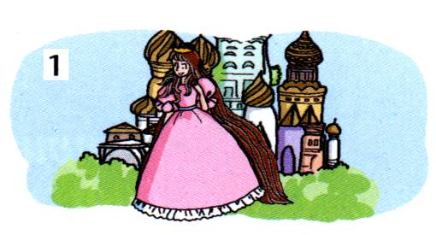
____________________________________________________________ (was born/Princess Laura/18 years/ago/ Magic Land/in)
Princess Laura was born in Magic
Land 18 years ago.

Slide 31
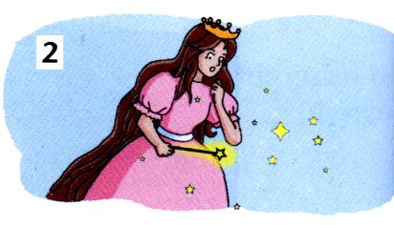
__________________________
_____________________________ when her hair grows to six feet long. (a magic wand/was given/ Princess Laura/but/it only works)
A magic wand was given to
Princess Laura but it only works

Slide 32
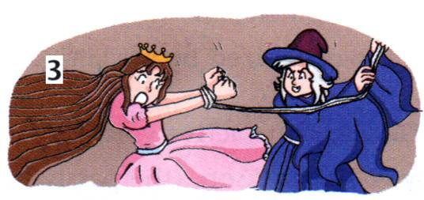
__________________________________________________________ (was caught/an/witch/evil/ Princess Laura/by)
Princess Laura was caught by an
evil witch.

Slide 33
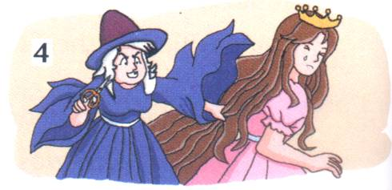
The princess’s hair was cut short
by the evil witch.
________________________________________________________ (witch/by/The princess’s hair/ the/evil/was cut short)

Slide 34
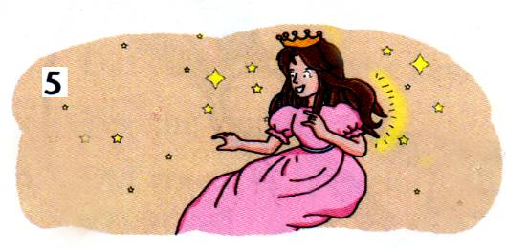
When a question is answered
correctly
___________________________
__________________
the princess’s hair will grow an inch. (a question/When/is answered/correctly)

Slide 35
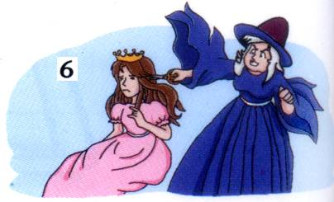
When a question is answered
incorrectly
___________________________
___________________________
the witch will cut an inch of the princess’s hair. (a question/ When/ incorrectly/is answered)

Slide 36
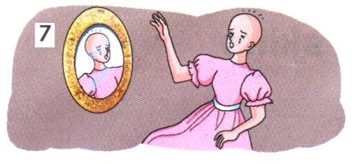
When a total of ten questions are
answered incorrectly
__________________________________________________, the game is over, and ____________________________.
(a total of/the princess/When/are answered/bald/ten questions/will/ become/incorrectly)
the princess will become bald

Slide 37
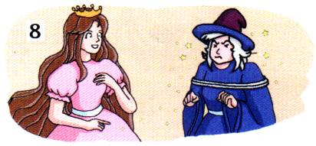
_______________________, the princess is free, and ____________
________.
(the witch/When/you/is caught/win the game)
When you win the game
the witch is
caught

Slide 38
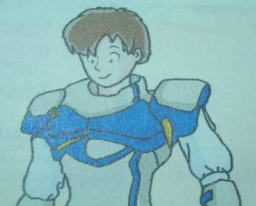
Do B2
Neil Johnson
Name of the game | Travel in space
No. of levels | 5
Main character | Neil Johnson
Age | 13
Setting | Mars,year2733
Area of study | science
designer | Harry Jones

Slide 39
Millie: I have a new computer game. Would you like to play it?
Daniel: Oh, yes. What's the game called?
Millie: It ______________ 'Travel in Space'.
Daniel: It sounds interesting. Who's the main character?
Millie: He _________________(call) Neil Johnson.
Daniel: Who designed the game?
Millie: I think it _________________
(design) Harry Jones.
is called
is called
was designed by

Slide 40
is
set
Daniel: Where ______ the game ________ (set)? ________it _______(set) on Earth.
Millie: No. I think it ______________(set) on Mars. We have to answer questions pass to level.
Daniel: Oh, I see. What questions___________ (ask)?
Millie: Questions about science _____________ (ask). The questions get more difficult as you go to higher levels
Daniel: That sounds exciting. Let‘s start.
Is
set
is set
are asked
are asked

Slide 41
被动语态
am/is/are+动词的过去分词
一般现在时
结构
一般过去时
was/were+动词的过去分词
主动语态和被动语态的转换:
主:
+
+
I
learn
English
被:
English
+
is learned
by
me

Slide 42
Exercises:
He cleaned the blackboard.
2. I often help Jim.
3.He planted many trees last year.
The blackboard was cleaned by him.
Jim is helped by me.
Many trees were planted by him
last year.

Slide 43
The orange is very delicious.
____ it _______(eat) by you
yesterday?
Was
eaten

Slide 44
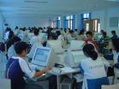
The computer is very popular now.
_____ it ______(use) all over the world now?
Is
used

Slide 45
Vegetables are very important for our health.
Are
eaten
______they ________(eat) by you every day?
aren’t eaten
No, they ____________(not eat) by me every day.

Slide 46
Most of us like watching TV.
_____ it ________ by you last night?
Was
watched

Slide 47
It’s good for us to play basketball.
Do you play it as often as possible?
____ it_______( play) by you as often as possible?
Is
played

Slide 48
被动语态
am/is/are +not
动词的过去分词
一般现在时
否定句结构
一般过去时
was/were+ not
动词的过去分词
一般疑问句将be动词提到句首.

Slide 49
Change the active voice into the passive voice.
Millie didn’t paint this picture.
2. Do people grow rice in China?
.
This picture wasn’t printed by Millie.
Is rice grown in China by people?

Slide 50
Conclusion :
一、主动语态变为被动语态
把主动语态的宾语变为被动语态的主语,用主格把谓语变为被动结构,注意be 的时态和原句要保持一致。把主动语态的主语放在介词by后作宾语，将主格变为宾格。

Slide 51
二、被动句变为主动句的步骤:
1) 找到动作的执行者(常为被动句的宾语)作主动句的主语.
2) 找到be+过去分词结构还原为及物动词原形.
3) 找到动作的承受者(常为被动句的主语)作主动句的宾语.

Slide 52
4) 确定及物动词的时态。数(注意)在以上转换中,代词作主语用主格, 代
词作宾语用宾格.

Slide 53
Change the active voice into the passive voice.
1. Millie painted this picture.
This picture was painted by Millie.
2. He sells coke in a small shop.
Coke is sold in a small shop.
3. People grow rice in China.
Rice is grown in China.

Slide 54
4. He wrote the letter last night.
The letter was written last night.
5. Tom took many beautiful photos.
Many beautiful photos were taken by Tom.

Slide 55
将下面的被动语态句子变为主动语态句子
1. The blackboard was cleaned by him.
He cleaned the blackboard.

Slide 56
2. Jim is helped by me.
3. Many trees were planted by
him last year.
I help Jim.
He planted many trees last year.

Slide 57
把下列句子变成被动语态:
1 Millie printed this picture last week.
2 He sells coke in a small shop.
3 People grow rice in China.
4 He wrote the letter last night.
This picture was printed by Millie last week.
Coke is sold in a small shop.
Rice is grown in China.
The letter was written by him last night.

Slide 58
5 Tom took many beautiful photos in the Summer Palace.
6 My brother didn’t turn on the TV last night.
7 Do they sell the computers in this shop?
Many beautiful photos were taken by Tom in the Summer Palace.
The TV wasn’t turned on by my brother last night.
Are the computer sold in this shop?

Slide 59
8 We connected the keyboard to the computer.
9 Some of us don’t like English.
10 Did your parent look after you in the hospital?
The keyboard was connected to the computer.
English isn’t liked by some of us.
Were you looked after by your parent in the hospital?

Slide 60
选词填空
build eat paint steal
catch grow sell write
1 This picture __________ by Millie.
2 Coke __________ all over the world.
3 Rice ___________ in China.
4 Some money __________from the
bank yesterday.
5 The thieves _________ by the police.
6 This flat _________ in 1996.
7 This newsletter article __________
by Daniel.
8 All the snacks _________ before the
party ended.
was painted
is sold
is grown
was stolen
were caught
was built
was written
were eaten

Slide 61
改错:
1.Cards were played by we yesterday.
__ us
2. The food were eaten up in the morning.
___
was
3. Computers are used for chat with friends.
__
chatting
4. The house was built by you and I in 1990.
______
you and me

