Slide 1
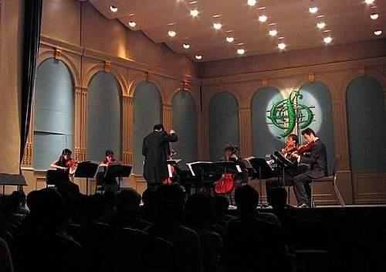
Module 12 Western music
Unit 1 It’s so beautiful!
WWW.PPT818.COM
WWW.PPT818.COM

Slide 2
Review
Words and expressions

Slide 3
Words
lively adj. 活泼的，轻快地
modern adj. 现代的
noisy adj. 吵闹的
pop adj. 流行的，受欢迎的
rock n. 摇滚乐；石头；岩石
sound n. 声音
violin n. 小提琴
Western adj. 西方的
/’l aɪvli/
/’mɒ də n/
/’nɔɪ zi/
/pɒp/
/rɒk/
/saʊ nd/
/,vaɪə’lɪ n/
/’westən/

Slide 4
Words
hmm int. 嗯
by prep. 由……创作；被；由
through prep. 穿过
both pron. 两个；两者
opera n. 歌剧
voice n. 声音
drum n. 鼓
believe v. 相信
/m,hm/
/baɪ /
/θ ru:/
/bəʊ θ/
/’ ɒ pərə/
/vɔɪ s/
/drʌ m/
/bɪ’li:v/

Slide 5
Objectives：
To learn to talk about music with a friend
To understand the dialogue on
Page 72
To learn the key words and useful expressions in the dialogue

Slide 6
Words:
lively, modern, nosy, traditional, pop, rock, sound, violin, opera
Phrases:
the capital of, go through, Beijing opera, a fan of
Patterns:
—Is this by Strauss or Mozart?
—It’s by Strauss.
What a beautiful city!
I’m a fan of rock music.
Give us a break!

Slide 7
Look and Say
Try to point out the type of music for each picture.

Slide 8
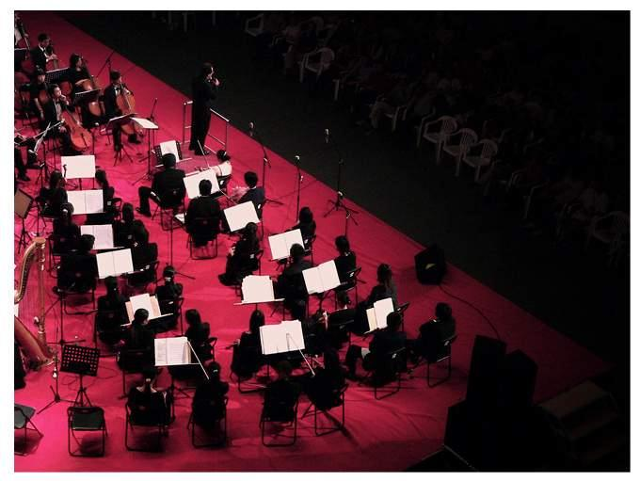
Classical music

Slide 9
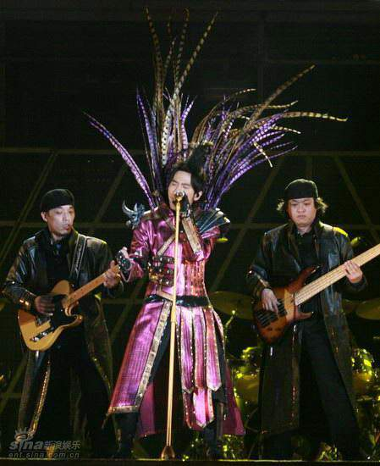
Pop music

Slide 10
Rock

Slide 11
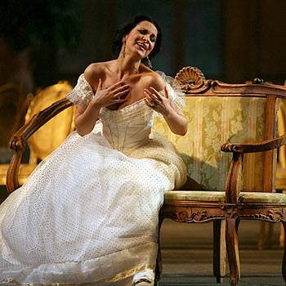
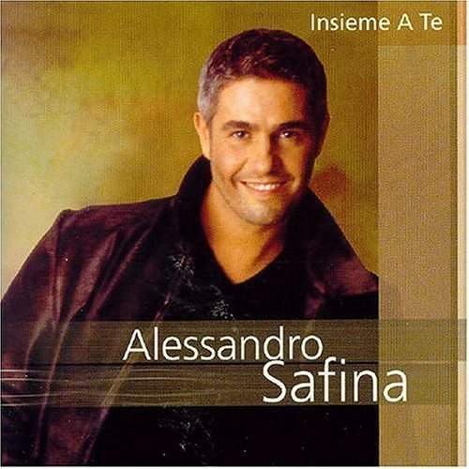
Opera

Slide 12
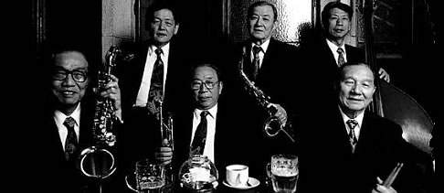
Jazz

Slide 13
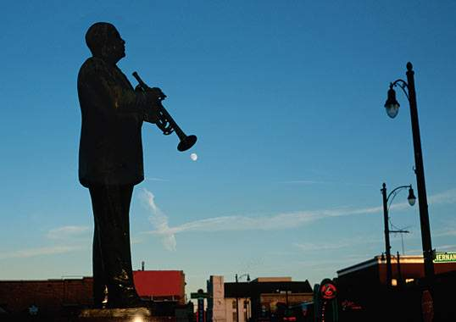
Blues

Slide 14
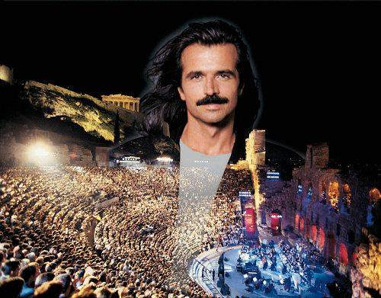
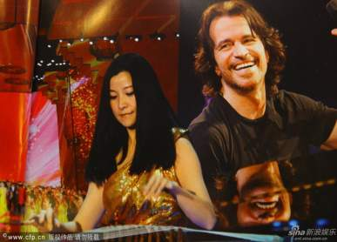
New age

Slide 15
Listen and number the words as you hear them.
1
lively ( ) modern ( ) music ( )
noisy ( ) pop ( ) rock ( )
sound ( ) violin ( ) Western ( )
7
5
1
9
8
6
3
4
2

Slide 16
2
Work in pairs. Answer the questions about the conversation in Activity 1.
Which modern music does Tony like?
2.What does Tony’s mum think about rock music?
He likes pop and rock music.
It’s lively.

Slide 17
3.Why doesn’t Tony like traditional Western music?
4.Which music does Tony’s dad think is too noisy?
Because it’s too slow.
He thinks pop music is too noisy.
Listen again and check.

Slide 18
Language points
Western music, isn’t it?
西方音乐，不是吗？
You listen to pop music, Lingling, don’t you?
你听流行音乐，是吧，玲玲？
The sound is very … different, isn’t it?
这种音乐很不同，不是吗？
以上这些句子中都包含一个反义疑问句。

Slide 19
反意疑问句
1. 含义
在一个陈述句之后附上一个简短的疑问句，对陈述句提出相反的疑问，这种疑问句叫反意疑问句。
如：
1) Lions are scary, aren’t they?
2) We speak Chinese, don’t we?

Slide 20
2. 结构：
结构一: 前肯 + 后否
eg. Lions are scary, aren’t they?
狮子很恐怖，不是吗？
结构二: 前否 + 后肯
eg. Lions aren’t scary, are they?
狮子不恐怖，对吧？

Slide 21
结构一: 前肯 + 后否
Be 动词：
1. You are an actor, __________?
2. He is a good boy, ________?
3. It was fine yesterday, _________?
行为动词：
1. It often rains here, _________?
2. He likes soccer, _________?
3. You have a headache, _________?
4. I called you yesterday, _______?
aren’t you
isn’t he
wasn’t it
doesn’t it
doesn’t he
don’t you
didn’t I

Slide 22
结构二: 前否 + 后肯
1. You aren’t an actor, _________?
2. He isn’t a good boy, ________?
3. It wasn’t fine yesterday, ________?
4. It doesn’t rain here, __________?
5. His sister doesn’t have a headache,
_________?
6. You didn’t call me yesterday,
___________?
are you
is he
was it
does it
does she
did you

Slide 23
3. 在回答反义疑问句时，不管问题的提法如何，若事实是肯定的，就要用yes，事实是否定的，就要用no。这和汉语不一样，应特别注意。例如：
You’re not ready, are you?
你没有准备好，是吧？
Yes, I am. 不，我准备好了。
No, I’m not. 是的，我没有。

Slide 24
Is this by Strauss or Mozart?
是由斯特劳斯还是莫扎特创作的？
by表示“由……作曲”，by短语用作be
动词的表语。by还可根据句子翻译成
“由……写的”“由……演唱”。
I like novels by Lu Xun.
我喜欢鲁迅写的小说。

Slide 25
It goes through Vienna.
它流经维也纳。
through 意为“穿过，经过”，常与pass,
go, walk 等动词连用。
He walked through me without saying
hello to me.
他从我身边经过，但是没和我打招呼。
across, through, over 三者都有“通过，
穿过”之意。区别是：

Slide 26
① across 表示从一定范围的一边到另
一边，与on 有关，表示动作是在某
一物体的表面进行的。
They walk across the road.
他们穿过公路。
② through 表示从中间通过，强调动
作是在里面进行的。
We walk through the forest.
我们穿过森林。

Slide 27
③ over 多指空间范围上通过，
越过或垂直在上，和表面不
接触等。
The birds fly over the city.
鸟儿飞过城市。

Slide 28
Choose the best answer for each sentence.
1 Strauss was not _______, he was _____.
A. Austrian, German
B. German, Austrian
C. Vienna, Finland
2 Vienna is the capital of _____.
A. German B. Austria C. Norway
3 The Danube is the river in ______.
A. London B. Vienna C. Paris

Slide 29
4 Lingling listens to _____ music.
A. jazz B. classical C. pop
5 The Blue Danube is _______ music.
A. pop B. techno C. Western
6 Lingling also likes _____.
A. classical music
B. Beijing Opera
C. rap music

Slide 30
Now check ( ) the true sentences.
√
√
1 They’re listening to Western music.
2 Tony knows little about Strauss.
3 Strauss was born in the capital of
Australia.
4 The Blue Danube is pop music.
5 Lingling enjoys Beijing opera very
much.
√
×
×
√

Slide 31
Check the types of music the students like and don’t like.
4
 | Tony | Lingling | Betty | Daming
traditional Western music
Beijing opera
pop
rock
√
√
√
√
√
√

Slide 32
5
Complete the sentences with the correct form of the words from the box.
believe, both, drum
German, noisy, voice
Strauss wasn’t _________. He came from Austria.
Daming thinks the _______ in rock music are too ________.
German
drums
noisy

Slide 33
3. Tony can’t _________ that Daming
doesn’t like rock music.
4. Betty likes ______ traditional Western
music and pop music.
5. Tony thinks the sound of the ________
in Beijing opera is very different.
believe
both
voice

Slide 34
Complete the sentences about yourself.
6
My favourite music is …
I like it because …
My parents like …

Slide 35
Pronunciation and speaking
分析: 英语有两种基本语调:升调和降调。 说话人可通过语调准确地表达各种信息。 升调多用来表示 “不肯定” 和 “未完结”， 在一般疑问句、委婉的祈使句和打招呼 的用语中。降调表示“肯定”和“完结”， 一般出现在陈述句、祈使句和特殊疑问 句中。感叹句中多用降调表示感叹。

Slide 36
Listen and read.
7
What a beautiful city!
It’s so beautiful!
I love his music!
Listen to this！

Slide 37
Work in pairs. Ask and answer questions about the music you like or don’t like.
8
— What music do you like?
— I like pop. It’s lively and good to
dance to, but I don’t like rock. It’s
too noisy. What
about you?

Slide 38
Dialogue Practice
A: What music do you like?
B: I like classical music. It’s beautiful.
What about you?
A: I like pop. It’s good to dance to.

Slide 39
Dialogue Practice
A: What music do you like?
B: I like Beijing Opera. It’s traditional.
What about you?
A: I like rap. I’m a fan of rap.

Slide 40
Dialogue Practice
A: What music do you like?
B: I like techno music. It’s modern.
What about you?
A: I like rock. It’s noisy but it’s
exciting.

Slide 41
课后回顾
本课时主要句型
What a beautiful city!
I’m a fan of rock music.
Give us a break!
I don’t believe it!
It’s so beautiful!
Is this by Strauss or Mozart?

Slide 42
一、完成下列反意疑问句。
Quiz
1. He is in Class One, _______?
2. You don’t speak English, _______?
3. They have been to China, ___________?
4. Your uncle didn’t return
yesterday, ______?
5. There are ten pandas in the
zoo, ___________?
isn’t he
do you
haven’t they
did he
aren’t there

Slide 43
6. You won’t go to USA, _________?
7. There isn’t a boy in our classroom,
_________?
8. There weren’t many cars in the street,
___________?
9. Don’t smoke, __________?
10. Let’s not do it, _________?
will you
is there
were there
will you
shall we

Slide 44
二、翻译下列词组
Beijing Opera
京剧
奥地利首都
认为，考虑
流行音乐
西方音乐
随着…跳舞
the capital of Austria
think about
pop music
Western Music
dance to

Slide 45
三、根据汉语完成句子。
1. 谁是你最喜欢的古典音乐家?
__________________________________
2. 萨莉不喜欢流行音乐，是吗？
__________________________________
3. 让我们休息一下。
______________
Who’s your favourite classical musician?
Sally doesn’t like pop music, does she?
Give us a break.

Slide 46
4. 你喜欢传统西方音乐还是流行音乐？
_____________________________
_____________________
5. 哪条河穿过上海？
_______________________________
6. 你不喜欢摇滚乐？我不信。
______________________________
______________
Do you like traditional Western music or pop music?
Which river goes through Shanghai?
You don’t like rock music? I don’t believe it!

Slide 47
Preview
1. To preview the passage on Page 74
2. To practise the vocabulary

Slide 48
Homework
Write a short passage about your favourite music or musician.

