Slide 1
Unit 1 Lesson 2
At the Sports Shop
WWW.PPT818.COM

Slide 2
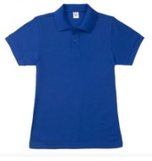
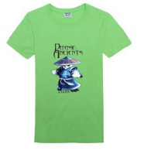
Warm-up
Which T-shirt do you like? The blue one or the green one?

Slide 3
Let’ learn
this
This T-shirt is near.
It looks big.

Slide 4
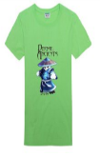
Let’ learn
that
That T-shirt is far.
It looks small.

Slide 5
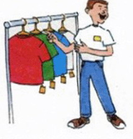
Let’ learn
these
These are T-shirts.

Slide 6
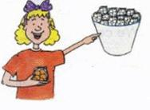
Let’ learn
those
Those are ping-pang balls.

Slide 7
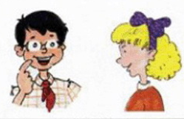
Read and answer
And we need some ping-pong balls.
Let's see, Jenny. I need a T-shirt.

Slide 8
Read and answer
Read the conversation on Page4. Then answer the questions.
Where are Li Ming and Jenny?
At the sports shop.
What does Li Ming need?
A T –shirt.

Slide 9
Read and answer
Read the conversation on Page4. Then answer the questions.
Do they need some ping-pang balls ?
Yes, they do.
Which ping-pang balls do they want, these or those?
They want those.

Slide 10
Listen to the conversations on Page4 again and check the words you hear.
show dollar
or excuse
teacher wear

Slide 11
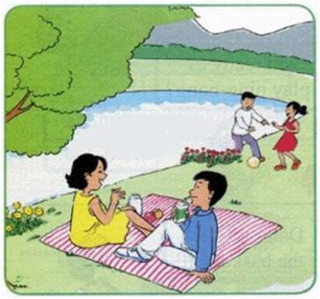
Tick or cross
□ This woman is wearing a yellow dress.
□ That woman is wearing a white dress.
□ This man is wearing a blue shirt.
□ That man is wearing a red sweater.
√
×
√
×

Slide 12
Tick or cross
□ These flowers are yellow.
□ Those flowers are red.
□ These people are talking.
□ Those people are singing.
√
√
√
×

Slide 13
Look and write
Near or far?
This woman is near. That woman is far.
This man is . That man is .
These flowers are . Those flowers are .
near
far
near
far

Slide 14
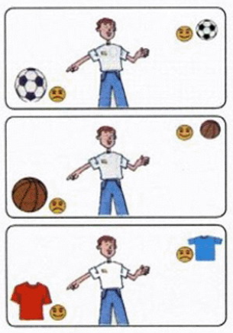
Talk and write
—Do you like this football or that football?
— I like that football.
—Do you like this basketball or that basketball?
— I like that basketball.
—Do you like this T-shirt or that T-shirt?
— I like this T-shirt.

Slide 15
Summary and evaluation
What have you learned in this class?
A excellent B good C adequate D need improvement
内容 | 学生自评 | 小组互评
我能认真听老师讲课，听同学发言
遇到我会回答的问题主动举手了
活动中坚持使用英语来交际
我能积极参与小组讨论活动，能与他人合作。

Slide 16
Homework
1. Recite the conversations on Page4.
2. Go to a shop to buy something using the
sentences learned in class.

