Slide 1
Unit 8 Culture Shapes Us
Supper with the Bradshaws
WWW.PPT818.COM

Slide 2
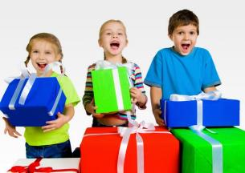
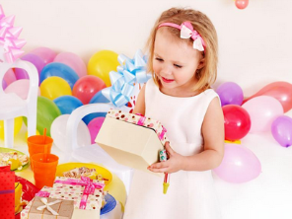
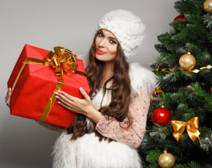
When would you like to receive gifts?
What gifts would you like to get? Why?

Slide 3
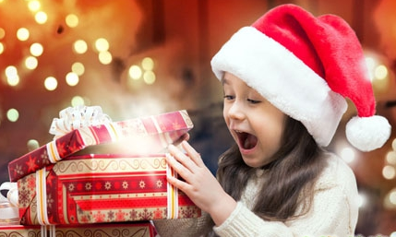
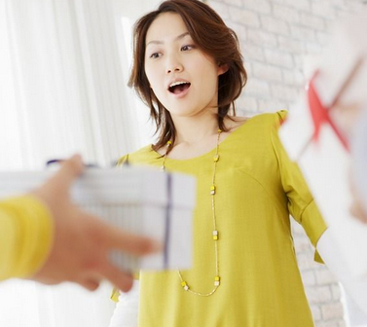
How do you react when you receive a gift you
don’t like?

Slide 4
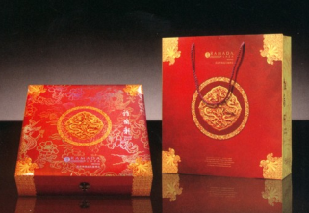
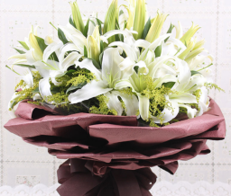
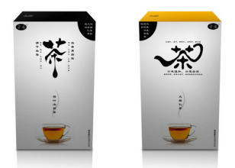
When your family visits another, what do you
usually take as a gift?

Slide 5
New words
chalk n. 粉笔
tradition n. 传统
reaction n. 反应
react v. 反应
officer n. 政府官员
gun n. 枪
doll n. 洋娃娃；玩偶

Slide 6
Read the lesson and write(T) or false(F).
1. Li Ming liked Mr. Bradshaw’s cookies. ( )
2. Li Ming accepted Mr. Bradshaw’s gift although he didn’t like it. ( )
3. Debbie liked the toy gun that Danny gave her as a Christmas gift. ( )
4. Danny is planning another trip to Chinatown. ( )
F
T
F
T

Slide 7
Read the lesson and answer the questions.
①When did Bruce and his father visit Li Ming?
②Why didn’t Li Ming like the cookies that Mr.Bradshaw brought for them?
③Why does Danny love Chinese culture?
④Why did Danny buy a toy gun for Debbie?
⑤Did Debbie hurt Danny’s feelings when she said she wanted a doll?
The day before yesterday.
They tasted like chalk.
Because he think it’s polite and nice.
Because Debbie hopes to become a police officer and wanted a toy gun for Christmas.
Yes.

Slide 8
Read the text and find out main phrases and main sentences.
Main phrase:
·police officer
Main sentences:
·My Australian pen pal,Bruce,and his father,came to visit me the day before yesterday.
·At the end of the meal,Mr.Bradshaw opened a box of cookies he had brought from home.
·We each took a cookie and ate it.
·The cookie tasted like chalk to me!

Slide 9
·But in good Chinese tradition,I told Mr.Bradshaw that I enjoyed it.
·I don’t know what we’ll do with them.
·I am so busy with Christmas these days.
·I couldn’t help but laugh when I read your e-mail.
·Maybe you can send them to me.
·I wish everyone here,especially Debbie,could learn some Chinese manners.
·Debbie dreams of being a police officer.
·She changes her mind so quickly!

Slide 10
☆教材解读☆
1.My Australian pen pal,Bruce,and his father,came to visit me the day before yesterday.
the day before yesterday前天。
【拓展】 yesterday昨天,today今天,tomorrow明天,the day after tomorrow后天

Slide 11
2.At the end of the meal,Mr.Bradshaw opened a box of cookies he had brought from home.
◆at the end of 意为“在……尽头;在……结束时”,既可以指地点,也可以指时间。
【辨析】 at the end of,by the end of
(1)at the end of在……尽头/末端,在……结束时,后面可接地点或时间,后接时间时,通常与一般过去时或一般将来时连用。

Slide 12
(2) 到……为止,仅指时间,指某一动作在某个时间点以前或到某一时间段为止就已发生或完成,多用于过去完成时;若后面接的是将来时间,句子要用将来完成时。
◆句子he had brought from home运用了过去完成时,过去完成时由“had+过去分词”构成,其基本用法包括:
(1)表示在过去某一时间或某一动作之前已经完成了的动作或状态,动作发生的时间是“过去的过去”。
(2)表示从较远的过去的某一时间开始一直延续到较近的过去的某一时间的动作或状态,往往与for或since连用。

Slide 13
3.We each took a cookie and ate it.
each在本句中作We的同位语,此时谓语动词要与We保持一致。
【拓展】 (1)each单独作主语,谓语动词用单数形式。
(2)each of短语作主语,谓语动词用单数或复数形式都可以。
4.The cookie tasted like chalk to me!
本句中的taste用作系动词,意为“尝起来”,后面可接形容词。taste like意为“尝起来像”。
【拓展】 常用的系动词还有:look(看起来),
feel(摸起来),smell(闻起来),sound(听起来)等。

Slide 14
5.But in good Chinese tradition,I told Mr.Bradshaw that I enjoyed it.
in good tradition意为“按照优良传统”。
6.I don’t know what we’ll do with them.
do with与what连用时,意为“对待;处理;利用”。
【拓展】 (1)do with与can或could连用时,意为“想要;需要”。
(2)do with在否定句中,意为“容忍,忍受”。
【注意】 deal with与how连用时,意为“处理;处置”。

Slide 15
7.I am so busy with Christmas these days.
busy为形容词,意为“忙碌的”。be busy with sth.意为“忙于某事”,with后要接名词或代词;be busy doing sth.意为“忙于做某事”,be busy后面接动词时要用v.-ing形式。
8.I couldn’t help but laugh when I read your e-mail.
can’t help but意为“不得不;不会不,必然”,后接动词原形。

Slide 16
9.Maybe you can send them to me.
maybe为副词,意为“也许”。
【辨析】 maybe,may be
(1)maybe为副词,意为“也许,可能”,相当于perhaps,常位于句首。
(2)may be为“情态动词may+动词原形be”构成,意为“也许是,可能是”,在句中作谓语,与主语形成系表结构。

Slide 17
10.I wish everyone here,especially Debbie,
could learn some Chinese manners.
当wish是一般现在时的时候,后面的宾语从句可使用一般过去时,这是虚拟语气,用来表达某种愿望。
11.Debbie dreams of being a police officer.
◆dream of 意为“梦见,梦想,渴望”。
◆police officer意为“警察,警官”。
12.She changes her mind so quickly!
change one’s mind意为“改变某人的主意”。 【拓展】 (1)固定短语:make up one’s mind下定决心,做出决定;keep…in mind记住……。 (2)mind为动词,意为“介意”时,常用于疑问句、否定句或条件句中,其后跟名词或动名词作宾语,不能跟不定式。

Slide 18
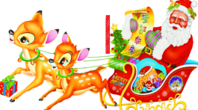
Let’s do a quick quiz!
1.Where does Santa Claus live?
2.Santa rides in a sleigh.What animals pull his sleigh?
3.Children believe that Santa visits them on Christmas Eve.How does he get into their houses?
It is said that Santa Claus lives at the North Pole.
Reindeer pull Santa’s sleigh.
Santa comes down the chimney.When he leaves,he goes up the chimney.

Slide 19
Ⅰ.Complete the passage with the correct forms of the words in the box.
officer gun praise catch react
There was a robbery yesterday afternoon.Two men rushed into the City Bank with in their hands.All the people were scared except a smart clerk.She quickly and pushed the alarm immediately.Soon the robbers __________ by the police .Luckily,there was no loss or injuries.This clerk by the mayor.
guns
reacted
were caught
officers
was praised

Slide 20
Ⅱ.Choose the correct answers.
1.When I heard what he said,I couldn’t help .
A.laugh B.to laugh
C.laughing D.laughed
2.— did you do with the old magazines and newspapers?
—I donated them to a primary school.
A.How B.What C.Where D.Why
C
B

Slide 21
3. the road you can see a tall building.
A.By the end of B.In the end
C.At the end of D.On the end of
4.The e-mail is very popular today. People seldom write letters now, ?
A.did they B.do they
C.didn’t they D.don’t they
5.This kind of peach looks really nice,but it
very sour.
A.tastes B.looks
C.feels D.sounds
C
B
A

Slide 22
Ⅲ.Rewrite the following sentences as required.
6.I don’t know what I can do.(改为简单句)
I don’t know what .
7.We can’t help telling him the truth.(同义句转换)
We can’t him the truth.
8.Jack is busy doing his homework.(同义句转换)
Jack his homework.
9.I was a little hurt,but I still enjoyed Christmas very much.(同义句转换)
I was a little hurt,I still enjoyed Christmas very much.
10.I don’t know what we’ll do with them.(同义句转换)
I don’t know we’ll them.
to do
help but tell
is busy with
Though/Although
how deal with

Slide 23
Homework
1.Finish off the remaining exercises in the activity book.
2.Finish off the exercises in Unit Review.

