Slide 1
Unit 5 Languages Around The World
Section B Reading and Thinking
WWW.PPT818.COM

Slide 2
Ⅰ
Ⅱ
Ⅲ
Ⅰ.知识体系图解
civilisation
despite
factor
base
symbol
carve
variety
major
means
classic
regard
character
appreciate
affair
specific

Slide 3
Ⅰ
Ⅱ
Ⅲ
浮沉;兴衰;荣辱
以……为根据
追溯到
把……看作
一开始
发展成
导致
非常重要
与……连接
在……中起作用
在现代
和……一起

Slide 4
Ⅰ
Ⅱ
Ⅲ
Ⅱ.释义匹配
1.Civilisation A.one of several things that influence or cause a situation
2.factor B.a sign,shape or object which is used to represent something else
3.symbol C.relating to one thing and not others;particular
4.dialect D.a society that is well organised and developed
5.specific E.a form of a language which is spoken only in one area
答案:1.D 2.A 3.B 4.E 5.C

Slide 5
Ⅰ
Ⅱ
Ⅲ
Ⅲ.阅读导学
根据P62课文内容,选择正确答案。
1.What does the word “this” in the first paragraph most probably mean?
A.How the Chinese writing system was created.
B.What China has experienced in history.
C.Chinese ancient civilisation has gone through into modern times.
D.The Chinese writing system is known all over the world.
答案:C

Slide 6
Ⅰ
Ⅱ
Ⅲ
2.The ancient Chinese recorded what they had done by .
A.drawing pictures on walls
B.carving symbols in bones and shells
C.writing their experiences on Xuan paper
D.writing Hanzi on bones and shells
3.Why did many dialects and characters appear in the Shang Dynasty?
A.The Shang Dynasty was too long a time in history.
B.People at that time had different opinions on writing.
C.The country was divided in several different states.
D.People from different states seldom communicated with each other.
答案:B
答案:C

Slide 7
Ⅰ
Ⅱ
Ⅲ
4.What can we infer from the text?
A.Qinshihuang made great contributions to the Chinese writing system.
B.People in China can understand each other no matter what dialect they speak.
C.The Chinese writing system began to develop in several directions in the Qin Dynasty.
D.Chinese calligraphy was well known all over the world in ancient times.
答案:A

Slide 8
重点词汇
重点句式
随堂练习
1.base vt.以……为据点;以……为基础 n.底部;根据
【课文原句】At the beginning,written Chinese was a picture-based language.
一开始,书面汉语是一种以图画为基础的语言。
【词汇精讲】句中的base是及物动词,意为“以……为基础”。
Please do remember that success is based on hard work.
请一定要记住,成功基于艰苦的努力。
He used the house as a base for his printing business.
他把这座房子用作印刷业的基地。

Slide 9
重点词汇
重点句式
随堂练习
【词汇拓展】
You shouldn’t have based your report on inaccurate information.
你不应该把你的报告基于不准确的信息。
The study was based on data from 2,100 college students.
这项研究基于从2,100名大学生那里收集来的数据。
Although he was based in Wales,distance didn’t matter.
虽然他以威尔士为基地,但距离不是问题。

Slide 10
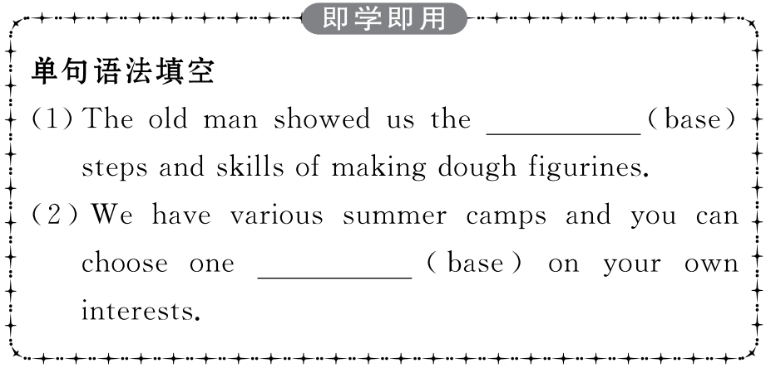
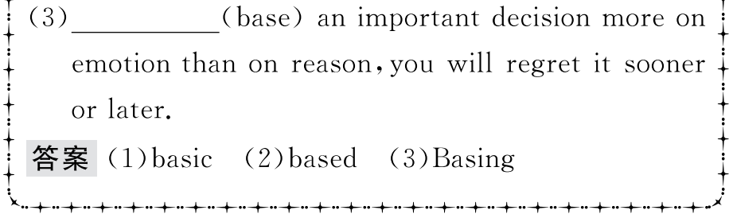
重点词汇
重点句式
随堂练习

Slide 11
重点词汇
重点句式
随堂练习
2.date back to追溯到……;始于……
【课文原句】It dates back several thousand years to the use of Longgu...
它可以追溯到几千年前的龙骨的使用……
【词汇精讲】句中的date back to相当于date from,意为“追溯到……;始于……”,一般无进行时态和被动语态。
The old town dates back to the late seventeenth century.
这个古老的城镇始于十七世纪末。
My interest in stamp collecting dates from/back to my school days.
我从学生时代就开始爱好集邮。
In China acupuncture dates back to ancient times.
在中国,针灸疗法可以追溯到古代。

Slide 12
重点词汇
重点句式
随堂练习
date back to/date from做后置定语时,用动词-ing形式。
There is a wooden tower dating back to the Qing Dynasty in the village.
村子里有一座清朝的木塔。
The South Lake Park in Changchun,dating back to 1933,is located in the southwestern part of the city.
长春南湖公园始于1933年,位于城市的西南部。
【词汇拓展】

Slide 13
重点词汇
重点句式
随堂练习

Slide 14
重点词汇
重点句式
随堂练习
3.major adj. 主要的;重要的;大的 vi. 主修;专门研究 n.主修课程;主修学生
【课文原句】Emperor Qinshihuang united the seven major states into one unified country where the Chinese writing system began to develop in one direction.
秦始皇将七大国统一为一个统一的国家,中国的书写制度开始朝一个方向发展。
【词汇精讲】句中的major是形容词,意为“主要的”,做定语修饰states。
There is a major problem with parking in London.
在伦敦,停车是一个大问题。
I think that is one of the major factors in his success.
我认为那是他成功的主要因素之一。

Slide 15
重点词汇
重点句式
随堂练习
【词汇拓展】
I’ve made up my mind to major in English after I finish middle school.
我决定中学毕业后主修英语。
My best friend,Tom,is a physics major.
我最好的朋友,汤姆,是专攻物理的学生。
It is not their interest but the need of the market that affects students’ choices of college majors.
不是他们的兴趣而是市场需求影响着大学生的专业选择。

Slide 16
重点词汇
重点句式
随堂练习
“the majority of+复数名词”用作主语时,谓语动词常用复数;“the majority of+不可数名词”用作主语时,谓语动词用单数;“a majority of+复数名词”用作主语时,谓语动词通常用复数。

Slide 17
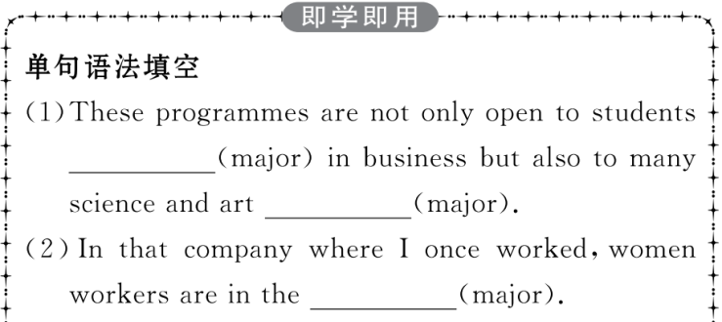
重点词汇
重点句式
随堂练习

Slide 18
重点词汇
重点句式
随堂练习
4.means n.方式;方法;途径
【课文原句】Written Chinese has also become an important means by which China’s present is connected with its past.
书面汉语也成为中国现在与过去联系的重要手段。
【词汇精讲】句中的means意为“方法;途径”,其单复数形式相同。
For most people,the car is still their main means of transport.
对大多数人来说,汽车仍是主要的交通方式。
The cellphone is more than a means of communication.
手机不仅仅是一种通信工具。

Slide 19
重点词汇
重点句式
随堂练习
【词汇拓展】
Students build up their vocabularies by means of reading.
学生通过阅读的方法增加词汇量。
We can carry out the new project by this means.
我们可以用这种办法来实施新计划。
means是单复数同形的名词,其谓语动词的数要根据means前的修饰语来决定。

Slide 20
重点词汇
重点句式
随堂练习

Slide 21
重点词汇
重点句式
随堂练习
5.regard n. 尊重;关注 vt. 把……视为;看待
【课文原句】The high regard for the Chinese writing system can be seen in the development of Chinese characters as an art form,known as Chinese calligraphy,which has become an important part of Chinese culture.
对汉字书写体系的高度重视可以从汉字作为一种艺术形式(被称为中国书法)的发展可以看出,它成为中国文化的重要组成部分。

Slide 22
重点词汇
重点句式
随堂练习
【词汇精讲】句中的regard是名词,意为“尊重;关注”。
My roommate shows little regard for others.
我的室友很少关心别人。
【词汇拓展】
We all have high regard for our English teacher.
我们都非常尊敬英语老师。
Lincoln is regarded as one of the most inspiring figures in the world.
林肯被认为是世界上最鼓舞人心的人物之一。

Slide 23
重点词汇
重点句式
随堂练习
①regard表示“关心”“关怀”等,是不可数名词;表示“尊重”“赞赏”,也是不可数名词,但有时可与不定冠词连用。
He is a warm-hearted man and always shows regard for the poor.
他是个热心人,总是关注穷人。
②regard表示“问候”,要用复数形式。如:
Please give him my (best)regards.请代我向他问好。

Slide 24
重点词汇
重点句式
随堂练习

Slide 25
重点词汇
重点句式
随堂练习
6.appreciate vt. 欣赏;重视;感激;领会 vi. 增值
【课文原句】As China plays a greater role in global affairs,an increasing number of international students are beginning to appreciate China’s culture and history through this amazing language.
随着中国在全球事务中发挥越来越大的作用,越来越多的国际学生开始通过这种令人惊叹的语言来欣赏中国的文化和历史。

Slide 26
重点词汇
重点句式
随堂练习
【词汇精讲】句中的appreciate是及物动词,意为“欣赏”。
You can’t appreciate English poetry unless you understand its rhythm.
你若不懂英文诗的韵律,就不能欣赏英文诗。
He did not fully appreciate the significance of signing the contract.
他没有重视签订合同的重要性。
Thanks so much for your help;I really appreciate it.
非常感谢你的帮助,我真的很感激。
It is difficult to appreciate how bad the situation had become.
很难理解现在的情况有多糟糕。

Slide 27
重点词汇
重点句式
随堂练习
【词汇拓展】appreciation n.欣赏;感激
①appreciate表示“感激;赞赏”时,通常为及物动词,其后可接名(代)词、动词-ing形式、名词性从句等做宾语,但不能接不定式。
②当appreciate后接宾语从句时,一般先加it,再接宾语从句。类似的词还有hate,dislike,love,like,depend/rely on等。
I appreciate your giving me so much of your time.
真感激你为我花了这么多时间。
I would greatly appreciate it if you could give me a hand.
如果你能帮我一下,我将非常感激。
I like it when my father tells us stories.
我很喜欢爸爸给我们讲故事听。

Slide 28
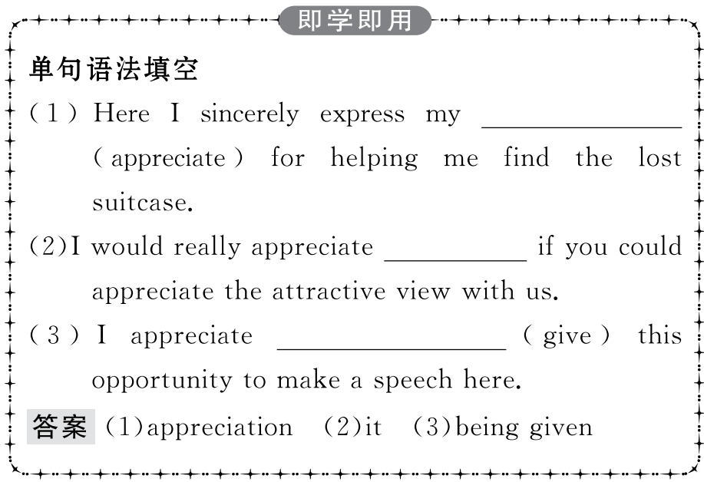
重点词汇
重点句式
随堂练习

Slide 29
重点词汇
重点句式
随堂练习
Even today,no matter where Chinese people live or what dialect they speak,they can all still communicate in writing.
即使在今天,不论住在哪里,也不论说何种方言,中国人仍能通过书写(文字)进行交流。

Slide 30
重点词汇
重点句式
随堂练习
【句式剖析】
本句是一个复合句。no matter where...or what dialect...引导的是让步状语从句,主句是they can all still...。“no matter+疑问词”结构引导让步状语从句时,可以和“疑问词+ever”互换。
No matter where you work,you can always find time to study.
不管你在哪里工作,你都能找到时间学习。
No matter what happens,I’ll always stand by you.
不论发生什么事,我都永远支持你.
I ensure I’ll help you no matter when you have difficulties.
=I ensure I’ll help you whenever you have difficulties.
我保证无论何时只要你有困难,我就帮你。
No matter what you do,you must put your heart into it.
=Whatever you do,you must put your heart into it.
无论你做什么,你必须全身心地投入。

Slide 31
重点词汇
重点句式
随堂练习
whatever,whichever,who(m)ever既可引导让步状语从句,又可引导名词性从句,no matter what,no matter which,no matter who(m)只引导让步状语从句。
Please give the flowers to whoever gets to the finish line first.
请把花给第一个到达终点的人。

Slide 32
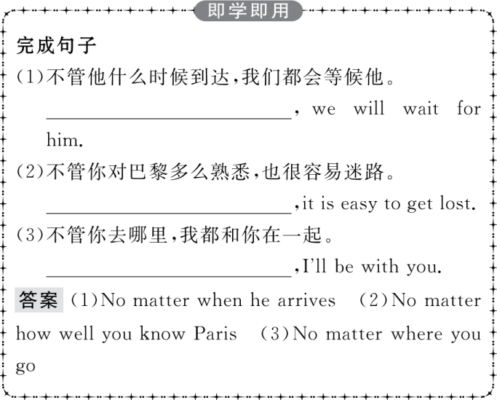
重点词汇
重点句式
随堂练习

Slide 33
重点词汇
重点句式
随堂练习
Ⅰ.介(副)词填空
1.Business English has gradually developed an important practical style.
答案:into
2. the bad weather,they still went on climbing the mountain.
答案:Despite
3.This great event is a milestone the development of Sino-Russian relations.
答案:in
4.Prof.Jackson plays an important role the scientific world.
答案:in

Slide 34
重点词汇
重点句式
随堂练习
Ⅱ.概要写作
根据教材P62的语篇内容写一篇60词左右的内容概要。
参考范文
The Chinese writing system plays an important role in the ancient civilisation.(要点1) At first,people carved symbols on bones and shells which developed into different forms.(要点2) It was Emperor Qinshihuang that enabled the writing system to develop in one direction.(要点3) Written Chinese serves as a bridge for modern people to know about the past and the Chinese writing system is appreciated by people all over the world.(要点4)

