Slide 1
Unit 3 Topic 1
What’s your hobby?
Section A
WWW.PPT818.COM

Slide 2
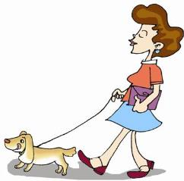
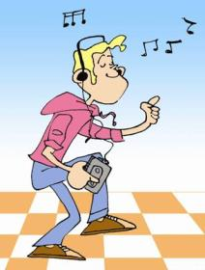
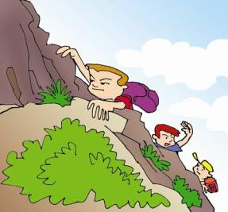

What’s your hobby ?
collect stamps
climb mountains
walk a pet dog
listen to music

Slide 3

He loves fishing.

Slide 4
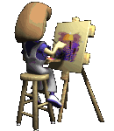
She likes painting.

Slide 5
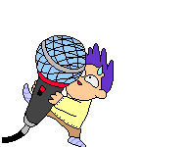
He prefers singing.

Slide 6

He is interested in running.

Slide 7

She is fond of speaking English.

Slide 8
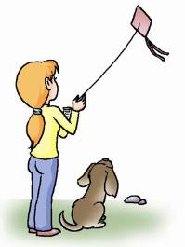
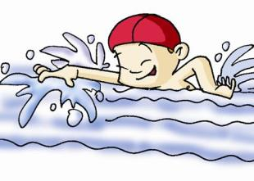
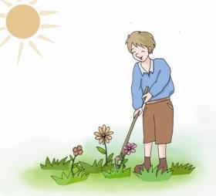
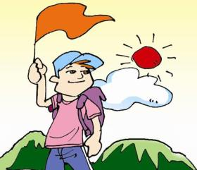
go swimming
fly kites
plant flowers
go hiking

Slide 9

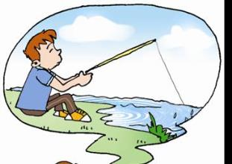
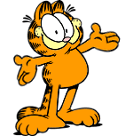
What do you often do in your free time?
I often go fishing.

Slide 10
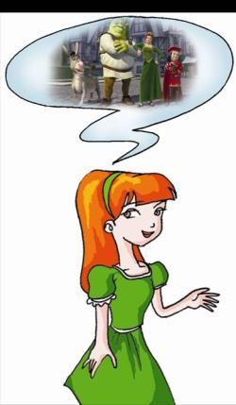
Helen likes watching movies. She is a movie fan.

Slide 11
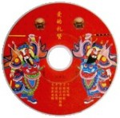
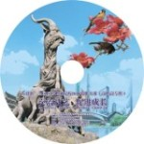
DVDs

Slide 12

Why not go out and do some outdoor activities?
Maybe I need a change.

Slide 13
喜欢做某事：
like
love
enjoy
prefer
be interested in
be fond of
+doing sth

Slide 14

1a Listen, look and say.
Helen: What do you often do in your
free time?
Wen Wei: I often go fishing. It’s my favorite hobby. And I also enjoy reading stories and listening to music. It’s great fun. Well, what’s your hobby?
Helen: I love reciting poems. And I’m a movie
fan, too. I go to the movie theater a lot. I also rent DVDs and watch them at home.

Slide 15
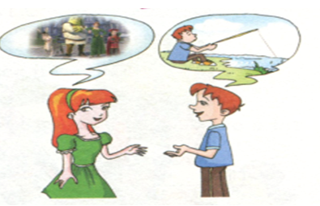
Wen Wei: Why not go out and do some outdoor
activities?
Helen: Sounds good! Maybe I need a change.

Slide 16

1b
Listen to 1a and choose the correct answer.
What are Helen and Wen Wei talking
about ?
Going to the movie theater.
Their hobbies.
Outdoor activities.
★

Slide 17

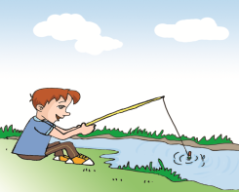

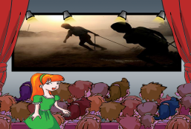
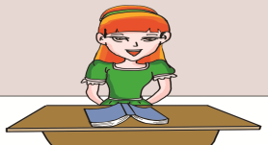
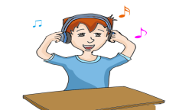
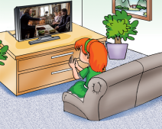
1c
Listen again, then write H for Helen’s hobbies and W for Wen Wei’s . Then write the phrase for each picture.
W
H
W
enjoy reading stories
go to the movie theater
go fishing
H
W
H
love reciting poems
enjoy listening to music
watch DVDs at home

Slide 18
1d
Read 1a and fill in the blanks.
Helen and Wen Wei are talking about their hobbies. Wen Wei enjoys ______, reading stories and _______ to music. He gets great ____ from these activities. Helen enjoys _________ poems and _________ movies. She goes to the movie ________ a lot and also _______ DVDs and watches them at home.
fishing
listening
fun
reciting
watching
theater
rents

Slide 19
Key points
What do you often do in your free time ?
在你的空闲时间你经常干什么？
in one’s free time
Eg: 我爸爸在空闲时间去打篮球。
My father goes to play basketball
___________________________ .
我经常在空闲时间去旅游。
I often go traveling
____________________________.
= in one’s spare time
in his free time/in his spare time
in my free time/in my spare time

Slide 20
2. And I enjoy reading stories and listening to music.
I love reciting poems.
enjoy doing sth. 喜欢做某事
love doing sth. 喜欢做某事
Eg: 我喜欢唱歌，我妹妹喜欢跳舞。
I ____________ and my sister
___________ .
do some outdoor activities
enjoy singing
loves dancing
做些户外活动

Slide 21
4. Maybe I need a change .
也许我需要改变一下。
change （名词）改变 ；零钱
eg: Here’ s your change.
给你的零钱。
北京发生了很大的变化。
Great changes took place in Beijing.

Slide 22



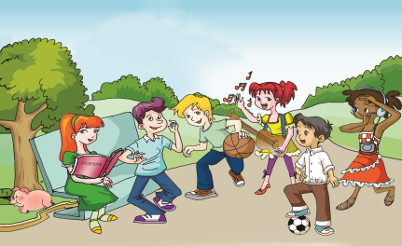
2
Look at the picture. Then listen and complete the sentences.
singing
I love _______and
playing the guitar.
2. I am interested in
_______________.
playing basketball
dancing
3. I enjoy _______ to
music.
4. I like
________.
Collecting different expressions with similar meanings will help you in your talking and writing.
sleeping
5. I like ______ poems.
reciting
acting
prefer
6. I am fond of______.
7. I ______ playing soccer.

Slide 23



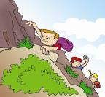
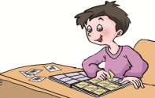
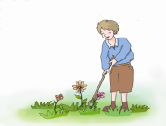
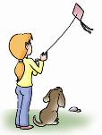


3a
Match the pictures with the phrases. Then listen to the sentences and number the pictures.
A
7
B
3
E
1
C
5
D
2
G
8
H
6
F
4
A. walk a pet dog B. listen to music C. collect stamps
D. plant flowers E. climb mountains F. fly kites
G. go traveling H. go swimming

Slide 24
Hobbies
collect stamps
climb mountains
walk a pet dog
listen to music

Slide 25



3b
Work in pairs
Talk about your hobbies in pairs with the following sentence patterns.
What’s your hobby?
I love/enjoy/like/prefer/am interested in/am fond of …

Slide 26
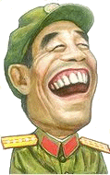
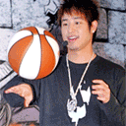
I like laughing.
I am fond of playing basketball.

Slide 27


I enjoy dancing very much.
I prefer singing songs.

Slide 28

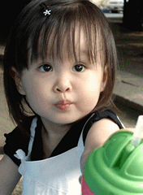
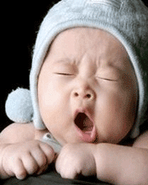
I am interested in having delicious food.
I like sleeping best.

Slide 29

Do the exercises .
Choose the best answer.
1. Zhao Yang is ____ in playing soccer. He thinks it is _____.
A. interested ; interested
B. interested ; interesting
C. interesting ; interesting
D. interesting ; interested
2. She is fond of _______ . She cooks for her family
every day.
A. cook B. cooking C. to cook D. cooks

Slide 30
A
3. Do you enjoy ___ football? I hear there will be a football game tomorrow.
A. playing B. play
C. played D. to play
A
4. The book is_____. Most of the teachers are _____ in it.
A. interesting, interested
B. interesting, interesting
C. interested, interesting
D. interested, interested

Slide 31
5. He used to ___ for school, but now he gets used to ___ school on time.
A. be late, get to
B. being late, get to
C. be late, getting to
D. being late, getting to
C

Slide 32

Summary
I can use:
喜欢做……
… love doing …
… like doing …
… enjoy doing …
… be fond of doing …
… be interested in doing …

Slide 33
Summary
I can say:
Why not go out and do some outdoor activities?
Maybe I need a change.
I can understand :
hobby, in one’s spare time

Slide 34
Homework
Read and recite 1a.
Make sentences with the
words and phrases of 2.
3. Preview Section B.

