Slide 1
Unit 1
Dream homes
Reading
WWW.PPT818.COM

Slide 2
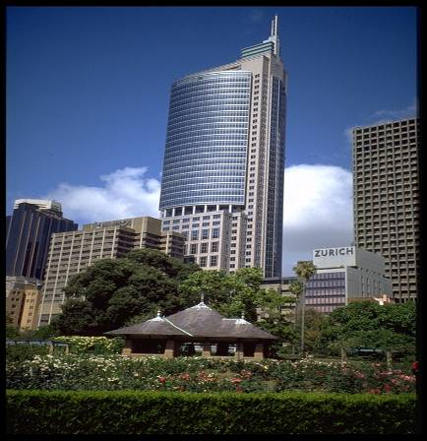
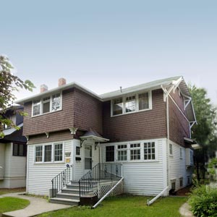
Where would you like to live?
flat
house

Slide 3
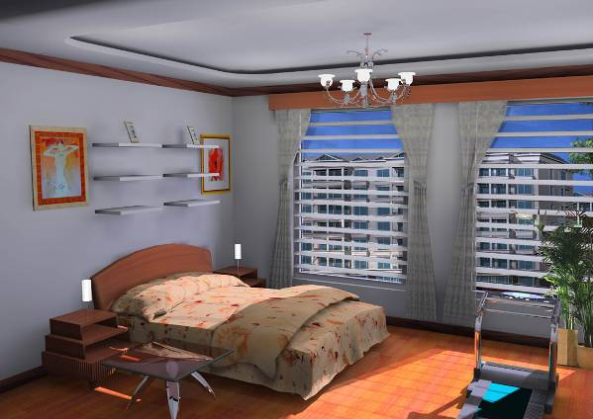
Dream home
bedroom
卧室
share
合用，分享
I share a bedroom with my sister.

Slide 4
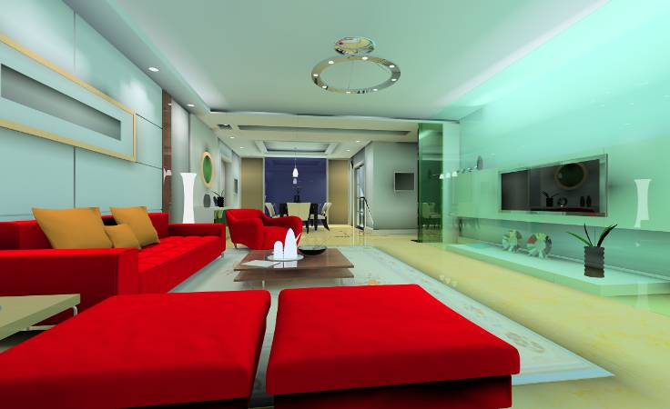
living room 起居室
We often watch TV in the living room.

Slide 5
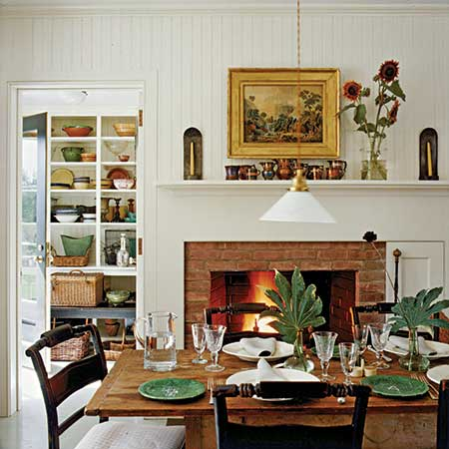
dining room
餐厅
A dining room is the best place to have meals.

Slide 6
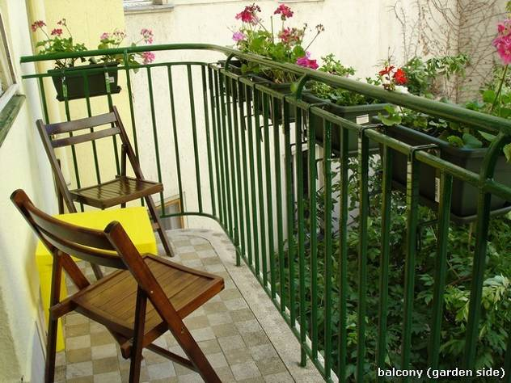
balcony
阳台
I can chat with my friends on the balcony.

Slide 7
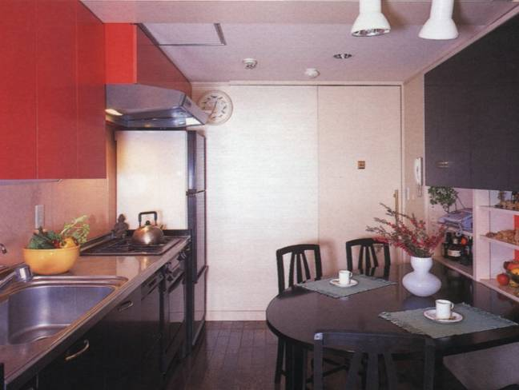
cook 烹调
厨师
kitchen
厨房
I can cook in the kitchen.

Slide 8

Listen and
answer

Slide 9
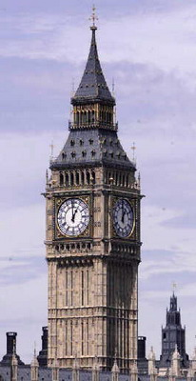
Neil
Where is Neil from?
What is his favourite room?
A town 15 miles from London.
Kitchen.

Slide 10

Anna
Where does she live?
2. What does she like to do after dinner?
3. Does she have her own bedroom?
She lives in the centre of Moscow.
She likes to watch TV and chat in the living room.
No, she doesn’t. She share it with her sister.

Slide 11
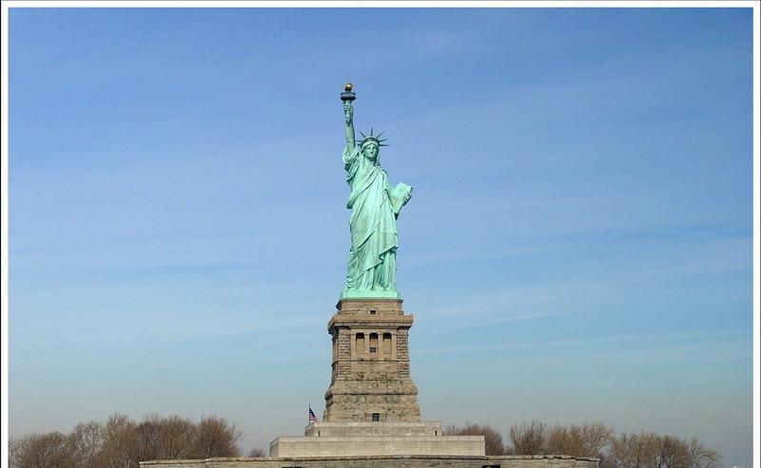
Stephen
Where is he from?
Which is his favourite place? Why?
Los Angeles, the USA.
His favorite place is the balcony. He loves to sit there and look out at the beach and the sea.

Slide 12
True or false
F
( ) 1. Neil lives in the centre of London.
( ) 2. Neil always have fun with his cat in the garden.
( ) 3. Anna and her family often watch TV and chat in their kitchen.
F
F

Slide 13
True or false
T
( ) 4. Anna does not have her own bedroom.
( ) 5. There are eight rooms in Stephen’s house.
( ) 6. Stephen lives near the sea.
T
T

Slide 14
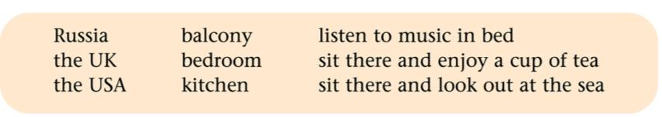
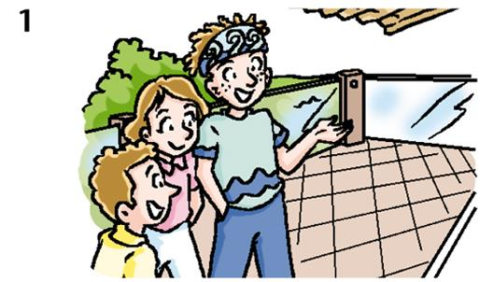
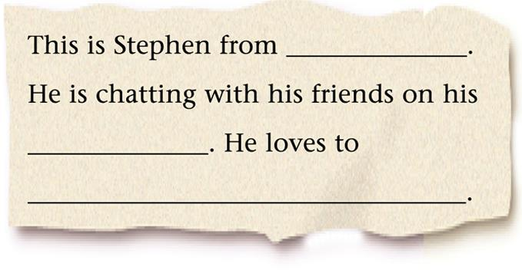
the USA
balcony
sit there and look out at the sea

Slide 15
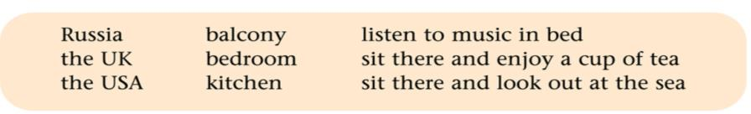
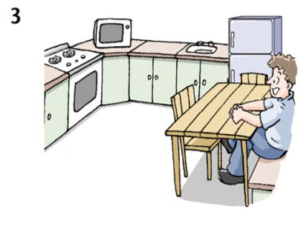
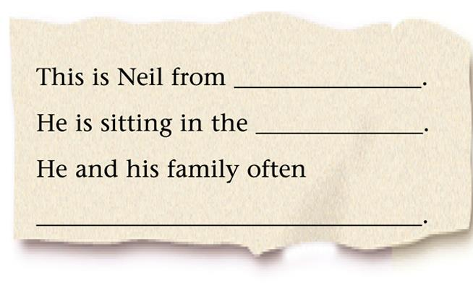
the USA
kitchen
sit there and enjoy a cup of tea

Slide 16
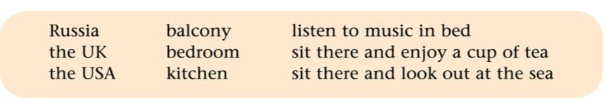
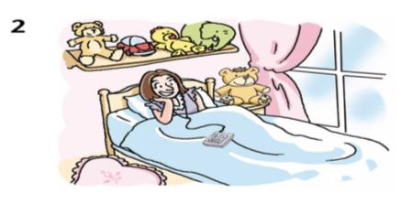
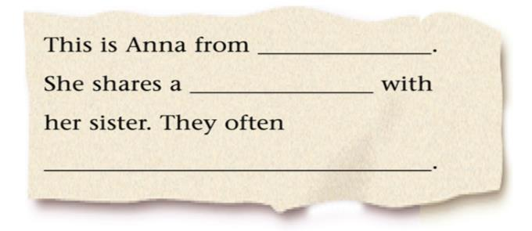
flat
Russia
bedroom
listen to music in bed

Slide 17



1. Read the text correctly and
fluently.
2. Make some sentences with
new words and expressions.

Slide 18


