Slide 1
Unit 3
Could you please clean your room?
R 八年级下册
第3课时
WWW.PPT818.COM

Slide 2
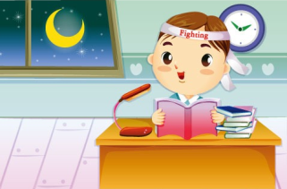
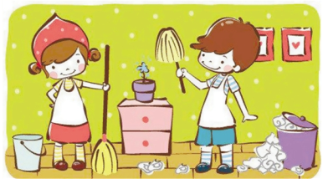
Lead-in
What do your parents ask you to do?
study hard
do chores

Slide 3
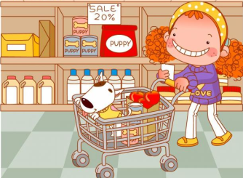
go to the store
/supermarket to buy things for them

Slide 4
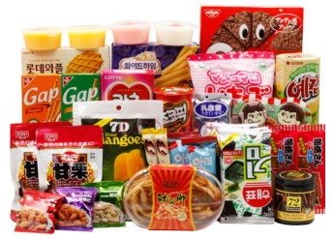
What do you ask your parents’ permission for?
buy drinks and snacks

Slide 5
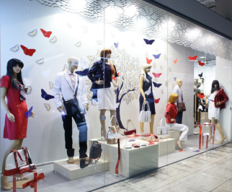
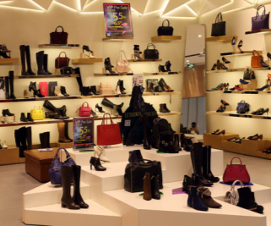
buy new clothes and shoes

Slide 6
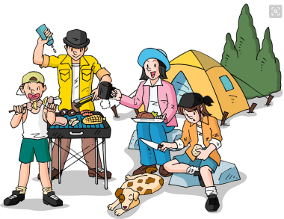
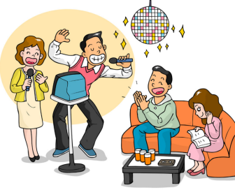
go out with friends

Slide 7
What do teenagers ask their parents’ permission for? What do parents ask their teenagers to do? Write parents or teenagers next to each phrase.
1a
1. buy some drinks and snacks
2. borrow some money
3. clean your room
teenagers
teenagers
parents

Slide 8
______________________ 4. invite my friends to a party
______________________ 5. go to the store
______________________ 6. use your CD player
______________________ 7. take out the rubbish
______________________ 8. make your bed
teenagers
Teenagers/ parents
teenagers
parents
parents

Slide 9
1b
Use the phrases in 1a to make conversations.
Parent:Could you clean your room?
Child: Yes, I can.
Child: Could I invite my friends to a party?
Parent: No, you can’t have a party. You have
a test on Monday.

Slide 10
Could you make your bed?
Yes, I can.

Slide 11
Could I use your CD player?
No, you can’t. I’ll use it.

Slide 12
Language points
Could I invite my friends to a party?
invite用作及物动词，意为“邀请；招待”.
常用结构:invite sb. to some place邀请某人去某地；
invite sb. to do sth.邀请某人做某事。
她邀请我们参加她的生日聚会。
She invited us to her birthday party.

Slide 13
Listen to a conversation between Sandy and her mom. Check (√) the things in 1a that you hear.
1c
1. buy some drinks and snacks
2. borrow some money
3. clean your room
4. invite my friends to a party
___ 5. go to the store
6. use your CD player
7. take out the rubbish
8. make your bed

Slide 14
1d
Listen again. Fill in the chart.
 | What are they going to do?
Sandy’s mom
Sandy | invite her friends
Sandy and Dave
go to the store
buy drinks and snacks
clean her room
use her mom’s CD player
move the big chairs to the bedroom
clean the living room

Slide 15
You are having a party. Ask your partner for help with these things:
1e
go to the store buy drinks and snacks
do the dishes clean the living room
take out the rubbish

Slide 16
Could you please take out the rubbish?
Yes, sure.

Slide 17
Could you please do the dishes?
Yes, I’d love to.

Slide 18
Exercise
1. 我能和我朋友外出吃晚饭吗？
Could I __________________ with my friends?
2. 看完电影后我们能买点喝的吗？
Could we _____________________ after the movie?
3. 你能带狗去散散步吗？
Could you please _____________________?
4. 你能倒垃圾吗？_________________________________?
5. 可以，但我想先看一个节目。
OK, but I _____________ one show first.
go out for dinner
get something to drink
take the dog for a walk
Could you please take out the rubbish
want to watch

Slide 19
( ) 1. —Could you please help me choose an MP4 on line?
—_______. My computer doesn’t work.
A.I think so B. I hope so
C. I’m afraid I can’t D. I don’t agree
( ) 2.—Could I read your new magazine, dad?
— _________. I’m reading it.
A. Yes, you could B. Sorry, you can’t
C. Yes, sure D. No, please
C
B

Slide 20
( ) 3. I can ___ my bed and ___ my clothes.
A. make; fold B. make; do
C. fold; do D. fold; wash
( ) 4. —I don’t like doing chores. —_____.
A. So do I B. Neither did I
C. Neither do I D. Neither I do
( ) 5. —Are your parents teachers?
—No, ___. They are both office workers.
A. both B. either C. neither D. none
A
C
C

