Slide 1
Unit1
What’s your favourite season?
WWW.PPT818.COM

Slide 2
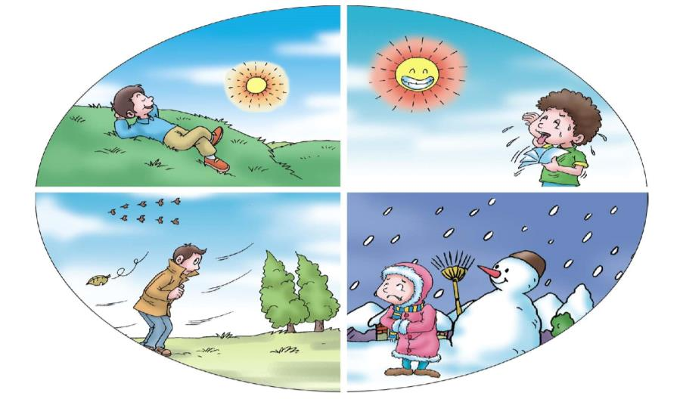
How many seasons are there in a year?
There are four.
summer
spring
autumn
winter

Slide 3
Let’s guess

Slide 4
1、根据中文意思写出英语。
go skiing plant flowers play outdoors
去滑雪 种花 去户外玩
look at… in the trees really love fly a kite
看…… 在树上 确实喜欢 放风筝
make a snowman like swimming
堆雪人 喜欢游泳

Slide 5
1、We can ( )in winter.
2、We can ( )in summer.
3、We can ( )in spring.
4、We can ( )in autumn.

Slide 6
4、根据实际情况回答问题。
1、What’s your favourite season？
answer:spring(summer、autumn、winter).
2、Is summer your favourite saeson?
answer:Yes,it is./No,it isn’t.
3、What’s your favourite saeson like?
answer:It’s very hot.very (warm/cool/cold)
4、Would you like eat ice cream in summer?
answer:Yes,I’d like./No,I don’t like.

Slide 7
小结：
1、there is not snow in Guangzhou.
中文：广州不会下雪。
2、there are four season in a year.
中文：一年有四个月。

