Slide 1





The four seasons
12
12
12
第三课时
spring
summer
autumn
winter
WWW.PPT818.COM

Slide 2













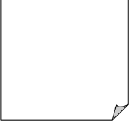
Look and chant
Warm spring, Hot summer,
Golden autumn, Silver winter,
Spring is warm.
Summer is hot.
Autumn is cool.
Spring is warm.
The plants grow and grow.
Spring, spring,
Nice and warm.
Spring, spring,
I like spring.
Summer is hot.
The sun shines and shines.
Autumn is cool.
The leaves fall and fall.
Winter is cold.
Spring comes before summer,
Autumn comes before winter.
Spring, summer, autumn and winter.
Warm, hot, cool and cold.
Summer, summer,
Sunny and hot.
Summer, summer,
I like summer.
Autumn, autumn,
Windy and cool.
Autumn, autumn,
I like autumn.
Winter is cold.
The wind blows and blows.
Winter, winter,
Cloudy and cold.
Winter, winter,
I like winter.

Slide 3
Look and chant
Do you like spring?
Why ?
______

Slide 4
clothes

Slide 5

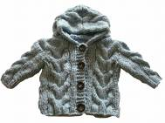
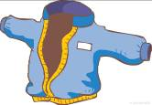
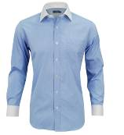




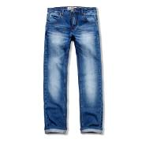
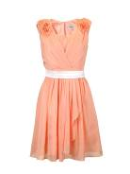
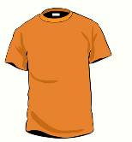
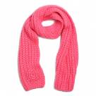
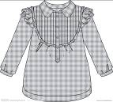
Brain storm
People wear different clothes in different seasons.
In ______, we wear ________.

Slide 6
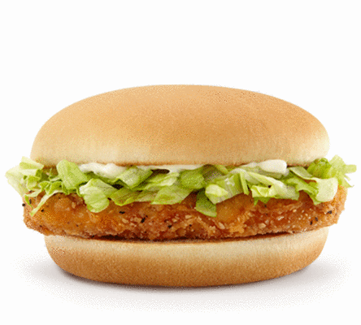
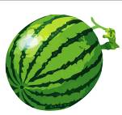
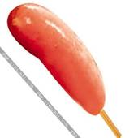
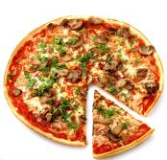
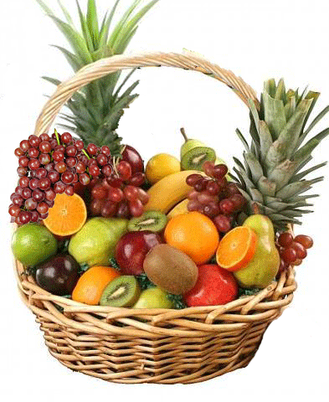
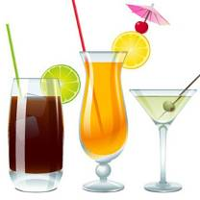
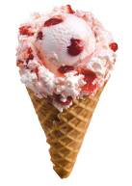
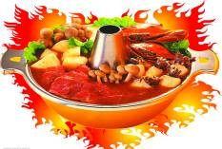
Brain storm
People eat different food in different seasons.
In ______, we eat ________.

Slide 7


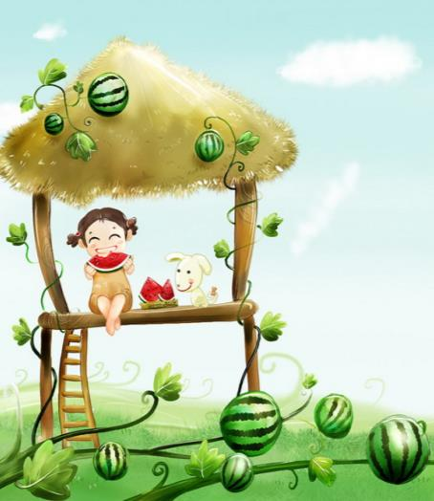
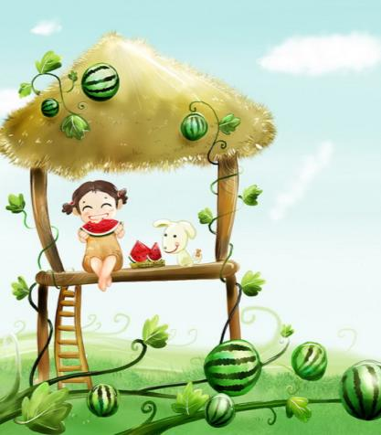



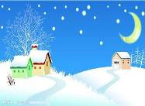
Seasons
I love winter best of all!
I like summer best!
It’s sunny and hot.
I have a T-shirt and shorts.
I eat ice cream and watermelon.
I can swim.
It’s fun.
summer

Slide 8
Group work
What do you know about seasons?
 | spring | summer | autumn | winter
Colour
Weather
Clothes
Food
Things to do

Slide 9

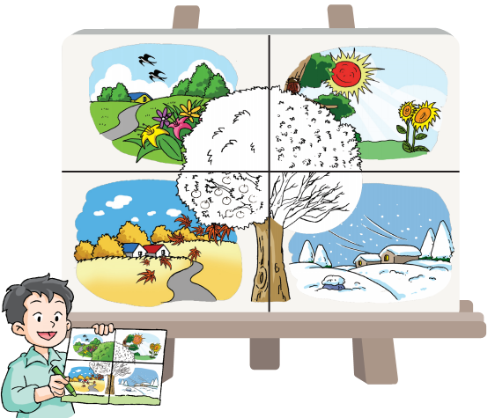

Slide 10







Point and say

Slide 11





Point and say

Slide 12
Point and say
Aa Hh Jj Kk
Ee Bb Cc Dd Gg Pp Tt Vv
Ii Yy
Oo
Uu Qq Ww
Ff Ll Mm Nn Ss Xx Zz
Rr

Slide 13
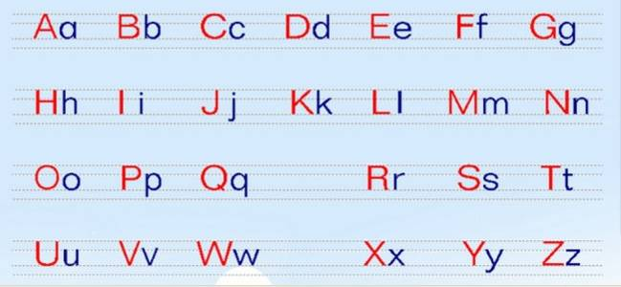
Look and write

Slide 14

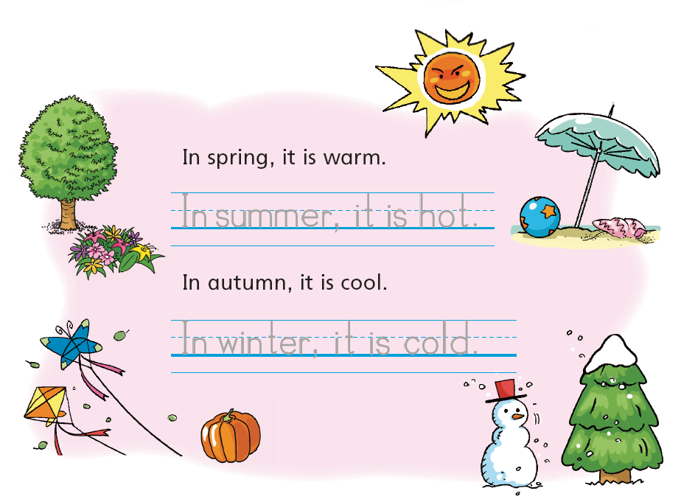
Notes:
14

Slide 15

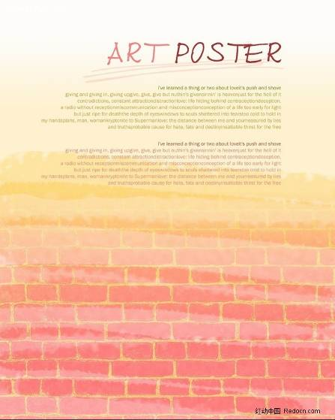
Let’s make a beautiful poster.
a poster

Slide 16

Group work
Make a poster of your favourtie season.
In spring,
It’s ____.
We can ___.
We wear ___.
We eat ____.
Notes:
16

Slide 17
Enjoy the song of seasons
Once a tree stands by the river.
Its leaves flutter in the soft summer breeze.
In autumn, the leaves turn gold, orange and red.
Many leaves fall.
With its roots deep in the earth,
the tree is ready for winter.
Snow falls on the branches and the trunk.
The world is waiting for spring.
A golden light warms the tree.
The leaves uncurled in the spring sunlight.
Once again, its leaves flutter in the soft summer breeze.
Notes:
17

Slide 18
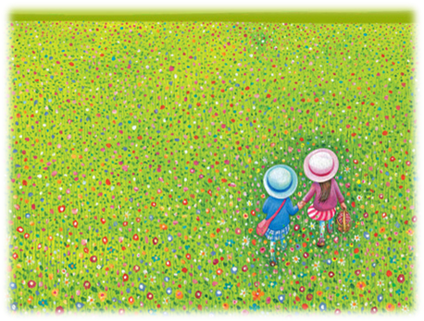
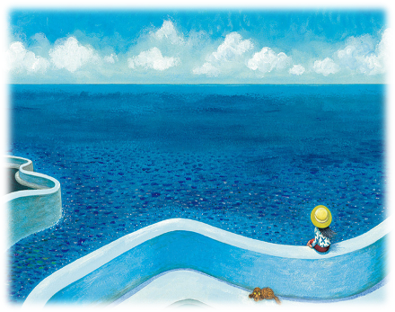

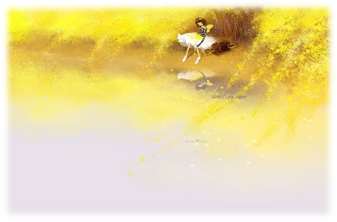
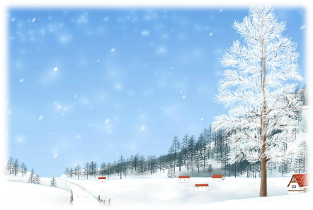
I
love
Seasons

Slide 19
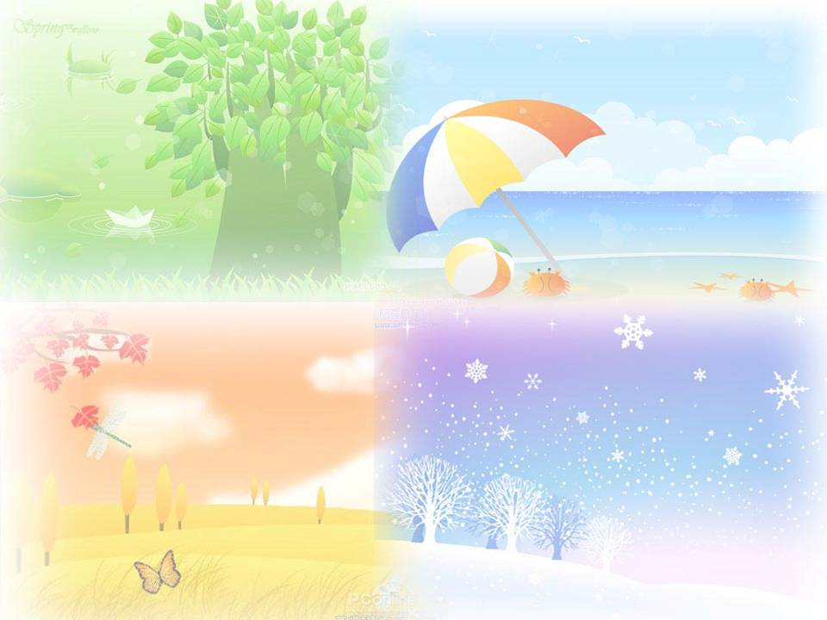
Homework
1 Sing the ABC song.
2 Write about the four seasons.

