Slide 1
Unit 2 Topic 2
What color is his hair?
Section B
WWW.PPT818.COM

Slide 2
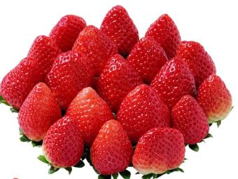
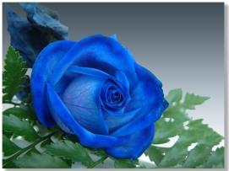
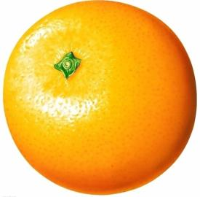
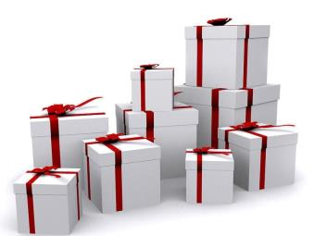
What color is this？

Slide 3
Cuba
The colors of the flag:
red white blue
Where is he from?
He is from Cuba.
What color is his hair?
It is brown.
(He has brown hair.)
What color are his eyes?
They are black.
(He has black eyes.)
1

Slide 4
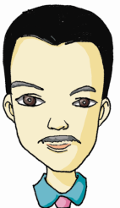
Japan
2
What color is his hair?
the colors of the flag:
His hair is black.
( He has black hair.)
red white
Where is he from?
What color are his eyes?
He is from Japan.
His eyes are black.
( He has black eyes.)

Slide 5
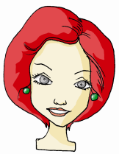
Canada
the colors of the flag:
red white
Where is she from?
She is from Canada.
What color is her hair?
Her hair is red.
( She has red hair.)
3
What color are her eyes?
Her eyes are gray.
( She has gray eyes.)

Slide 6
the U.S.A.
the colors of the flag:
blue red white
Where is she from?
She is from the U.S.A.
What color is her hair?
Her hair is brown.
( She has brown hair.)
What color are her eyes?
Her eyes are black.
( She has black eyes.)
4

Slide 7
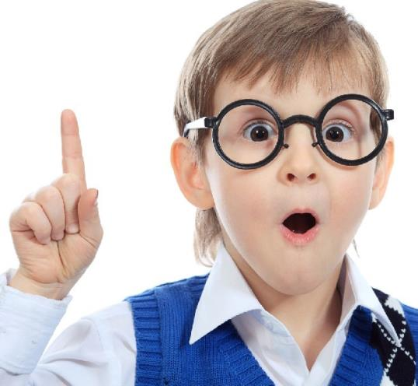
Look at this picture, can you describe it?
He has…
His …

Slide 8
I want to give
the letter
to
Jane.
I want to give
Jane
the letter .
But I’m sorry, I don’t know her.
What does she look like ?
看起来像

Slide 9
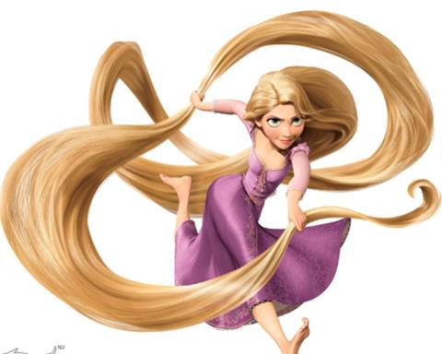
What does she look like?
tall
young
She is a young girl. She is tall.

Slide 10
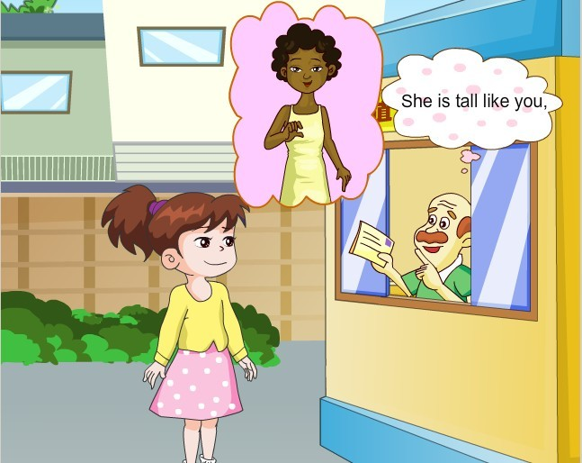
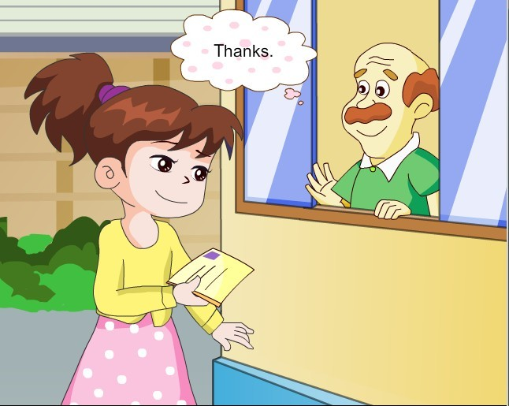
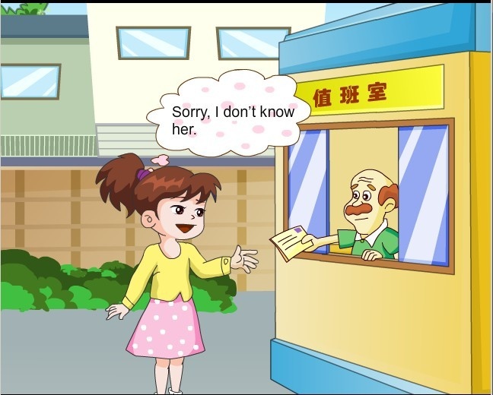
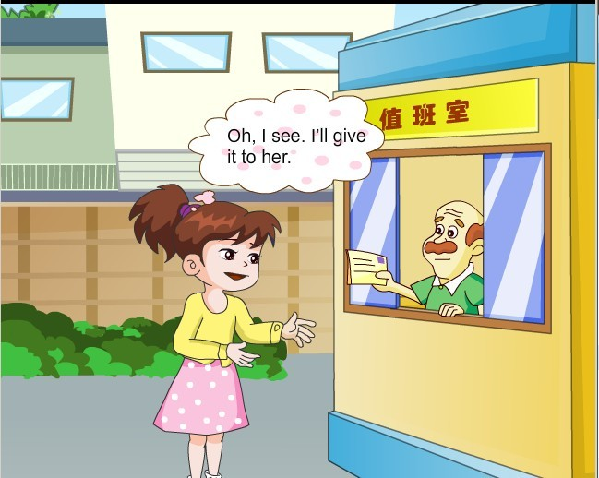
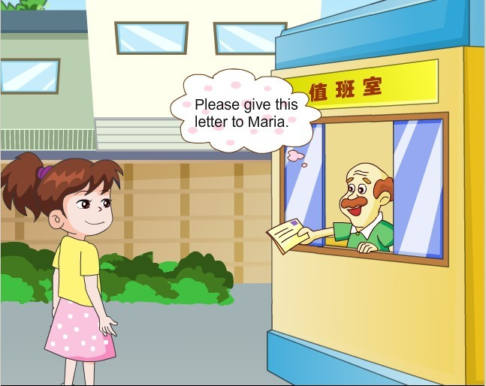
1a Look, listen and say

Slide 11
1b
Pair work
Practice the conversation above with your partner. Pay attention to What does he/she look like? Then make your own conversation.
Key words
A: …
B: … What … look like?
A: … tall\short …, …has …
B: I see. …
A: …
B: …

Slide 12
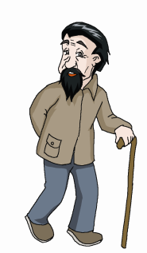
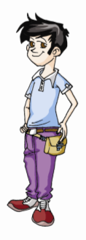
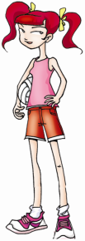
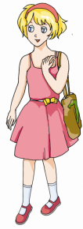
2 Pair work
1. He is short. He has black hair and big black eyes.
2. She is tall. She has red hair and long legs.
3. she is young. She has short blond hair and a small nose.
4. He is old, but he doesn’t have gray hair. His hair
is black.
2
4
1
3

Slide 13
What does she look like?

Slide 14
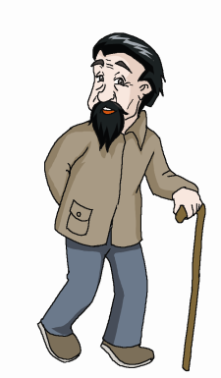
What does he look like?

Slide 15
What does he look like?

Slide 16
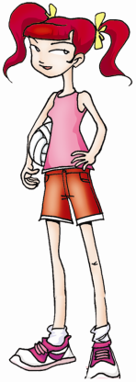
What does she look like?

Slide 17
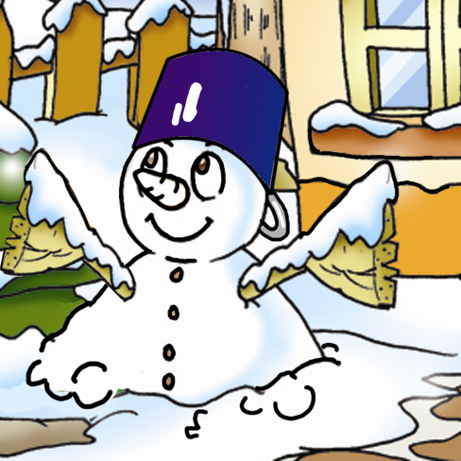
4 Work alone
Listen to the passage and color the snowman.

Slide 18
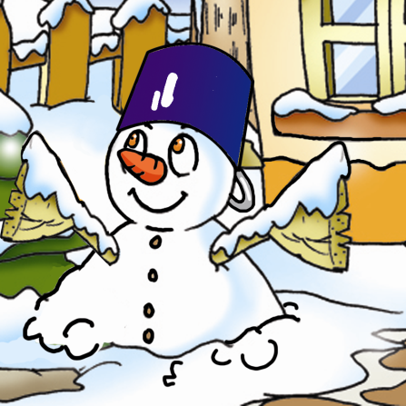
Good job！

Slide 19
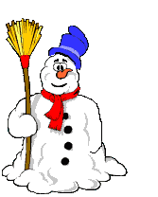
4 Work alone
Listen again and answer the following questions.
Does the snowman have black eyes?
______________
2.What color is his nose?
_________________
3.Does he have short arms?_________________
4.Does he have hair?__________________
No, he doesn’t.
His nose is red.
Yes, he does.
No, he doesn’t.

Slide 20
Class activity
Group A
Group B
I have big eyes
I don’t have big eyes.
Linda doesn’t have a red ruler.
Linda has a red ruler.
...
...

Slide 21
Summary
词汇：
give, give...to..., look like, like,
tall, young, sorry, will,
letter, snowman
句子：
What does she look like?
I don’t know her.
I don’t have big eyes.

Slide 22
Homework
你能把自己的面部特征画下来吗? 然后，用英语把你的画给大家描述一下吧！

