Slide 1
Module 2 My family
Unit 3 Language in use
WWW.PPT818.COM

Slide 2
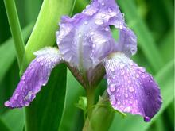
Objectives:
To learn to use the pronouns: this, that, these, those

Slide 3
【本单元例句】
Is this your family?
Yes, it is.
Are these your grandparents?
Yes, they are.
Who’s this?
That’s my dad.
Those are Paul’s son and daughter.
My dad’s parents are on the right.

Slide 4
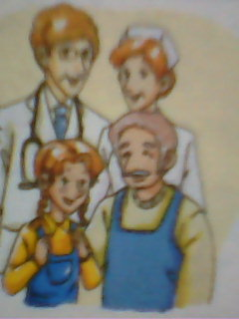
Look at the pictures and talk about
the family.
Lily’s family
Father: doctor
Mother: nurse
Grandfather:
farmer worker
Now write sentences about them.
This is Lily’s family. Her father is a doctor
and her mother is a nurse. Her grandfather
is a farmer worker.

Slide 5
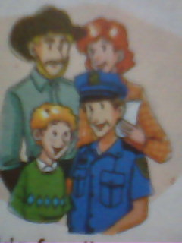
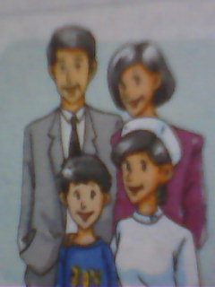
Jack’s family
Father: farmer worker
Mother: teacher
Uncle: bus driver
Li Ming’s family
Father: actor
Mother: manager
Aunt：nurse

Slide 6
名词所有格的用法
英语中的名词所有格表示一种所属关系,
’s所有格多用于有生命的名词。
★ 构成:
① 在单数名词的末尾加’s构成名词的所有格,
表示 “……的”。
Tony’s mother 托尼的妈妈
Tom’s pen 汤姆的钢笔
②在以-s 或-es结尾的复数名词后只需加’。
the girls’ bags 女孩们的书

Slide 7
③在不以-s 或-es 结尾的复数名词后，
加’s构成所有格。
Women’s Day 妇女节
④如表示无生命物体的所有关系,
一般用of。
the door of the classroom 教室的门
⑤表示时间、距离的名词所有格与有生命的
名词所有格构成方法相同。
today’s class 今天的课

Slide 8
★ 注意:
①可用名词所有格表示地点。at my aunt’s 在我姑姑家，at the doctor’s 在医生的诊所
②如果并列名词各自所拥有某物，每个名词后都加’s；若表示两人共同拥有的物品，在最后一个名词后加’s。
Linda’s and Jim’s mothers琳达和吉姆的妈妈Lucy and Lily’s room 露西和莉莉的房间

Slide 9
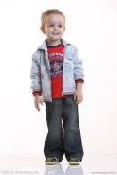
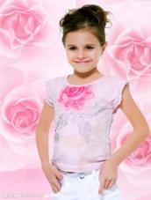
this, these, that, those的用法
通常我们谈论离自己近的 人或物时用this/these, 离自己远的人或物时用that/those。如：
I like these books, but I don’t like those books.
This girl is Mary.
That boy is in Class 5.

Slide 10
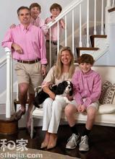
在英语中，this, these, that, those这四个词称为“指示代词”，用来指示或标识人或事物。其中，this 和 that 为单数指示代词，these 和 those 为复数指示代词。
This is my mother.
That’s my dad.
These are my parents.
Those are Paul’s son and daughter.
They are my brother and sister, too.

Slide 11
这些指示代词作主语构成一般疑问句时，答句所使用的主语变化，请观察以下句子:
Is this your bike?
Are these your grandparents?
由此可以看出，当指示代词所指的事物已确定时，后面的指示代词指人时用he, she和they来代替，指物时用it和they来代替。
—Is that a bird or a plane? —It’s a plane.
—Is this your friend Tony? —Yes, he is.

Slide 12
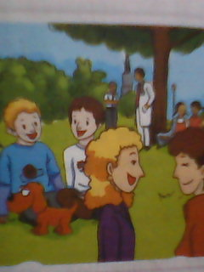
2. Look at the picture and complete the sentences with this, that,these or those.
_______ are my sons,Tom and Alex.
_______ is our dog.
_______ is my uncle.
He’s a bus driver.
3.--Is ____ man a doctor?
-- Yes, he is.
4.-- Are _____girls students?
-- Yes, they are.
These
This
That
that
those

Slide 13
3. Write sentences.
His father is a hotel manager. (Tony)
Tony’s father is a hotel manager.
Her parents are teachers. (Sarah)
Sarah’s parents are teachers.
2. His parents are shop workers. (Wang Hui）
Wang Hui’s parents are shop workers.
3.His mother is a nurse. (Daming)
Daming’s mother is a nurse.
4. Her father is a bus driver. (Lingling)
Lingling’s father is a bus driver.

Slide 14
4. Match the words in Box A with the words in Box B.
人称代词（主格）
A. he I it she they we you
B. her his its my your their our
形容词性物主代词

Slide 15
5. Complete the passage with the correct form of the words from the box.
he her his my we our she their
my
Hello! My name is Amy. These are _____
friends. _____names are Jack, Lily and Mike.
Jack is American. ____father is a doctor. He is
____family doctor. Lily isn’t American. _____
family is Chinese. Mike isn’t Chinese. _____
is English. Mike’s mother is a teacher. _____
is our English teacher. ____are her students.
Their
His
our
Her
He
She
We

Slide 16
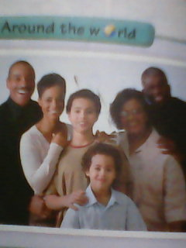
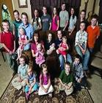
Around the world
Families
In America, many people have grandparents
from different countries. For example, their
parents are American and they are American,
but their grandparents are from Asia, Europe,
or Africa.
亚洲，欧洲
非洲

Slide 17
一、根据句意完成句子。
Is there
1. __ _____ any bread in the box?
2. She doesn’t ____ a nice kite.
3. Under the tree _____ ___ some
women drinking tea.
4. ___ _____ any cakes in your bag?
5. ___ _____ your parents?
have
there are
Are there
Are these

Slide 18
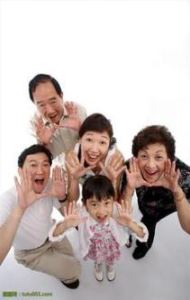
二、根据括号内的要求改写下列句子。
1. There are five people in my family.
(对划线部分提问)
_____________________________
_____________________________
2. This is my parent.
(改成复数形式的句子)
_____________________________
How many people are there
in your family?
These are my parents.

Slide 19
3. His brother works at a factory.
(变为一般疑问句)
____________________________
4. This is David’s sister.
(变为否定句)
____________________________
5. This is a big family.
(变为感叹句)
____________________________
Does his brother work at a factory?
This isn’t David’s sister.
What a big family this is!

Slide 20
三、根据汉语意思完成英语句子，
每空词数不限。
1. 贝蒂的妈妈在医院工作。
Betty’s mother _____ at a _______.
2. 他的姐姐在警察局工作。
His _____ works at a _____ ______.
3. 他的祖父母没有和他在中国。
His grandparents aren’t in China
____ ___.
works hospital
sister police station
with him

Slide 21
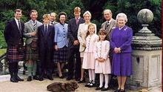
4. 你家有几口人？
________________________ in
your family?
5. 她是你妈妈还是你姨姨？
Is she ______________________?
6. 这是你的爷爷奶奶吗？
____ these ____________?
How many people are there
your mother or your aunt
Are grandparents

Slide 22
四、把下列句子连成短文。
A. He is a worker.
B. She is a doctor.
C. This man is my father.
D. This woman is my mother.
E. This girl is my sister, Mary.
F. Its name is Mimi.
G. It’s a picture of my family.
H. She is ten.
I. Can you see our cat in the picture?
J. Look at this picture.
正确顺序为：___________________.
J G C A D B E H I F

Slide 23
Homework
1.Review the grammar we have learned today.
2. Draw your family tree and write about your family.
3. Preview the dialogue in Module 3 unit 1
4. Learn the new words and expressions in Module 3 unit 1 by heart

