Slide 1
七年级上册
Unit 3 Is this your pencil?
Section B (第1课时)
WWW.PPT818.COM

Slide 2
学习目标
1、熟练掌握本课单词.
2、掌握句型：What’s this ？ It’a /an …. How do you spell it？
3、能听懂有关谈论物主的对话并进行自由交际.

Slide 3
知识回顾
一、重点句型
这是你的铅笔吗？
__ ____ your pencil?
2. 是的。它是我的。
Yes, __ __. It’s ______.
3. 那是你的书包吗？
__ ____ your schoolbag?
4. 不是。它是他/她的。
No, __ ____. It’s ___/_____.
5. 这是他的绿色钢笔吗？
__ this ___ ______ pen?
Is this
it is
mine
Is that
it isn’t his hers
Is his green

Slide 4
知识回顾
6. 不是。那只蓝色钢笔是他的。
No, __ _____. The _____ ____ is ___.
7. 这些是你的书吗？
____ _____ your books?
8. 是的。/ 不是。
Yes, ____ ____./No, ____ ______.
9. 那些是她的钥匙吗？
____ _____ her _____?
10. 不是。它们是她的。
No. ________ hers.
it isn’t
green pen his
Are these
they are
they aren’t
Are those keys
They’re

Slide 5
知识回顾
二、按要求写出下列单词的正确形式。
A) 写出下列表达的缩写形式
1. it is = ___ 2. they are = _______
3. is not = _____ 4. are not = _______
B) 写出下列各词的名词所有格或名词性物主代词
5. Eric _______ 6. sisters _______
7. parents ________ 8. your ________
9. my ______ 10. his ____
11. her _____
it’s
they’re
isn’t
aren’t
Eric’s
sisters’
parents’
yours
mine
his
hers

Slide 6
知识回顾
C) 写出下列各词的复数形式
12. schoolbag ___________ 13. family _______
14. dictionary __________ 15. box _______
schoolbags
families
dictionaries
boxes

Slide 7
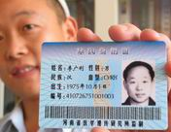
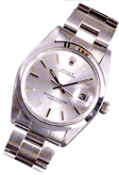
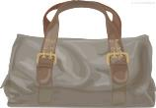
自主反馈
— What’s this ?
— It’s a(n) ________.
baseball
ID card
ring
watch
notebook
bag
computer game

Slide 8
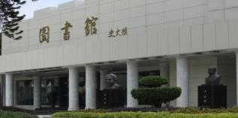
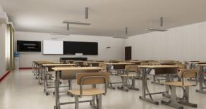
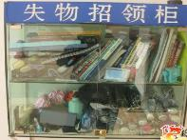
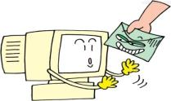
自主反馈
library
classroom
Lost and Found
call
email

Slide 9
分组活动
小组展示（记忆大比拼）
1 组
2 组
3 组
4 组
电子邮件
学生卡，
给……打电话
失物招领处
老师
橡皮
盒子
戒指
袋，包
计算机
图书馆
手表
笔记本
棒球
You’re great!
教室

Slide 10
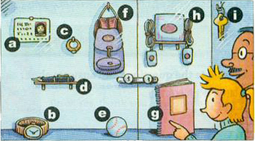
新课学习
1a.Match the words with the things in the picture.
e
a
1. baseball ____ 4. ID card ____ 7. ring ____
2. watch ____ 5. key ___ 8. pen ____
3. computer game ___ 6. notebook ___ 9. bag __
c
b
i
d
h
g
f

Slide 11
新课学习
1b.Ask and answer questions about the things in the picture.
A: What’s this?
B: It’s a watch.
A: How do you spell it?
B: W- A -T - C-H.
A: What’s this?
B: It’s a(n) _________.
A: How do you spell it?
B: ______________.

Slide 12
新课学习
1c.Listen and circle the things your hear in 1a.
1. baseball ___ 4. ID card __ 7. ring ___
2. watch ___ 5. key __ 8. pen ____
3. computer game __ 6. notebook __ 9. bag ___

Slide 13
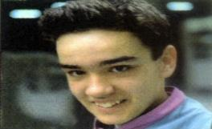
新课学习
1d.Listen again. Write the things that belong to Linda or Mike.
Linda
Mike
watch
pen
ID card
baseball

Slide 14
Listening
新课学习
Conversation 1
A: I lost my watch this morning.
B: OK. Is this your watch?
A: No, it isn’t. That’s my watch.
B: Here you are.
A: And that’s my ID card.
B: OK. What’s your name?
A: Linda.

Slide 15
Listening
新课学习
Conversation 2
A: That’s my pen.
B: This?
A: Yes, and that’s my baseball.
B: All right. What’s your name?
A: Mike.
B: OK. Here’s your baseball.
A: Thank you.

Slide 16
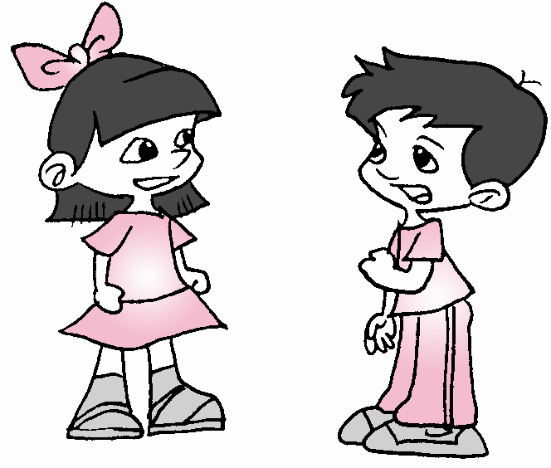
新课学习
Pair work
1e.Make conversations about the things in 1d. Then change roles.
Linda: I’m looking for my watch.
Teacher: OK. Is this your watch?
Linda: No, it isn’t. That’s my watch.
Teacher: Here you are.
Linda: And that’s my ID card.
Teacher: Ok. What’s your name?
Linda: Linda.
…
....

Slide 17
新课学习
Pair work
Mike: That’s my pen.
Teacher: This?
Mike: Yes… and that’s my
baseball.
Teacher: All right.
What’s your name?
Mike: Mike.
Teacher: Ok.
Here’s your baseball.
Mike: Thank you.
…
....

Slide 18
分组活动
小组讨论
1 组
2 组
3 组
4 组
总结本课自己的收获，小组内交流。

