Slide 1
Unit 6 An old man tried to move the mountains.
Section B 1a — 2e
WWW.PPT818.COM

Slide 2
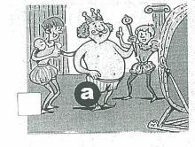
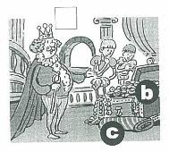
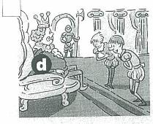
1a match the words with the letters in the pictures in 1c.
b
d
____ gold ____ emperor
____ silk ____ underwear
c
a

Slide 3
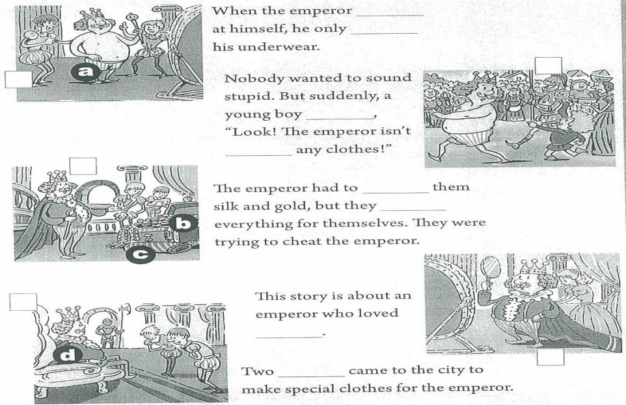
1c Listen again and fill in the blanks.

Slide 4
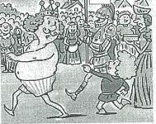
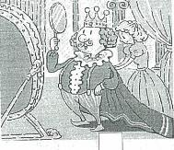
1d use the pictures in 1c to tell the story.

Slide 5
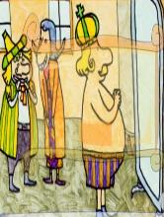
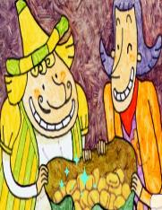
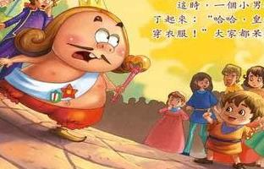
activity1: the ending of the new emperor’s new clothes
Activity 2:
Role-play the story:
Narrator:
Emperor:
Two men:
The kid:

Slide 6
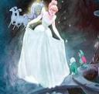
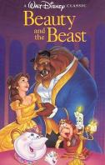
2a The fairy tales
Sleeping Beauty (睡美人)
Cinderella （灰姑娘）
Little Red Riding Hood （小红帽）
The Ugly Duckling （丑小鸭）
Beauty and the Beast （美女与野兽）

Slide 7
2b Hansel and Gretel
Task 1: Finding out the Text Type:Before you read, decide what kind of text it is. Is it a letter, a play, a short story or something else?
Task 2: Think about how the fairy tale will continue. Then read the rest of the story.
Task 3: Role play the play. (narrator, Hansel, Gretel, wife, husband)
Task 4: Act out the play in front of the class.
Task 5: Retell the story.

Slide 8
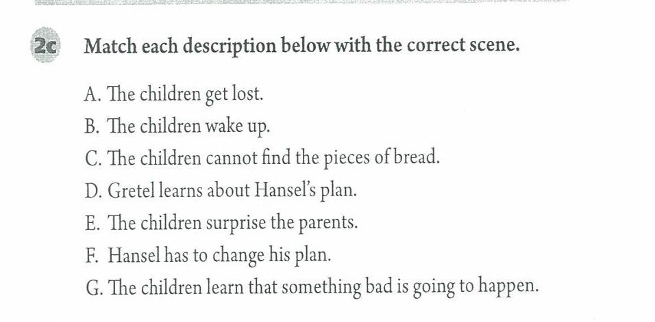
2b Hansel and Gretel
[参考答案] GBDEFCA

Slide 9
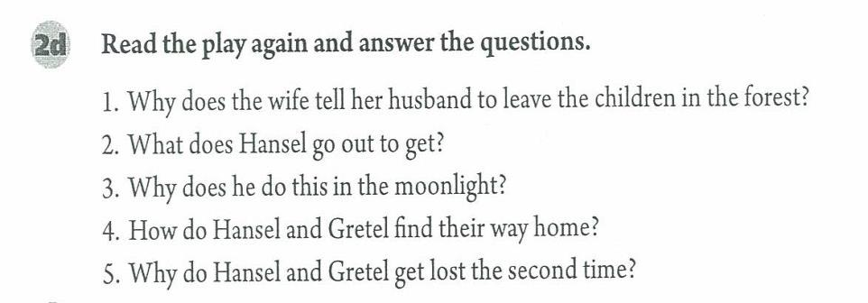
[参考答案]
1. Unless her husband leaves the children to die in the forest, the whole family will die.
2. Stones.
3. Because he can’t let his stepmother know this and he needs to get something they can see in the moonlight.
4. They can see the stones along the way home.
5. They can’t see any bread on the ground so they can’t find their way out.

Slide 10
summary
1. wife — husband 妻子— 丈夫
eg: Mary and Tom got married. So Mary is Tom’s wife and Tom is Mary’s husband.
玛丽和汤姆结婚了。 所以玛丽是汤姆的妻子，汤姆是玛丽的丈夫。
2. whole 全部的；整体的
eg: He studied the whole day, so he was very tired.
他学习一整天了，所以他太累了。
3. stone 石头
eg: Hansel dropped the stones along the way.
韩塞尔沿路扔了石头。
4. shine 发光；闪耀 （过去式: shone）
eg: While the moon was shining bright, we were eating mooncakes.
当月亮照耀时，我们正在吃月饼。

Slide 11
5. lead 带路；领路 （过去式: led）
eg: He led me to visit the museum last weekend.
上周末，他领着我去参观了博物馆。
6. voice 声音，一般指人的声音，说话、唱歌的声音。
eg: Tina sings very well, because she has a beautiful voice.
蒂娜歌唱的好听，因为她有甜美的嗓音。
sound 声音，当“响声”讲时，可以指人或动物发出的声音，或物体碰撞的声言。这个词的使用范围很大。大自然的任何“声音”都可以用sound。
eg: Light travels much faster than sound.
光的传播速度比声音快得多。
noise意为“噪音” “喧闹声”，常指不悦耳、不和谐的嘈杂声。
eg: Don’t make any noise! 别吵闹!
Note: sound和noise不仅能指人的声音，还可以表示别的动物发出的声音;而voice除了有时可指鸟的声音外，很少表示其它动物的声音。

Slide 12
homework
Write a feeling about your favorite fairy tale and share it in your group. Next lesson, let’s choose the best one to share it with the whole class.

