Slide 1
外研·八年级上册
Module 10 The weather
Unit 1 It might snow.
WWW.PPT818.COM

Slide 2
Sunny

Slide 3
Cloudy

Slide 4
Rainy

Slide 5
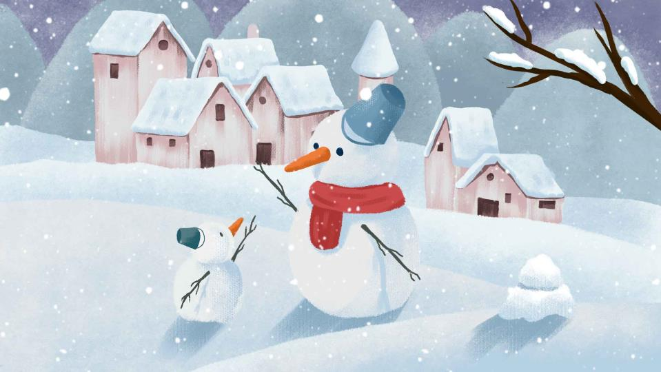
Snowy

Slide 6
Listening and vocabulary
Work in pairs. Talk about the weather. Use the words in the boxes to help you.
1
cloud rain shower snow storm sun wind
cloudy rainy snowy sunny windy

Slide 7
sunny
cloudy
rainy
snowy
weather
windy
showery
多阵雨的

Slide 8
New
words
cloud
shower
snow
storm
cloudy
rainy
snowy
sunny
windy
n.云；云雾
n.阵雨
n.雪 v.下雪
n.暴风雨
adj.多云的
adj.多雨的；下雨的
adj.多雪的；下雪的
adj.晴朗的
adj.多风的；刮大风的

Slide 9
skate
thick
ice
joke
might
temperature
minus
degree
although
wet
v.滑冰
adj.厚的
n.冰
v.说笑话；开玩笑 n.笑话；玩笑
v. aux.可能；也许
n.温度
adj.负的；零下的
n.度；度数
conj.然而；尽管
adj.下雨的；湿的

Slide 10
neither
terrible
wish
probably
come on
adv.（某人或某物）也不
adj.使人烦恼的；可怕的
v.但愿；希望
adv.或许；可能
快点

Slide 11
degree (s)
minus
- 8℃
temperature

Slide 12
What’s the temperature? It’s…
20℃
twenty degrees
-16℃
minus sixteen degrees
-7℃~1℃
between minus seven and one degrees
5℃~8℃
between five and eight degrees
10℃~21℃
between ten and twenty-one degrees

Slide 13
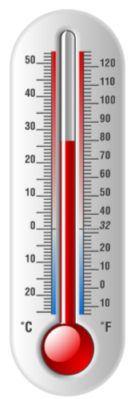
Put the words in order.
cold
cool
hot
hot
freezing
wram
warm
cool
cold
freezing

Slide 14
City | Temperature | Weather
Beijing | -8 ~-2ºc
Shanghai | 5~9ºc
Xi’an | –1~14ºc
Guangzhou | 10~21ºc
Hong Kong | 17~20ºc
Listen and check (√) the correct informa-tion
in the
table.
2

Slide 15
Tapescript
Good morning, here is the weather for China today.
In Bejing, there’ll be clouds in the early morning, and
it will be between minus eight and minus two degrees.
Shanghai will be rainy and windy, and between five and eight degrees.

Slide 16
It’ll be cloudy and snowy in Xi’an with a temperature between minus four to two degrees. In Guangzhou, it’ll be cloudy. There may be some showers, and it’ll be between ten and twenty-one degrees. In Hong Kong, it’ll be cloudy. There will be storms later, and it’ll be between seventeen and twenty degrees.

Slide 17
Work in pairs. Correct the wrong
information in the table.
3
Shanghai will be rainy and windy, and between five and eight degrees.
5℃~8℃
Xi’an will be cloudy and snowy with a temperature between minus four to two degrees.
-4℃~2℃

Slide 18
Listen and answer the following questions.
1. Where is Betty going?
2. What’s the weather like in Beijing now?
3. Does Tony like showers and windy weather?
She is going to the park to skate.
It is very cold.
No, he doesn’t.

Slide 19
Listen and read.
4
Betty: Hey, boys!
Tony: Hi, Betty. Hi, Lingling. Where are you going?
Betty: We’re going to the park to skate. There’s
thick ice on the lake. Are you coming
with us?
Tony: Are you joking? It’s really cold today.
Daming: And it’s cloudy too, so it might snow.
你在开玩笑吗？
可能；也许

Slide 20
温度是多少？
Lingling: What’s the temperature?
Tony: It’s between minus eight and minus two
degrees! Winter is colder here than in
England.
Daming: Is it snowy in England in December?
Tony: Not usually, although this year it snowed
quite a lot. Most Decembers are wet and
rainy.
-8℃~-2℃
不经常

Slide 21
Daming: What’s the weather like in America in
winter, Betty?
Betty: We have cold winters and hot summers.
It’s snowy in New York in winter.
Tony: Sounds great! I like sunny weather, and I
like snow as well. But I don’t like showers
or windy weather.

Slide 22
我也不喜欢。
Betty: Me neither. Rainy weather is terrible!
I wish I were in Australia now. It’s
probably sunny and hot there.
Lingling: You can go to Hainan Island if you like
sunny weather.
Betty: One day I will.
Lingling: Come on, better get going! We can
skate in the park and get warm.
或许，可能，大概
虚拟语气
快点儿，走吧！

Slide 23
Everyday English
Are you joking?
Sounds great!
Me neither.
Come on!

Slide 24
Summarize and fill in the table
Places | Weather
Beijing | cloudy, it might ______
England | Most Decembers are ____ and ______
America | cold winters and ____ summers. It’s ______ in New York in winter
Australia | It’s probably ______ and hot
Hainan Island | ______ weather
snow
wet
rainy
hot
snowy
sunny
sunny

Slide 25
Now check (√) the true sentences.
1 Tony and Daming are going to skate.
2 Winter is colder in Beijing than in England.
3 It sometimes snows in England in winter.
4 It is not hot in the US in summer.
5 It usually snows in New York in winter.
6 Tony does not like windy weather.

Slide 26
Complete the passage with the correct form of the words in the box.
5
dangerous degree joke may minus
skate temperature
When it is very cold, it might be safe to
(1) __________ on lakes, but be very careful!
Although it (2) __________ feel cold, it might
not be safe.
skate
may

Slide 27
dangerous degree joke may minus
skate temperature
The (3) ____________ has to be at least (4) __________
one or two (5) __________ or even lower for several
weeks, and the ice will be thick enough. Falling through
the ice is (6) ___________. I am not (7) __________!
temperature
minus
degrees
dangerous
joking

Slide 28
Pronunciation and speaking
Listen to the speaker asking a question or showing surprise.
6
What’s the weather like?
What’s the weather like?

Slide 29
Listen and write *if the speaker is asking a
question or **if he is showing surprise.
7
1 When is the best time to visit your country?
2 What clothes should she bring?
3 What is the temperature?
4 Where are you going?
Now listen again and repeat.

Slide 30
Make a weather forecast for different cities in
China. Use the correct information in the table
in Activity 2 to help you.
8
Now say what the weather might or might not be like in your town.
tomorrow
next week
next month
It’ll probably be cold tomorrow.
It might be rainy next week in my town.
It might be snowy next month in my town.

Slide 31
Be a reporter
Good morning, here is the weather for China today. In…, there’ll be… and it will be… In Shanghai, there may be some showers, and it will be... Hongkong will be…

Slide 32
Beijing |  | 15℃
Shanghai |  | 16℃
Jinan |  | 12℃
Lhasa |  | 6℃
Harbin |  | -8℃
Hong Kong |  | 14℃
That’s all, thanks for listening. Goodbye!

Slide 33
Exercises
一、选择题。
1. —Where is Miss Yang now?
—I’m not sure. She ______ be in the teachers’
office.
A. may B. need C. must

Slide 34
2. —Whose green coat is this?
—It _______ Mary’s. She always wears
green coats.
A. might be B. must be C. may be

Slide 35
3. The world wide web is sometimes jokingly
called the world wide wait because it ______
be very slow.
A. must B. will C. can

Slide 36
4.（河南中考）—Honey, where are you?
—I ________. Just let me put on my shoes.
A. come B. came
C. am coming D. have come

Slide 37
5.（广西贵港中考）________ Mr. Smith has
learned Chinese for only half a year, he can
speak it very well.
A. But B. so
C. Although D. And

Slide 38
二、按照要求完成下列句子。
1. It might be cold and wet in February in
England. (改为否定句)
It _____________ cold and wet in February in
England.
might not be

Slide 39
2. It is wet in summer in South China.
(对划线部分提问) ______ is the ____________ in summer in
South China?
What
weather like

Slide 40
3. The best time to visit my hometown is in autumn.
(对划线部分提问) _________ the best time to visit your hometown?
When is

Slide 41
Homework
1. Read and retell the conversation.
2. Do the exercises.

