Slide 1
Unit 3 Topic 3
What were you doing at this
time yesterday?
Section A
WWW.PPT818.COM

Slide 2
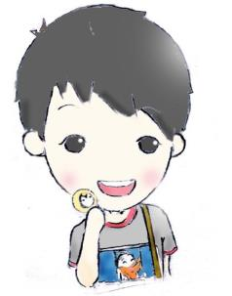

What are you doing?
We are having classes.

Slide 3
What were you doing at this time yesterday?
?

Slide 4

1a
Listen, look and say.
Watch the flash of 1a, and fill in the blanks.
1. The telephone rings while Jane is
_________ the violin.
2. This is Maria ________.
3. What _____ you doing at this time yesterday?
4. I called you to go to the English corner but
nobody _________.
practicing
speaking
were
answered

Slide 5

1b
What was Jane doing at that time yesterday?
She was taking a shower.

Slide 6

take a shower

Slide 7


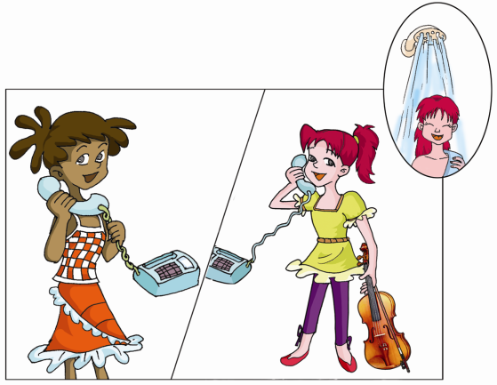
Listen and read the conversation of 1a, and find out the sentences with “v.+ing”.

Slide 8
The telephone rings while Jane is practicing
the violin.
2. What are you doing, Jane ?
I’m practicing the violin.
3. What were you doing at this time yesterday ?
Oh, I was taking a shower.
am/is/are +v.ing
现在进行时
was/were + v.ing
过去进行时

Slide 9
The Past Continuous Tense
过去进行时由be动词的过去式was/were加动词现在分词构成。过去进行时主要表示过去某个时刻或过去一段时间正在进行的动作。过去进行时常与表示过去的时间状语如then，at that time，at this time yesterday，a moment ago等连用，或者用另一动作来表示过去的时间。如：
It was raining all day yesterday.
昨天下了一整天雨。
They were playing basketball at four o’clock yesterday afternoon.
昨天下午4点他们在打篮球。
We were working from seven to eleven last night.
我们昨晚从七点工作到九点。

Slide 10

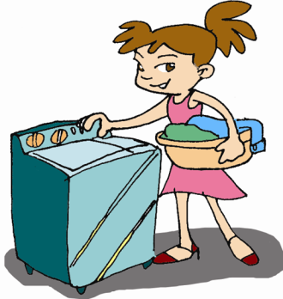
Pair work
Look at the pictures and write the correct words or phrases. Then make up conversations with your partner.
Example:
A: What were you doing at
this time yesterday?
B: I was washing some
clothes. What about you .
A: I was doing some
cleaning.
wash some clothes
___________________

Slide 11

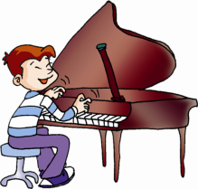
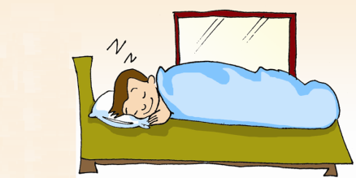
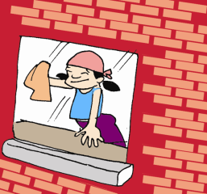
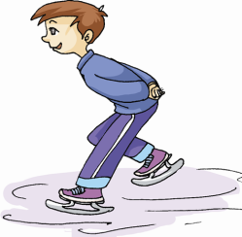
read English
___________
play the piano
____________
sleep
______
skate
________
do some cleaning
______________

Slide 12
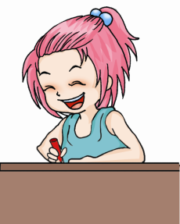
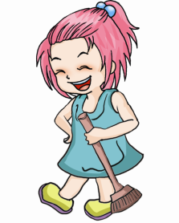
Were you doing some cleaning at this time yesterday?
Yes, I was.
No, I wasn’t.
过去进行时的一般疑问句及其肯定和否定回答：
Were/Was + S + v.ing + O + time ?
Yes , S was/were . No , S wasn’t/weren’t.

Slide 13

listen and fill.
Jim and Yingying are back at school in Beijing. Jim is very excited. Beijing is one of his ________
cities. From nine to eleven yesterday, Jim was
______ ______ ________and ______ ________ , and Yingying was ______ on a plane and _______
to pass the time. On the plane from New York, Jim ______ _________ computer games until they served the food.
favorite
doing some packing
some cleaning
sitting
reading
was playing

Slide 14
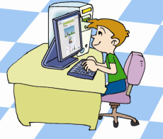
3
Pair Work
Look at the pictures and make up conversations with your partner.
7:00-9:00 a.m.
chat with friends
Example:
A: What were you doing from seven to
nine yesterday ?
B: I was learning English.
Were you playing computer games?
A: Yes, I was. / No, I wasn’t.

Slide 15
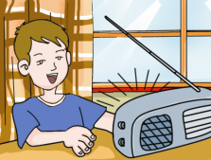
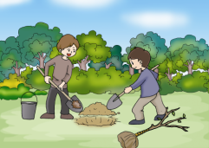
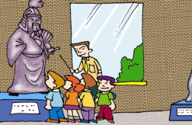

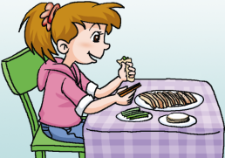
7:00 – 7:30 a.m. listen to the news
9:00 – 12:00 a.m. plant trees
2:00 – 4:00 p.m.
visit a museum
4:30 – 6:00 p.m.
practice English
6:30 – 7:00 p.m.
eat Beijing roast duck

Slide 16


Group work
Work in groups and talk about what you were doing at this time last weekend. Use the dialog in 1a to help you.

Slide 17

phrases
at this time yesterday
call sb. to do sth.
take a shower
do some washing
do some cleaning
from seven to nine yesterday
play on the computer
listen to the radio
visit a museum
dig a hole

Slide 18
telephone languages
This is … speaking.
May I speak to …?
Hold the line, please.
Answer the phone.

Slide 19
summary
I master the
Past Continuous Tense.
I know some
useful expressions.
I can write
a passage with the past continuous tense.
I know some
telephone languages.

Slide 20
Homework
Make a telephone dialog according to
the telephone languages.

