Slide 1
Unit 4
I used to be afraid of the dark.
Section A 2a-2d
WWW.PPT818.COM

Slide 2
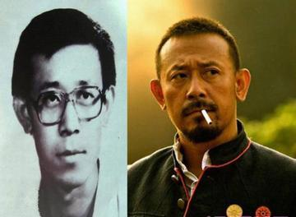
Presentation
Jiang Wen used to wear glasses, but now he doesn’t wear glasses.

Slide 3
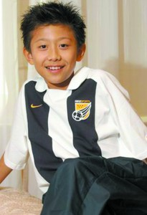
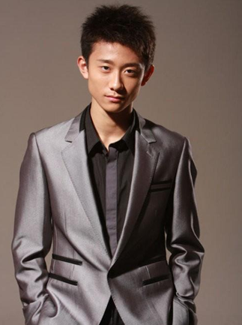
Zhang yishan used to be short, but he is tall now.

Slide 4
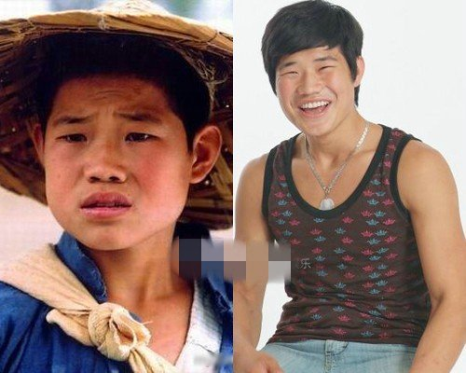
He used to be serious, but he is outgoing now.

Slide 5
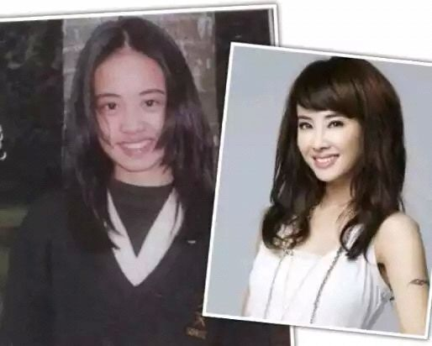
Cai Yilin used to be fat, but she is thin now.

Slide 6
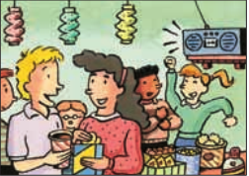
2a Listen and check (✔) the words you hear.
____ friendly _____outgoing _____serious ____humorous _____ silent _____active
_____brave ______quiet _____ helpful
✔
✔
✔
✔
✔
✔

Slide 7
2b Listen again and complete the chart
about how Paula has changed.
In the past | Now
1. Paula used to be really______. She was always silent in class. She wasn’t very________. She was never brave enough to ask questions. | 1. Now she’s more interested in_________. She plays ______ almost every day. She’s also on a ________ team.
quiet
sports
soccer
outgoing
swim

Slide 8
In the past | Now
2. She got good grades in ________. She was also good in______________. She used to play the ______. | 2. She still plays the ________ from time to time.
science
piano
music class
piano

Slide 9
2c Make conversations about Paula using the information in 2b.
A: Paula used to be really quiet.
B: I know. She was always silent in class.

Slide 10
Pair work
I know. She was always silent in class.
Paula used to be really quiet.
Notes:
10

Slide 11
But she was always friendly. She got good grades in exams. And she was really good in music class, too. She used to play the piano.
She wasn’t very outgoing. She was never brave enough to ask questions.

Slide 12
But now she is more interest in sports. She plays soccer almost every day. She still plays the piano from time to time.
I know, She’s so active now.

Slide 13
Survey
Who has changed most?
 | Past | Now
Hair
Height
Build
personality
Hobby

Slide 14
2d Role-play the conversation.
Alfred: This party is such a great idea!
Gina: I agree. It’s been three years since we
last saw our primary school classmates.
Alfred: It’s interesting to see how people have
changed.
Gina: Billy has changed so much! He used to
be so shy and quiet.
Alfred: Yeah, his face always turned red when
he talked to girls!

Slide 15
Gina: I used to see him reading in the library
every day.
Alfred: That’s because he was a really good
student. He studied hard and got
good scores on his exams.
Gina: Did he use to wear glasses?
Alfred: Yes, and he used to be thin, too. But
look how big and strong he is now!
Gina: He’s so popular now. Look at all the
girls around him!

Slide 16
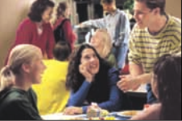
Watch and read

Slide 17
Language points
1. She was always silent in class.
在课堂上她总是很沉默。
silent作形容词，意为“不说话的；沉默的”，
其名词形式为silence （沉默；寂静）
►She was silent when her mother asked
her questions.
她妈妈问她问题时她沉默不语。

Slide 18
Silent 的副词形式是silently (默默的；静静的)
► He went in to the classroom and sat down
silently.
他走进教室静静地坐下来。
2）keep silent意为“保持安静”
► Please keep silent in public places.
在公共场合下请保持安静。

Slide 19
2. She still play the piano from time to time.
她仍然时常弹钢琴。
(1) still 副词，意为“仍然”，用来说明某人或某物没有变化。still 在句中通常放在实义动词前, 助动词、情态动词、连系动词后面。
► The woman still lives in shanghai.
► He is still in the classroom.
(2) From time to time 意为“时常；有时”相当于sometimes /at times.
► She goes to the movies from time to time.

Slide 20
3. This party is such a great idea!
这个派对真是个好主意！
He used to be so shy and quiet.
他过去非常害羞安静。
such与so 辨析
such为形容词，意为“这（那）样的；主要修饰名词；
so是副词，意为“这（那）么；如此地”，主要修饰形容词、副词和分词。

Slide 21
e.g. Do you like such weather?
你喜欢这样的天气吗？
I’m so glad to see you.
很高兴见到你。
He can draw so well.
他画得那么好。

Slide 22
当名词前有many，much，few或little等词修饰时，要用so而不用such。
e.g. There are so many / few people in
the hall.
大厅有这么多/这么少的人。
You have so much / little
homework today.
你今天有这么多/这么少的作业。

Slide 23
“such + a / an +形容词+可数名词单数
形式”相当于“so +形容词+a / an +可
数名词单数形式”，表示“如此……的
一个……”。
e.g. She is such a lovely girl. =
She is so lovely a girl.
她是这个如此可爱的女孩。

Slide 24
4. He studied hard and got good scores on his exams. 他努力学习，考试取得了好成绩。
score n. 得分；进球
e.g. He got high scores in the examination.
考试中他得了高分。

Slide 25
Exercises
I. 根据汉语提示填空，完成句子。
humorous
1. He has plenty of _________ (幽默的)
stories to tell us.
2. You’d better keep _______ (沉默) about what happened.
3. The lazy cat isn’t very ________ (有用的) in catching mice.
4. Tom got the highest ______(得分) in the exam.
silent
helpful
score

Slide 26
选用such或so填空。
1. The man told us ____ funny a story.
2. She has _____ a beautiful dress.
3. How can you get ____ much money to buy the car?
4. Don’t go out in ______ cold weather.
5. Don’t eat _____ quickly.
so
such
so
such
so

Slide 27
Translate the sentences into
English.
1. 马里奥过去很矮，他戴着眼镜。
___________________________________
2. 他现在长什么样子？
_________________
Mario used to be short and wear glasses.
What’s he like now?

Slide 28
3. 保拉以前很安静，她在班上总是很沉默。
_________________________________
________________________
4. 她总是不够勇敢去问问题。
_______________________________
_________
Paula used to be really quiet. She was always silent in class.
She was never brave enough to ask
questions.

Slide 29
Homework
1. Recite the conversation in 2d.
2. Preview the next part.

