Slide 1
Unit 4 Why don’t you talk to your parents?
Section A 1a—2d
WWW.PPT818.COM

Slide 2
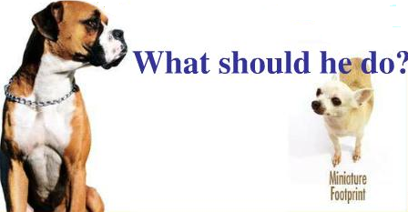
Look and say
What’s wrong with the dog?
I didn’t get enough sleep.
What should I do?
You look tired. What’s the matter?

Slide 3
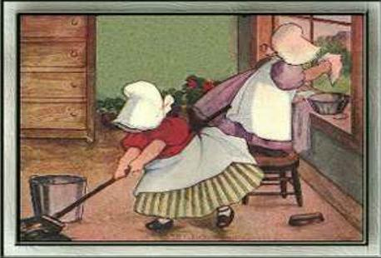
What should I do?
My room is dirty.
You should do some cleaning.

Slide 4
What should I do?
I’m so thirsty.
You should drink some water.

Slide 5
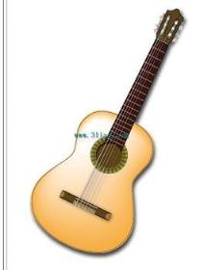
What should I do?
I want to buy a guitar. But I
don’t have enough money.
You should ask your parents for some money.

Slide 6
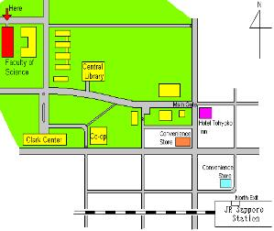
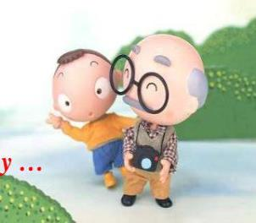
What should he do?
He doesn’t know the way
to …
He should ask someone
for help.

Slide 7
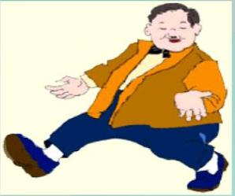
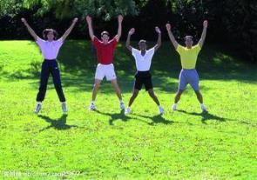
What should he do?
He is too fat.
He should exercise everyday.

Slide 8
1a Are they serious or not?
Serious | Not serious
1. I have to study too much so I don’t get enough sleep. 4. I have too many after-school classes. 5. I got into a fight with my best friend. | 2. I have too much homework so I don’t have any free time to do things I like. 3. My parents don’t allow me to hang out with my friends.

Slide 9
2a Listen and fill in the blanks with
could or should.
Advice
You _____ write him a letter. You _____ call him up. You _____ talk to him so that you can say you’re sorry. You _____go to his house. You _____take him to the ball game.

Slide 10
2b Listen and write the letters ( a-e ) next to the advice.
Advice
You _____ write him a letter. ( ) You _____ call him up. ( ) You _____ talk to him so that you can say you’re sorry. ( ) You _____go to his house. ( ) You _____take him to the ball game. ( )

Slide 11
2d Role-play the conversation:
Q: What’s wrong with Kim?
His sister took some of his new magazines and CDs without asking. He is angry with her.

Slide 12
Read and answer:
Q: What advice did Dave give Kim?
He told Kim that he could tell his sister
to say sorry and he could forget about it.

Slide 13
Key points
(1) look through 粗略地翻阅；细审
eg. He looks through several newspaper before breakfast. 他早饭前通常浏览几份报纸。
You should look through your notes before the examination. 考试前你应该复习一下笔记。
(2) so that 以便；结果，以致
eg. I’ll give you all the facts so that you can judge for yourself. 我会给你所有的事实以便你可以自己判断。
Everyone lent a hand, so that the work was finished in a few minutes. 每个人都帮了忙，所以工作在几分钟内就完成了。

Slide 14
（3）Although she’s wrong, it’s not a big deal. 虽然说她有错，但是这并不是什么了不起的事。
although conj. 尽管，虽然；但是，然而
eg. Although my car is very old, it still runs very well. 我的汽车虽然很旧，但仍然跑得很好。
Although quite young, he knows a lot. 虽然很年轻，但是他知道的东西却很多。

Slide 15
Homework
Writing
In our daily life, we often have some
problems that make us unhappy. We
may ask our parents, teachers, or
friends for help to solve the problems.
Please write down your conversation.

