Slide 1
Unit 8
It smells delicious
WWW.PPT818.COM

Slide 2
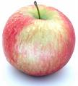
Guess
I’m sweet to eat. I’m red and round. I grow on the tree. My name begins with the letter as “ant”. What am I?
apple

Slide 3
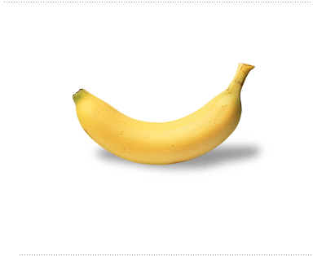
Guess
I’m yummy to eat. I’m yellow and long. I’m from the tree. My name begins with the letter as “bee”. What am I ?
banana

Slide 4
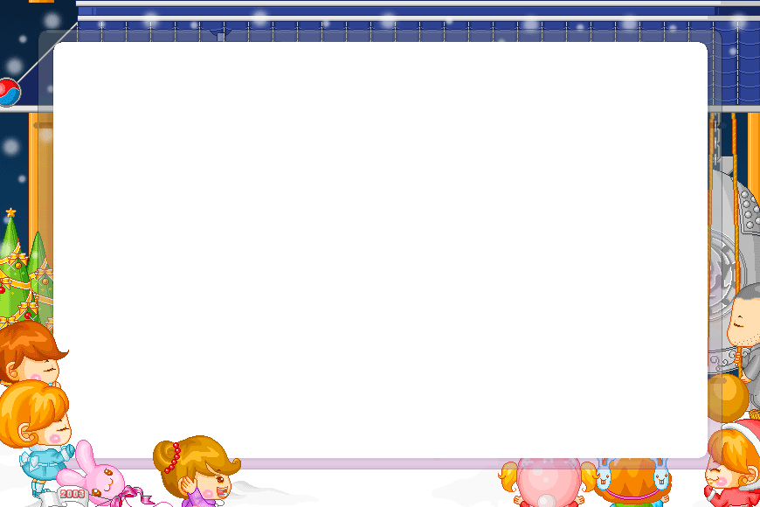
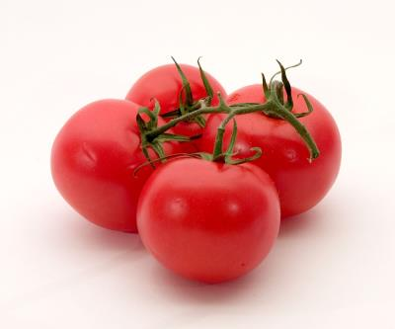
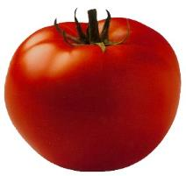
I like tomatoes．They’re full of VC（富含维Ｃ）. They‘re good for me.
I’m juicy to eat. I’m red and round. I grow on the ground. My name begins with the letter as “tea”. What am I ?
tomato
es

Slide 5
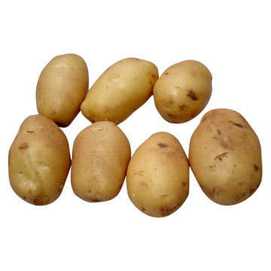
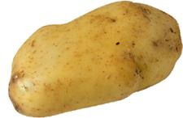
I like potatoes. Yummy and tasty.
Hello! I’m brown and tasty. I’m a friend of the tomato. We both like ‘o’ and ‘a’. What am I ?
potato
es

Slide 6
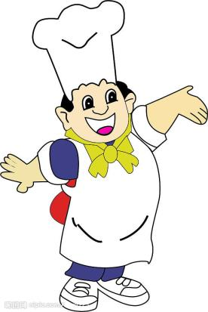
Cook: Come on, everyone. It’s time for lunch. I hope you’ll enjoy it.
Jiamin: Wow! Everything looks great.

Slide 7
Ben: I think I’ll try the chicken first . It smells delicious …Very hot.
Jiamin: Really? I don’t like hot food. I like sweet food.

Slide 8
Cook: Oh. Then don’t eat the sandwiches. They are very salty. Try the dumplings. They are quite sweet.
Janet: What do you think of the fish?

Slide 9
Jiamin: There are so many tings to try. I feel very hungry now. I can’t wait!
Cook: It’s good. And healthy too.

Slide 10
Let's play!

Slide 11
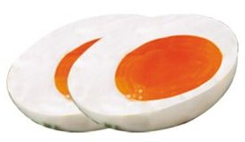
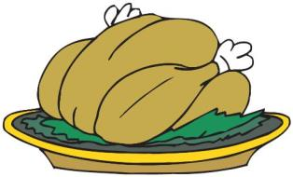
ice cream
eggs
vegetables
look fresh
is very sweet
are salty
meat
fish
chicken
looks quite good
smells delicious
tastes good

Slide 12
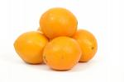
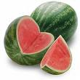
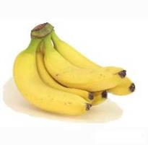
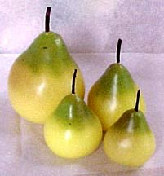
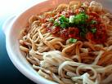
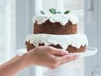
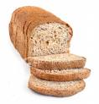
oranges
watermelons
bananas
pears
dumplings
hot dogs
rice
noodles
hamburgers
cakes
bread
chicken

Slide 13
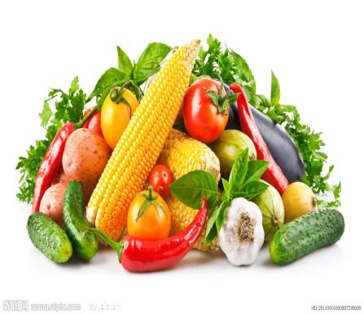
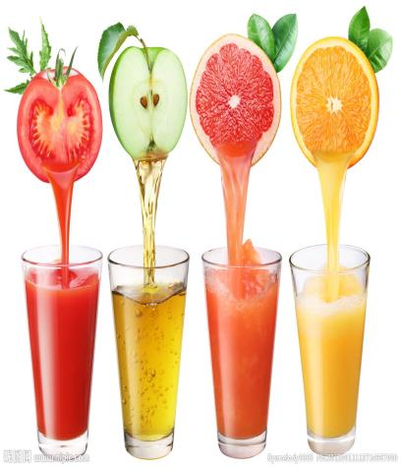
Let's talk!

Slide 14
I like fish. It’s tasty and fresh. It’s healthy, too. I’d like some fish for lunch.
fish
Look! I’m fresh. I can make you heathy. I’m tasty.

Slide 15
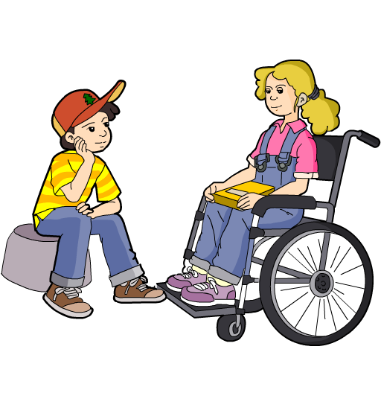
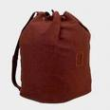
Look! My bag is full. But I’d like some meat for lunch. Meat can make me strong.

Slide 16
Let's play a game

Slide 17
Instructions(游戏规则)
1.三个同学上前来,代表一种食物，每一个同学尽力介绍自己的优点。
2.请一个学生扮演顾客,挑选自己喜欢的食物,并简单地说以下理由.
如学生A扮演hamburger
SA: I’m a hamburger, I’m very tasty ,come on, choose me!
其他食物也可以介绍自己的优点，扮演顾客的同学在听了介绍之后可以选择自己喜欢的食物，并且加上理由．如学生B扮演顾客．
SB: I like hamburger , It’s tasty ,It’s my favorite.

Slide 18
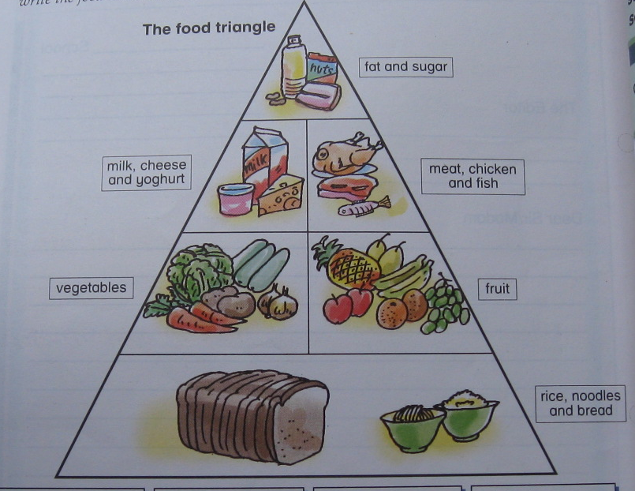
Do you know?
食物金字塔
油脂和糖
牛奶,奶酪和豆浆
肉类,禽类和鱼类
蔬菜
水果
杂粮类

