Slide 1
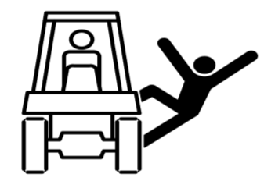
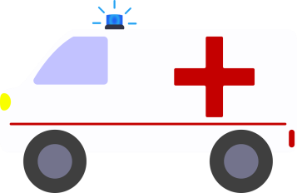
Module5 Look after yourself
Unit1 We’d better get you to hospital.
WWW.PPT818.COM

Slide 3
What should you do if you have a cold?
Stay hydrated by drinking more
water and eating vegetables and
fruit.
Get plenty of rest.
Stay warm.

Slide 4
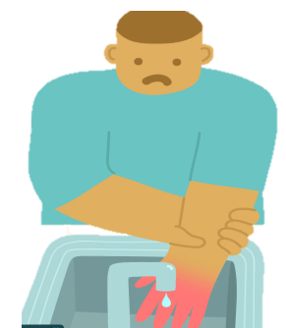
What should you do if you get burnt?
Flush the burned area with cool
running water for several minutes.
Apply a burn ointment (软膏） or spray to reduce pain.
Call the ambulance if you are
seriously burnt.

Slide 5
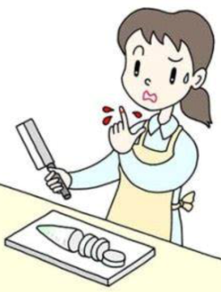
What should you do if you cut your finger?
Stop the bleeding.
Rinse the cut under clear
running water.
Apply a bandage if the
cut is deep.

Slide 6
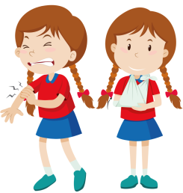
What should you do if you break your arm?
Stop the bleeding.
Apply ice to reduce swelling.
Cut away the sleeve if it can’t
be removed without moving
the injured arm.

Slide 7
Listening
A2. Listen and answer the questions.
1. Has Tony’s dad ever had an accident?
2. How long did it take for the wound to get better
after Tony’s dad cut his finger?
3. What parts of his body hurt after Tony’s dad fell
off his bike?
4. What is Tony reading about for his school trip?

Slide 8
1. Has Tony’s dad ever had an accident?
2. How long did it take for the wound to get
better after Tony’s dad cut his finger?
Yes, he cut his finger once, and he fell off his bike.
It took a month for the wound to get better.

Slide 9
3. What parts of his body hurt after Tony’s dad
fell off his bike?
4. What is Tony reading about for his school trip?
His knee and shoulder hurt after he fell off his bike.
He is reading about personal safety and accidents in the mountains.

Slide 10
A3. Listen and answer the questions.
1. Who is missing?
Tony and Daming are missing.
2. Who had an accident?
Daming had an accident.
3. When did he fall?
He fell ten minutes ago.
3. How did Daming feel?
His leg hurt and he couldn’t see very well.

Slide 11
Accident report
Where: _________________ Who: _______
When: ______________________
What happened: _______________________________
______________________________________________
How the person was hurt: ___________________________
How to save him: _________________________________
in the mountains
Daming
about 10 minutes ago
He fell over when he was running down the steps.
He hit his head and cut his knee.
He was sent to hospital.

Slide 12
Read again and answer the questions.
① Why did Mr. Jackson decide to go and look for
Tony and Daming?
② What happened to Daming?
They had an agreement to stick together, and it’s going to rain, so Mr. Jackson decided to go back and look for them.
Daming fell over. He hit his head and hurt his leg.

Slide 13
③ When did the accident happen?
The accident happened about 10 minutes
ago./The accident happened when Daming
was running down the steps.

Slide 14
Summary
How to describe an accident?

Slide 15
Write an accident report and then describe an accident to us.
When:
Where:
What happened:
How the person was hurt:
How to save him:

Slide 16
Expressions
赶上
几分钟后
在…的后面
同意
发生一起事故
摔倒
catch up
in a few minutes
at the back
have an agreement
have an accident
fall over

Slide 17
7.摔断腿
8.变瞎
磕破膝盖
把某人送到某地
求助
用某人的手机
没什么大事
取消
break one’s leg
go blind
cut one’s knee
get sb. to somewhere
call for help
on one’s mobile
nothing serious
call off

Slide 18
Sentences
1. They’ll catch up in a few minutes.
他们几分钟后就会赶上来的。
catch up 追上；赶上
catch up with sb. 赶上某人
I stopped and waited for her to ________.
我停住脚步，等她追上来。
She tries to ____________ (赶上)her classmates.
catch up
catch up with

Slide 19
2. I thought we had an agreement to stay together.
我原以为大家都商量好了，要一起走呢。
agreement n. 同意，意见一致
have an agreement to do sth.
同意做某事=agree to do sth.
Our class ___________________（同意）have a
picnic next week.
have an agreement to

Slide 20
reach an agreement 达成一致
The most important thing is to ________________
and to avoid a trade war.
最重要的是达成协议，避免贸易战。
agree on sth. 同意某事，达成一致
We rarely ___________what to do.
我们很少在要做的事情上看法一致。
disagree with sb. 不赞同某人
Some people _____________this argument.
有些人不同意这一论点。
reach an agreement
agree on
disagree with

Slide 21
3. He fell over when he was running down steps.
fell over 指向前摔倒
step n. 步伐、台阶、措施
He walked with a quick light step.
We are taking steps to prevent pollution.
We walked down some stone steps to the beach.
take a step towards…… 朝…走去
We _________________ the door. 我们朝门走去。
步伐
措施
台阶
took a step towards

Slide 22
4. Will I go blind?
我不会变瞎吧？
blind adj. 失明的；瞎的
Tom helped _____________across the road.
汤姆帮助那位盲人过马路。
blind adj.对某事视而不见
She is _______to her husband’s fault.
the blind man
blind

Slide 23
5. Tony, tell everyone we have to call off the
walk and go back home.
托尼，告诉大家取消徒步活动，我们回家。
call off 取消，决定终止
call on sb 拜访某人; 呼吁
call for 请求，要求
call out 大声叫出

Slide 24
用call的正确词组填空。
We finished the main course in short order
and ____________more wine.
I really should _________my aunt more often.
He has ___________ the trip.
I _________to him in the dark but no one seems to
be there.
called for
call on
called off
call out

Slide 25
Complete the passage with the words and expressions in the box.
accident agreement blind catch up hurt
agreement
We had a(an) _________ to stay together, but Tony and Daming were too slow. We stopped to wait for them to _________. But Daming had a(an) ________ and _________ himself. He was afraid of going _________ because he could not see very well. It was nothing serious, though. However, we had to call off the walk and go home.
catch up
accident
hurt
blind

Slide 26
Translation
1. 他们取消了这次运动会，因为糟糕的天气。
They called off this sports meeting because of bad weather.
2. 跑快点，否则你追不上他。
Run fast, or you will not catch up with him.
3. 他出差时我将照看他的孩子。
I will look after his children when I am on a business trip.
4. 她坐下来要了一些啤酒。
She sat down and called for some beer.

Slide 27
Choose the proper phrases in the box.
have been to call for help
catch up with wait for happened to
You will have work harder to ____________ the top students in your class.
2. I hear you ________________ Africa as a
volunteer.
catch up with
have been to

Slide 28
have been to call for help
catch up with wait for happened to
3. The children can’t ___________ the coming
New Year.
The young man had to _____________ at once on his mobile phone.
5. The girl is missing. What’s _____________ her?
wait for
call for help
happened to

