Slide 1
Module9 Friendship
Unit 2
I believe that the world is what you think it is.
WWW.PPT818.COM

Slide 2
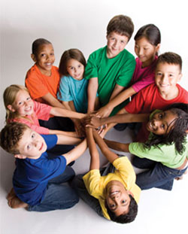
Warming up
Are you happy to have many friends?

Slide 3
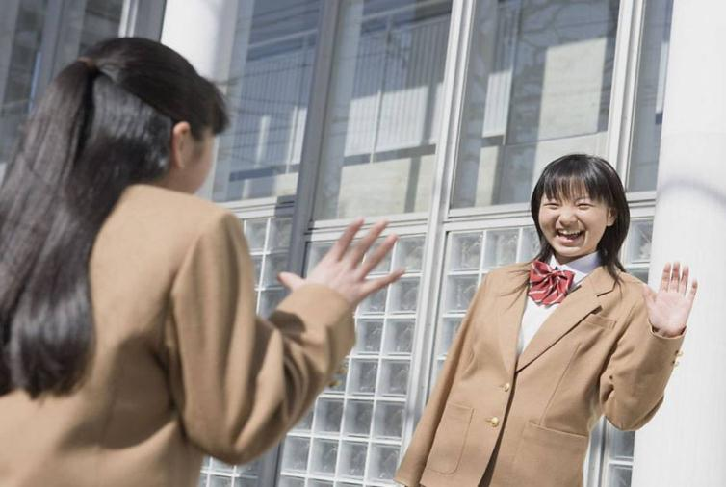
Are you afraid to make friends?

Slide 4
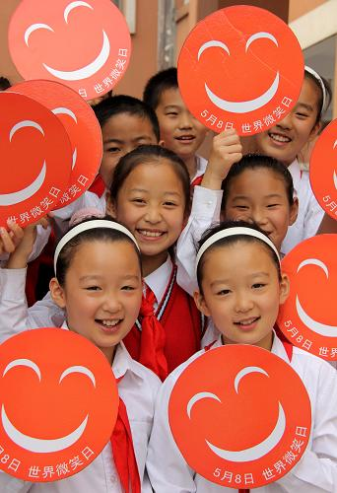
Do you often smile at others?

Slide 5
How do you feel when you are with your friends?

Slide 6
Words and expressions
silence
in silence
pass
bright
treasure
day by day
trust
n. 寂静，无声
安静地，沉默地
v. 经过，通过
adj. 欢快的，明亮的
n. 珍宝，珍贵之物
一天天地，渐渐地
v. 信任，信赖
n. 信任，信赖

Slide 7
Words and expressions
include
circle
stick
glue
suggestion
v. 包括，把……列为
一部分
n.（熟悉的，相关的
人形成的）圈子
v. 粘，粘贴
n. 胶水
n. 提议，建议

Slide 8
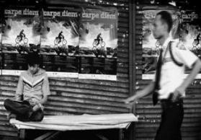
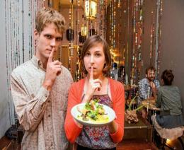
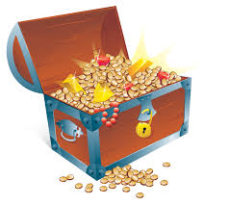
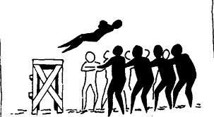
New words
pass v. 经过；通过
silence n. 寂静；无声
bright adj. 欢快的；明亮的
treasure n. 珍宝；珍贵之物
trust v./n. 信任；信赖

Slide 9
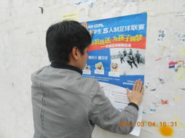
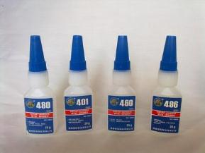
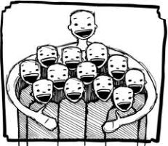
circle n. (熟悉的、相关的人形成的)圈子
stick v. (stuck, stuck)粘；粘贴
glue n. 胶水
include v. 包括；把……列为一部分
suggestion n. 提议；建议

Slide 10
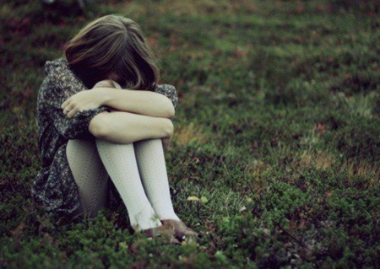
Work in pairs and answer the questions.
When was the last time you felt sad?

Slide 11
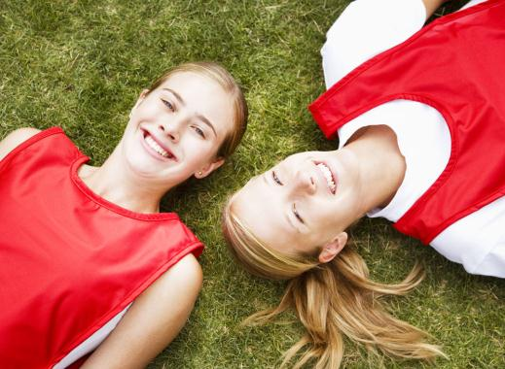
2 Who did you tell that you were sad?

Slide 12
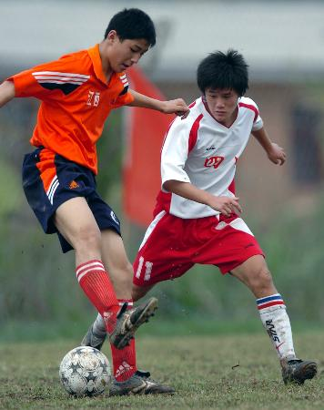
3 What did you do to feel better?

Slide 13
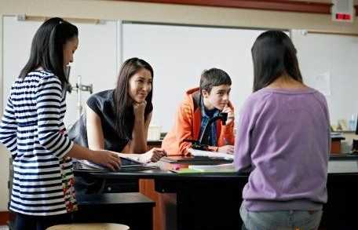
4 How can you make other people feel happy?

Slide 14
1st reading:
Who is the main character?
When did the story take place?
Where did the story take place?

Slide 15
A beautiful smile
By Zhang Bei
When I was thirteen years old, a girl gave me an important gift. It was a smile.
It was the early autumn of my first year at a new school. No one knew me. I was very lonely, and afraid to make friends with anyone.

Slide 16
2nd Reading
Find out the object clauses in the passage.
1. I didn’t know who she was.
2. One day, I asked her why she smiled at me that day.
3. She said she could not remember!
4. Now I believe that the world is what you think it is.

Slide 17
3rd Reading Complete the sentences.
At first
(1) _______ knew me.
I felt (2) ______
_______ and was afraid to (3) _____
______ with anyone.
Then one day
A girl looked at me and (4) ___________
_____________.
I felt (5)_______,
lively and warm.
Now
The girl has become my (6) ___________.
I believe that the world is (7)______
__________ it is.
No one
very
lonely
(without a
word) smiled
best friend
make
friends
happy
what
you think
Fact
Opinion: Smile at the world and (8) __________________.
it will smile back

Slide 18
Complete the sentences with the words in the box.
circle glue silence stick suggestion treasure trust
My father made the _________ that I should find a hobby.
Even today, some people search for _________ under the sea.
You can _______ them to look after the house.
suggestion
treasure
trust

Slide 19
circle glue silence stick suggestion treasure trust
4 You must make the stamp wet before you ______ it to the letter.
5 Have you got any _______? I want to stick these pieces of paper together.
John’s _______ of friends includes some students from the UK.
I like the _______ in the countryside. The city is too noisy for me!
stick
glue
circle
silence

Slide 20
Language points
1. Every time I heard the other students talking and laughing, I felt even more lonely.
every time, 表示“每次”。在本句中引导一个状语从句。every time等于each time。
例如：Every time/Each time I ask you to do something, you always say you are too busy.

Slide 21
2. One day, my classmates were talking with their friends, but I sat in silence.
in silence, 表示“安静地，沉默地”。
例如：He reads the book in silence.
3. Suddenly, I felt the touch of something bright and friendly.
bright表示“明亮的，欢快的”，形容词。例如：
The bright lights arrested the boy’s attention.

Slide 22
4. Day by day, I learnt to trust people, and they include me in their circle of friends.
day by day, 表示“一天天地，渐渐地”。
如：It is getting warmer day by day.

Slide 23
trust表示“信任，相信”。如：
n. A good marriage is based on trust.
v. If you break your word, he will never trust you again.
include表示“包括，把……列为一部分”。
例如：Please include me in the list.

Slide 24
5. And we stick together like glue.
stick表示“粘，粘贴”。如：
What’s wrong with this stamp? It won’t stick.
6. My suggestion is: Smile at the world and it will smile back.
suggestion是不可数名词，表示“建议”。它的动词形式为suggest。例如：
I suggested doing exercise every day.

Slide 25
Grammar
whether/if及疑问词引导的宾语从句
疑问词引导的宾语从句。
通过本模块的学习，相信同学们已经注意到，有的宾语从句既不用that引导，也不用whether或if引导，而是用when，where，how或why等疑问词引导，这是从句意思表达的需要。

Slide 26
例如要表达“他问什么时间出发”时，句中的“什么时间”之类的疑问时，我们就要使用相应的疑问词来引导从句。
但是，在疑问词引导的宾语从句中，一定要用陈述句语序。例如：
He asks how we can help protect the environment.
Do you know when we will hold the sports meeting?

Slide 27
Read the passage again. Find the paragraphs that describe the following stages.
Paragraph 1
Paragraph 2 Paragraph 3 Paragraph 4
Paragraph 5 Paragraph 6 Paragraph 7 Paragraph 8
What happened and when. ——
Where she was and how she felt.——
Why she felt that way. ——
What happened one day. ——
What happened suddenly. ——
What happened after this. ——
What happened later. ——
What she thinks now. ——

Slide 28
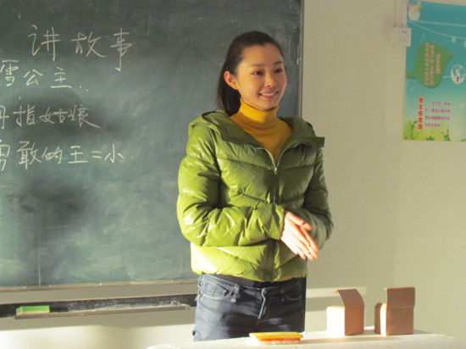
Write a passage about someone or something that changed your life. Use the stages in Activity 5 to help you.

Slide 29
本课小结
whether/if及疑问词引导的宾语从句
重点短语
in silence
day by day
every time

Slide 30
练一练：
1. ____ I read the novel, I felt the touch of something.
Every time B. Everytime
C. Every times
2. The boy felt _____ when he stayed at
home alone.
A. alone B. lonely C. happily
A
A

Slide 31
3. The little boy grew up day ____ day.
A. at B. to C. for D. by
4. I want to give you some _____ about
the hobby.
A. suggest B. suggestion
C. advices D. piece of advices
D
B

Slide 32
中考链接
The policewoman asked the little boy ______. 【2012贵州安顺】
A. where did he live
B. where he lived
C. where he lives
D. where does he lives
2. -- Could you tell me_____ he came here?
--He drove here himself. 【2012 安徽省】
how B. why C. when D. whether
B
A

Slide 33
3. --Can you tell me ____ the prize, Tom?
--Last year. 【2012北京】
when you got B. when did you get
C. when will you get D. when you will get
4. --Could you tell me _______?
--Certainly. In half an hour.【2012广东】
when will the high speed train arrive
B. when the high speed train will arrive
C. when would the high speed train arrive
D. when the high speed train would arrive
A
B

Slide 34
Homework
给老师写一封电子邮件，介绍你交友方面遇到的问题。

