Slide 1

陕旅版小学英语四下
WWW.PPT818.COM

Slide 2


Slide 3
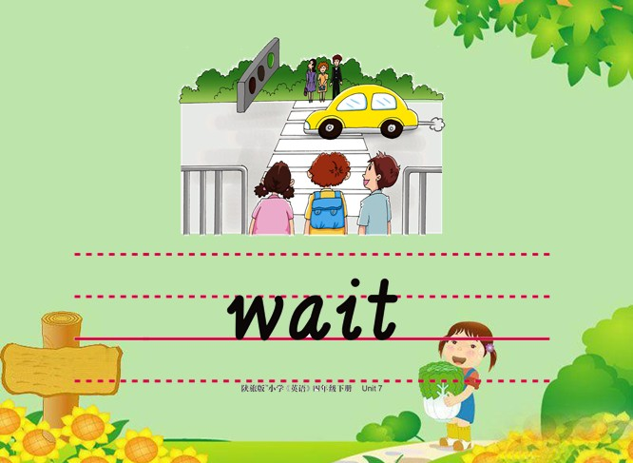

Slide 4


Slide 5


Slide 6


Slide 7


Slide 8
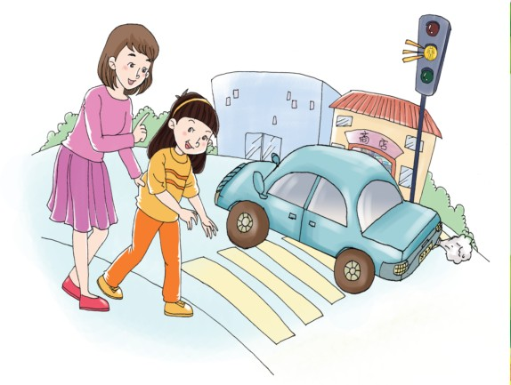
Let s go to the shop. I m going
to buy a gift for your grandpa.
OK.
All right.
Be careful! Look at the traffic lights. It s yellow.
Don t cross the street. Stop and wait.

Slide 9
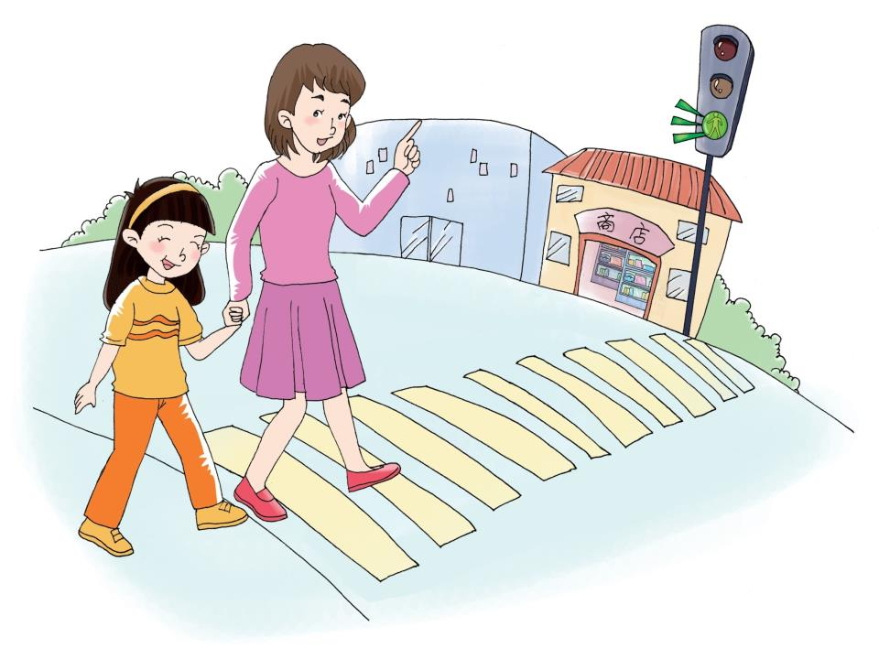
The light is green. We can go now.
Let,s go.

Slide 10
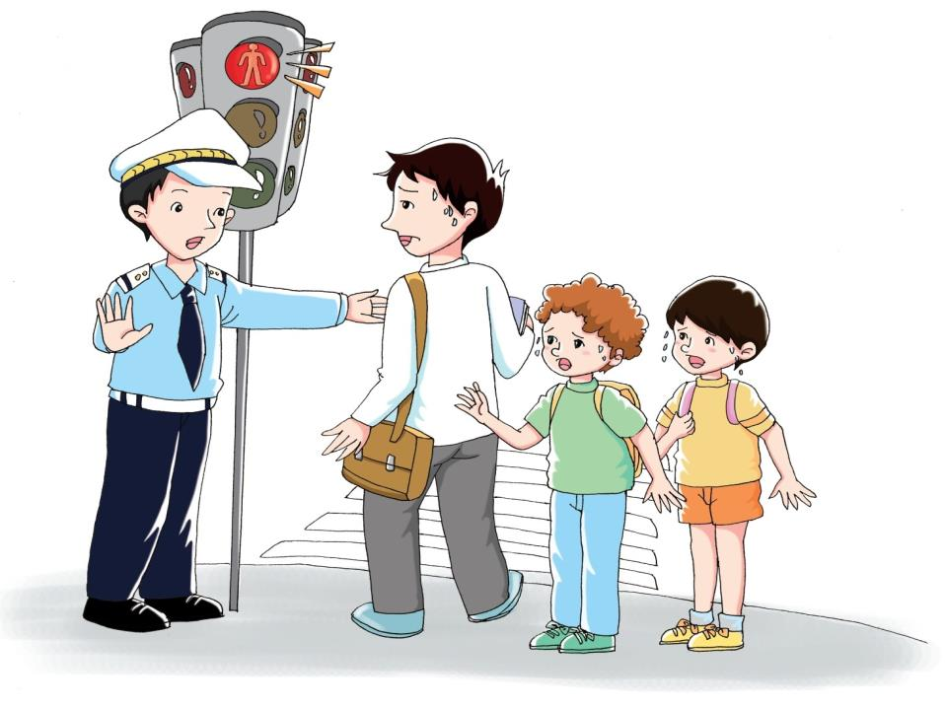
Please stop.
Don t cross.
The light is red.
I,m going to work.
We are going to school.
Sorry. Please
wait a minute.

Slide 11
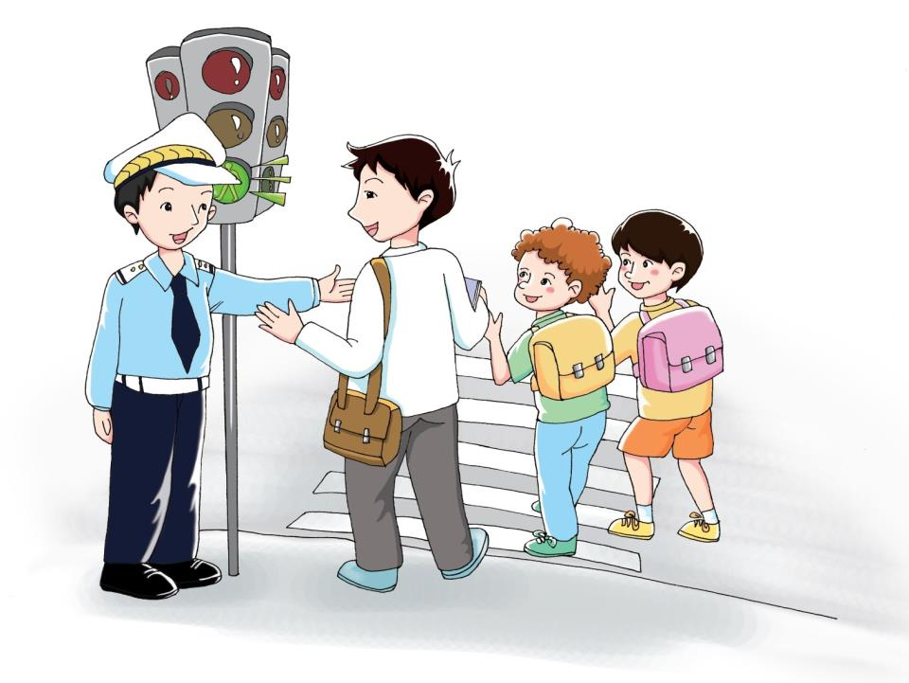
Now the light is green. You can go.
Thank you. Bye-bye.

Slide 12
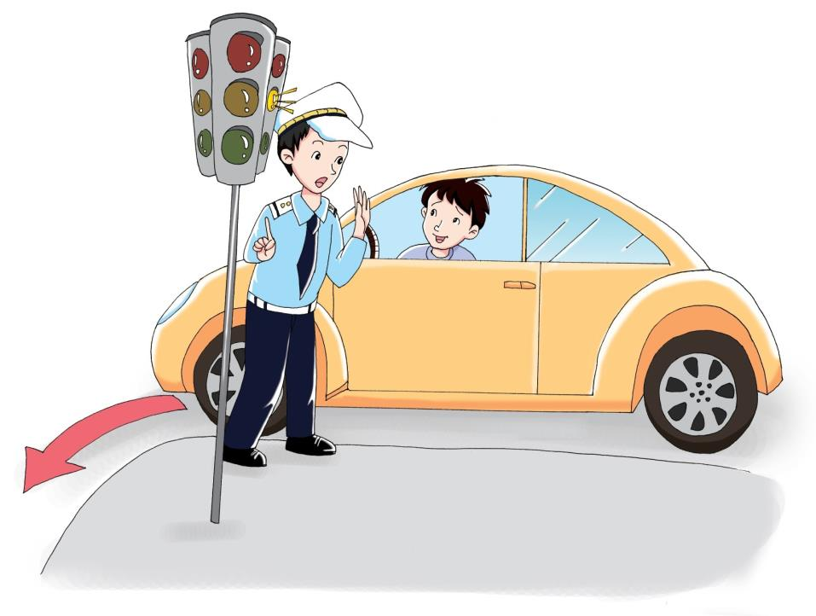
Look at the light! Don t turn left.
Please wait a minute.
I,m sorry.

