Slide 1
Unit 7 What's the highest mountain in the world?
Section A 第1课时
WWW.PPT818.COM

Slide 2
Do you know?
What's the highest mountain in the world?
What's the largest desert in the world?
What's the longest river in the world?

Slide 3
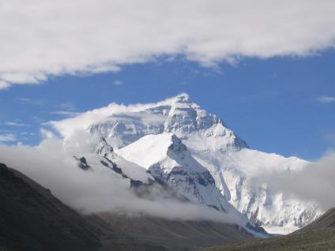
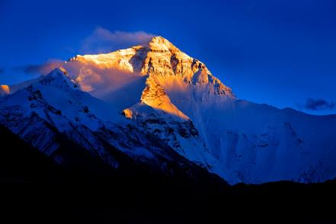
Qomolangma
the highest mountain

Slide 4
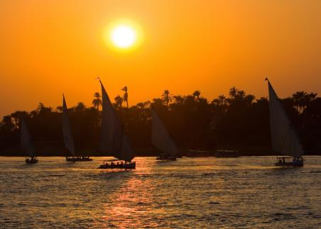
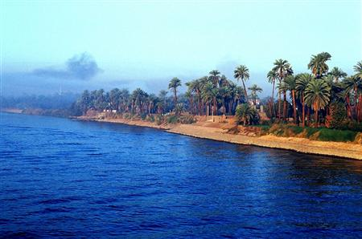
the Nile
the longest river

Slide 5
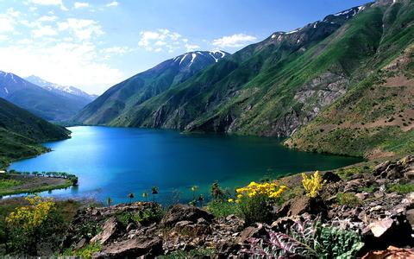
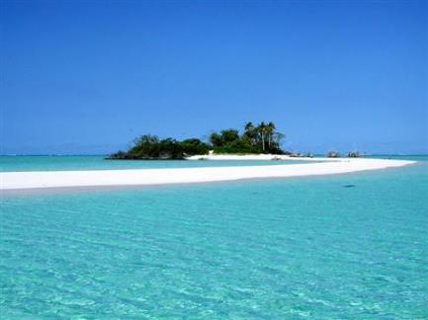
the Caspian Sea
the biggest salt lakes

Slide 6
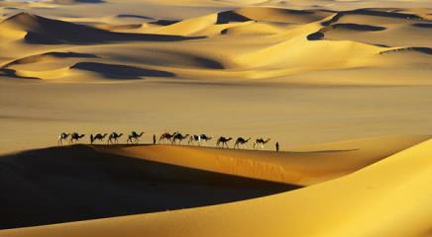
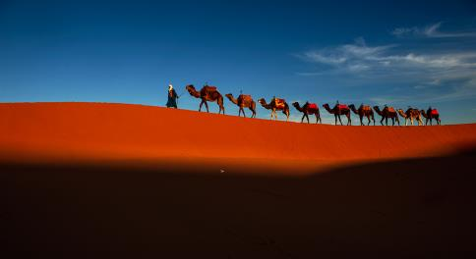
the Sahara
The biggest desert

Slide 7
1a
Match the facts you know.
Qomolangma | about 9,600,000 square kilometers in size
The Sahara | 1,025 meters deep
The Caspian Sea | 6,671 kilometers long
The Nile | 8,844.43 meters high

Slide 8
1b
Listen and complete the sentences.
higher
1. Qomolangma is ______ than any other
mountain in the world.
2. The Sahara is __________ desert in the
world.
3. The Caspian Sea is ___________ of all the salt lakes.
4. The Nile is __________ river in the world.
the biggest
the deepest
the longest

Slide 9
1c
Use the information in 1b to make conversations.
A: What is the highest
mountain in the world?
B: Qomolangma.

Slide 10
Which is the longest river in the world?
The Nile.

Slide 11
2a
Listen and number the facts [1-4] in the order you hear them.
6,300 5,000 5,464 300
__The Yangtze River is about _____ kilometers long and the Yellow River is _______kilometers long.
__ China has the biggest population in the world. It's a lot bigger than the population of the US.
__ China is over ______ years old. It has a much longer history than the US. The US is not even _____ years old.
__ China is almost as big as the US, but it is the biggest country in Asia.
4
2
1
3

Slide 12
2b
Listen again and fill in the blanks in 2a with the numbers in the box.
6,300 5,000 5,464 300
The Yangtze River is about _______ kilometers long and the Yellow River is _________kilometers long.
China has the biggest population in the world. It's a lot bigger than the population of the US.
China is over ______ years old. It has a much longer history than the US. The US is not even _____ years old.
China is almost as big as the US, but it is the biggest country in Asia.
6,300
5,464
5,000
300

Slide 13
2c
Make conversations using the information in 2a.
A: Did you know that China is one of the
oldest countries in the world?
B: Yes, I did. It's much older than my
country.

Slide 14
2d
Role-play the conversation.
Guide: Feel free to ask me anything on today's
Great Wall tour.
Tourist 1: How long is the wall? Guide: Ah, the most popular question! If we're
only talking about the parts from the
Ming Dynasty, it's about 8,850 kilometers
long. This makes it the longest wall in the
world.

Slide 15
Tourist 2: Wow, that's amazing! Why did the
ancient emperors build the wall?
Guide: The main reason was to protect their part
of the country. As you can see, it's quite
tall and wide. As far as I know, there are
no other man-made objects as big as this.
Tourist 3: Is Badaling part of the Ming Great
Wall?
Guide: Yes, it's the most famous part.

Slide 16
HOMEWORK
1. To memorize the important
phrases and sentences.
2. To make some dialogues about
asking the size of objects.

