Slide 1
Unit2 What Would You Like?
第1课时
WWW.PPT818.COM

Slide 2
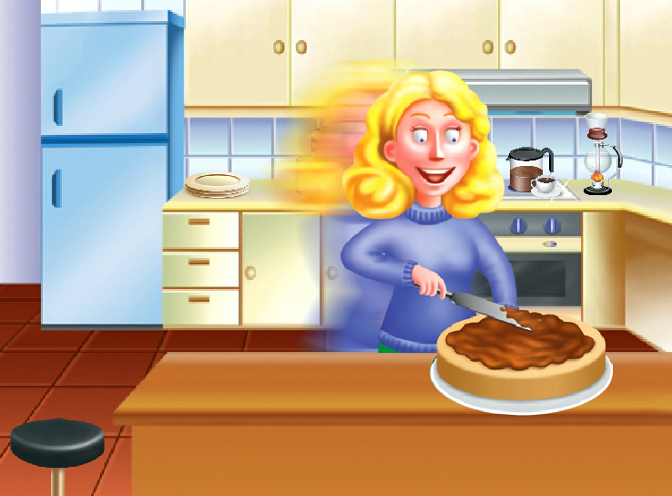
>>Warming-up
What did you have for breakfast this morning?
Let’s sing

Slide 3
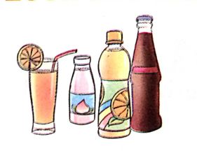
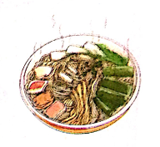
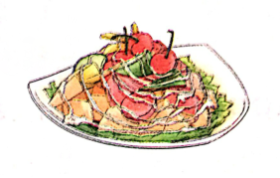
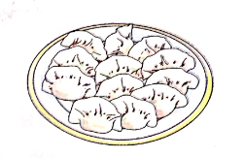
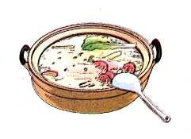
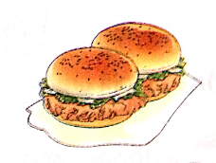
>>Lead-in
Look and match
dumplings
soup
hamburgers
drinks
fruit salad
noodles

Slide 4
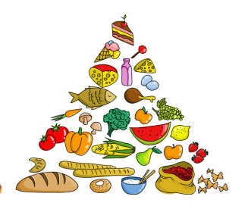
>>Lead-in
Let’s chant
I like milk. I like juice.
I like water. And I like tea.
I like bananas. I like grapes.
I like oranges. And I like apples.
I like noodles. I like dumplings.
I like hamburgers. And I like cookies.

Slide 5
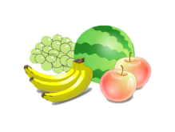
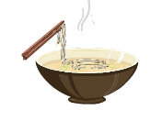
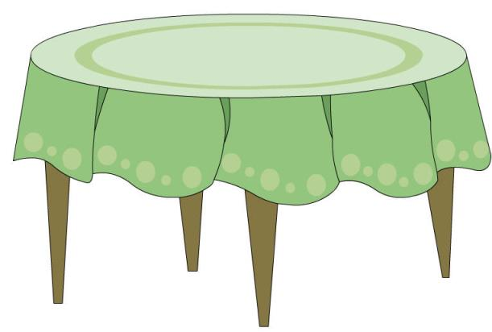
>>Lead-in
Look and say
How many apples/bananas… are there?

Slide 6
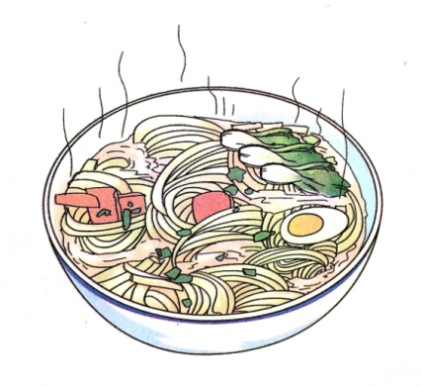
>>Presentation
Let’s learn
noodles
a bowl of noodles

Slide 7
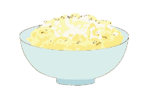
>>Presentation
Let’s learn
a bowl of rice
two bowls of rice
two bowls of noodles

Slide 8
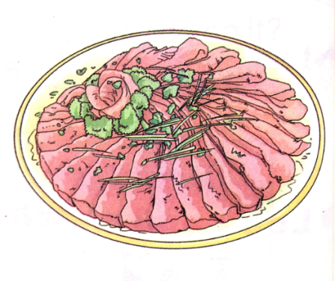
>>Presentation
Let’s learn
a plate of beef

Slide 9
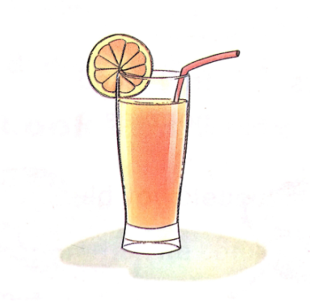
>>Presentation
Let’s learn
a glass of juice

Slide 10
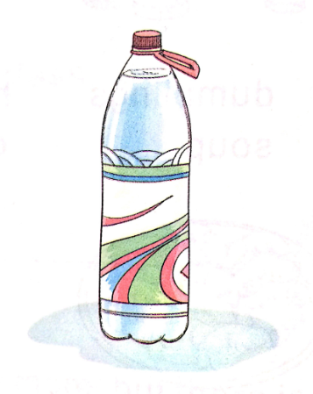
>>Presentation
Let’s learn
a bottle of water

Slide 11
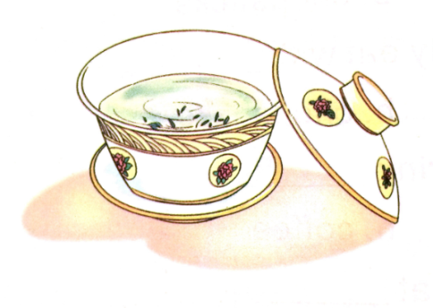
>>Presentation
Let’s learn
a cup of tea

Slide 12
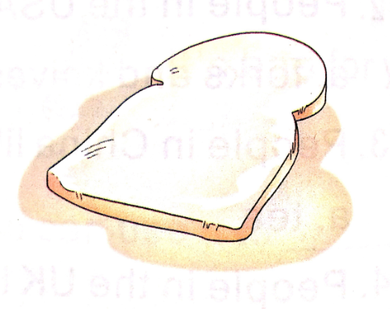
>>Presentation
Let’s learn
a piece of bread

Slide 13
>>Practice
Let’s play—Magic fingers
a bowl of noodles
a glass of juice
a plate of beef
a bottle of water
a cup of tea
a piece of bread

Slide 14
>>Practice
Quick response

Slide 15
>>Practice
Learn more
a bowl of rice/soup/noodles
a plate of beef/dumplings/
salad/chicken/meat/fish
a glass of water/juice/milk
a bottle of water/juice/milk

Slide 16
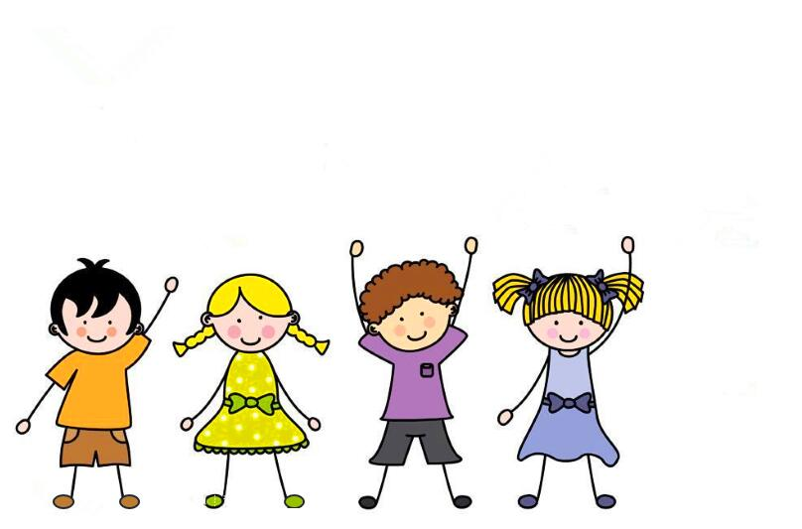
>>Practice
活动1
句子接龙
I’d like a glass of water.
I’d like three plates of beef.
I’d like two pieces of cakes.

Slide 17
>>Summary
词组：
a bowl of noodles
a glass of juice
a plate of beef
a bottle of water
a cup of tea
a piece of bread

Slide 18
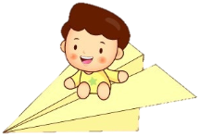
>>Homework
1.观看课文动画，按照正确的语音、语调朗读课文对话。
2.将“Let’s learn”部分词组每个抄写两遍。
3.预习“Let’s talk”。
close

