Slide 1

鲁科版五四制小学英语 三年级上册
Unit 5 Classroom
This is my desk.
WWW.PPT818.COM

Slide 2

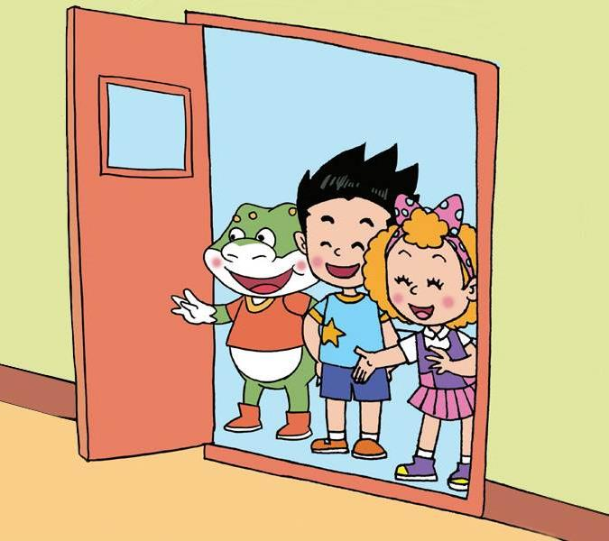







Slide 3

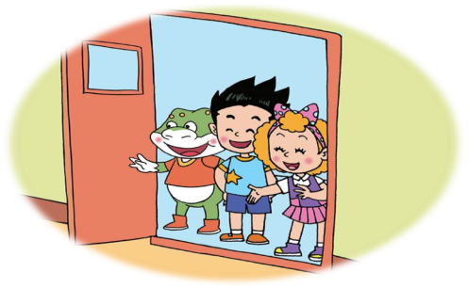
Why is Danny happy?
(Danny为什么很高兴？)

Slide 4

Why is Danny happy?
A. He goes to the new school.
（他去了新学校。）
B. He goes to the new classroom.
（他去了新教室。）

Slide 5
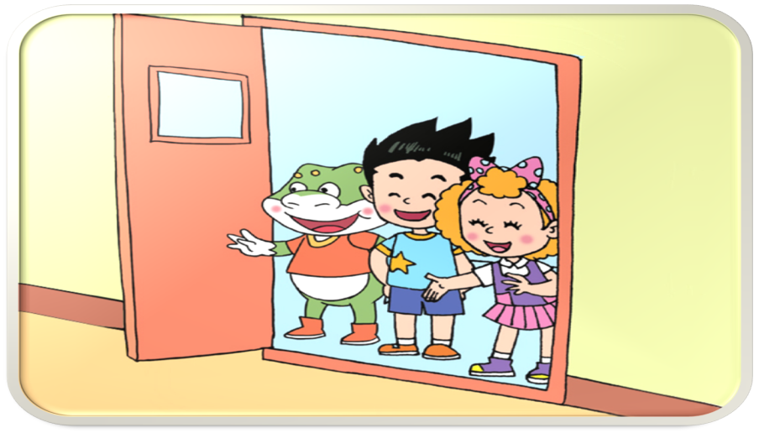

Oh！Our new
classroom.
This is our
classroom.

Slide 6

How does Jenny introduce her desk?
（Jenny怎样介绍自己的课桌？）
2. How does Danny talk about Jenny’s chair?
（ Danny怎样谈论Jenny的椅子？）
3. How does Ling Ming introduce his desk and chair?
（ Li Ming怎样介绍自己的课桌和椅子？）

Slide 7






air
chair
hair
pair
fair

Slide 8

How does Jenny introduce her desk?
（Jenny怎样介绍自己的课桌？）
2. How does Danny talk about Jenny’s chair?
（ Danny怎样谈论Jenny的椅子？）
3. How does Ling Ming introduce his desk and chair?
（ Li Ming怎样介绍自己的课桌和椅子？）

Slide 9


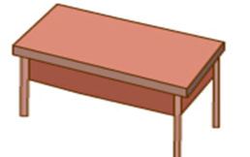
This is my desk.

Slide 10


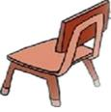
This is your chair.

Slide 11



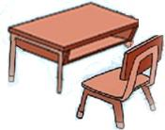

This is my desk. This is my chair.
That’s my desk. That’s my chair.

Slide 12






Can you read?
this
the
that
that’s

Slide 13
Can you read?

Slide 14




Slide 15
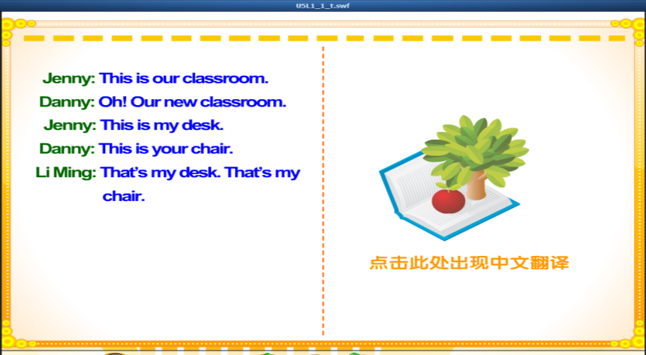

Slide 16


(请自己朗读课文。不要忘了互相帮助哟！）

Slide 17




(角色表演）

Slide 18


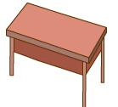
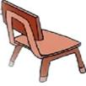
What does Jenny say？
This is my desk.
This is my chair.

Slide 19



That’s your desk.
That’s your chair.

Slide 20

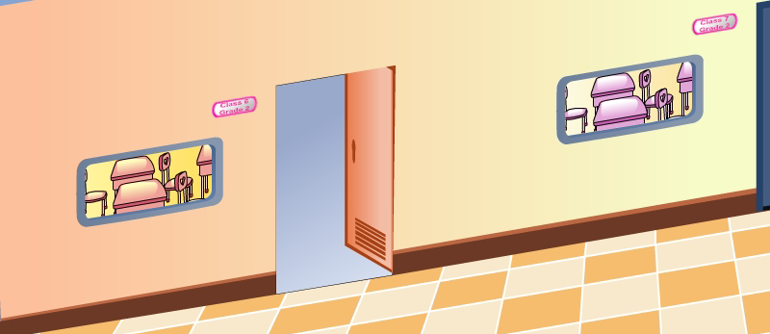


This is our classroom.
That’s your classroom.

Slide 21



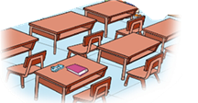

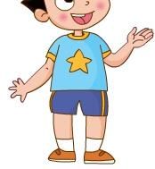

Slide 22
A: This is our….
This is my …. This is my ….
That’s your…. That’s your….
B: This is our….
This is my …. This is my ….
That’s your…. That’s your….

Slide 23

Tomorrow is the Parents’ Opening Day.
Can you be a little guide?
（明天是家长开放日，你能当小导游介绍我们的教室吗? ）

Slide 24
This is our….
This is my …. This is my ….
That’s your…. That’s your….
a. Work in groups.(小组合作)
b. Act in roles. (模拟表演开放日情景)
c. Show. (展示)

Slide 25
This is our….
This is my …. This is my ….
That’s your…. That’s your….
a. Work in groups.(小组合作)
b. Act in roles. (模拟表演开放日情景)
c. Show. (展示)

Slide 26

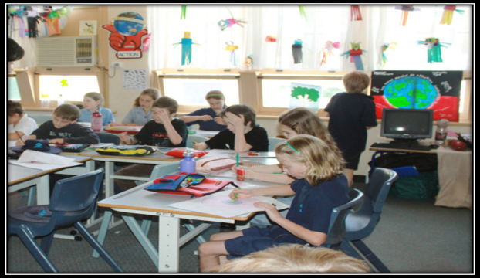
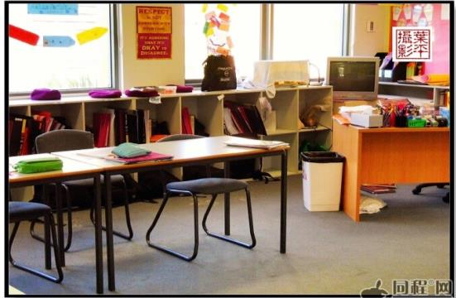
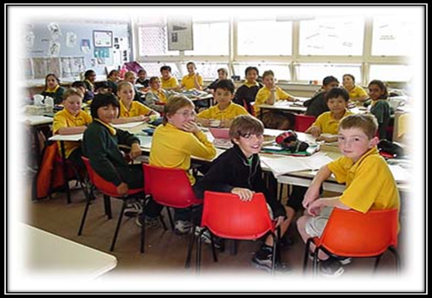
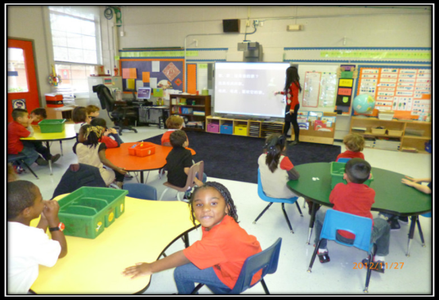
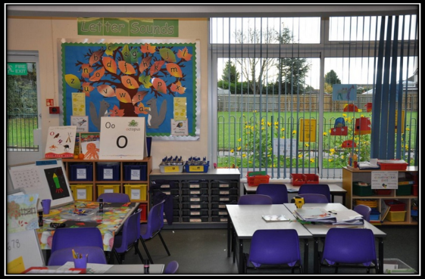
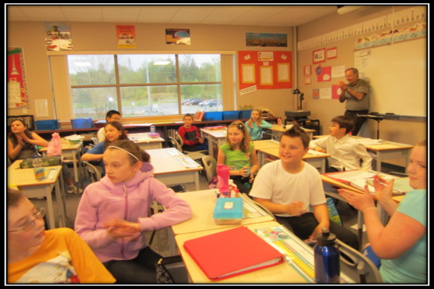
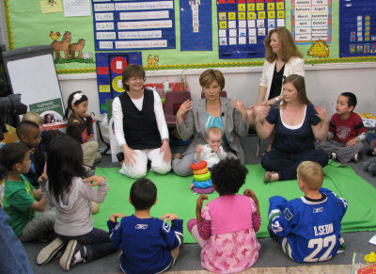
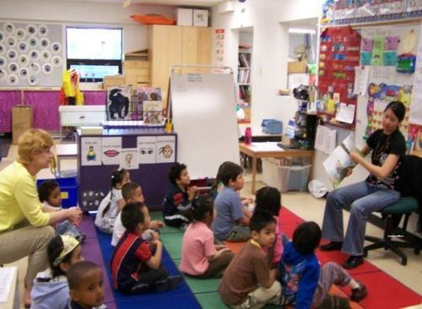
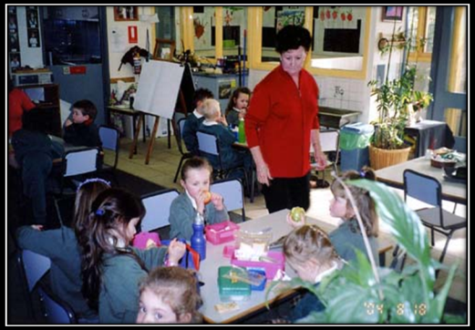

Slide 27

What’s the similarity among them?
（它们有什么相同点？）
Hh
Ii
Jj
Kk
Aa

Slide 28

1. Listen and repeat.
模仿课文。
2. Draw a picture of your classroom, then introduce it to your parents.
画一画你们的教室，并向爸爸妈妈介绍一下。
要注意 this 和 that 的区分啊！

