Slide 1
Unit 3 Winter in Canada
Lesson 18 The Snowman
WWW.PPT818.COM

Slide 2
Warming up
1.Play a guessing game.
What do you like to do?
I like/love to…

Slide 3
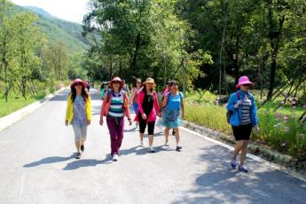
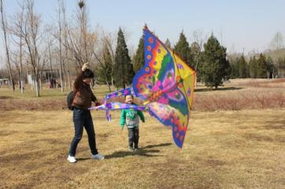
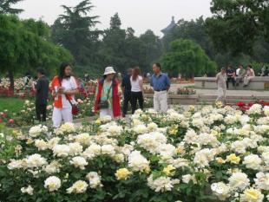
Warming up
2.Free talk
I went to the park with my friend last week.
We had fun.
Where did you go last week?

Slide 4
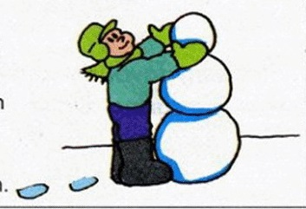
Presentation
观察图片，回答问题
What did John do in the season?
_____________________________
How was the weather on that day?
_____________________________
He played and made a snowman.
It was cold and snowy.

Slide 5
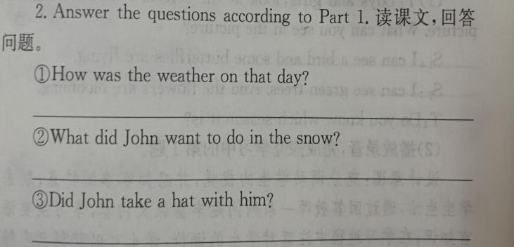
Presentation
It was cold and snowy.
He wanted to play in the snow.
Yes, he did.

Slide 6
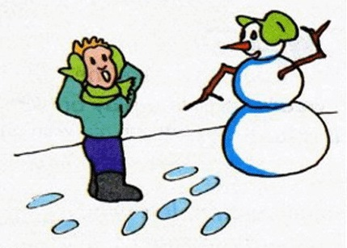
Presentation
观察图片，选出这段主题
A. John made a big snowman and he was surprised.
B. John found that the snowman could talk when he put his hat on the snowman.
C. John thought the snowman had a wonderful name.
D. John didn’t put his hat on the snowman because it was cold.

Slide 7
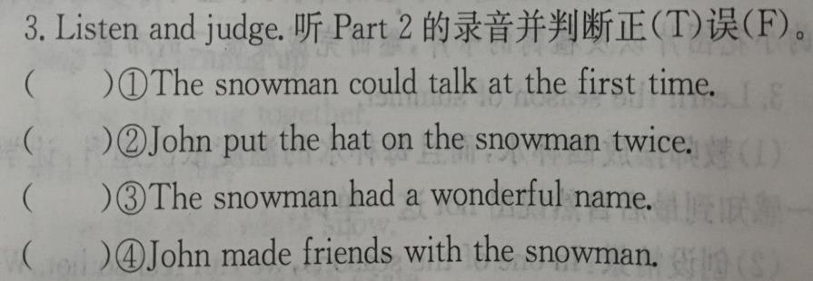
Presentation
F
T
F
T

Slide 8
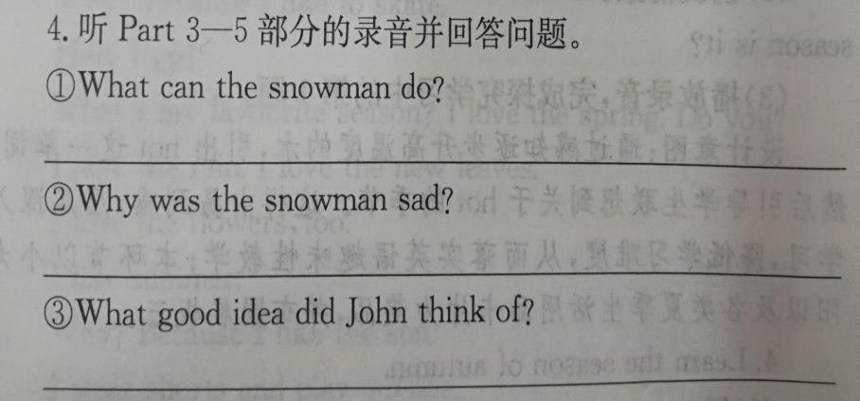
Presentation
The snowman can skate.
Because there were no snowmen in spring, summer and autumn.
He put the snowman in the fridge.

Slide 9
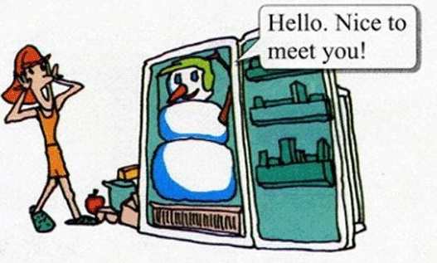
Practice
1.讨论回答以下问题：
What can the snowman do?
Why was the snowman sad?
What did John do for the snowman?
2.根据故事情节，你能续写妈妈打开冰箱后的故事吗？

Slide 10
Consolidation
Let’s choose the right answers.
( )1. He took ____ his hat and put it ____ the snowman.
A. of; on B. off; in C. off; on D. on; of
( )2.There is no ____ in summer.
A. snows B. snowy C. snowing D. snow
( )3.Can the snowman ______?
A. skate B. skating C. skates D. skating
( )4.At dinner time, John’s mother ____ the fridge.
A. opens B. opened C. opening D. open
C
D
A
B

Slide 11
Summing up
1.Words:
warm, rain, wind, snowy, ice, open
make snowman, play in the snow, put on, take off
2. Sentences:
John put on his hat.
He took his hat and put it on the snowman.
You can talk.
Can you skate?
3.
这节课我的收获是：_____________
这节课我的不足是：_____________

Slide 12
Homework
1.听录音，朗读本课的第一部分
2.完成相关习题
3.发挥想象，为故事编写结局。

