Slide 1
Module 1 Unit 2
What do you want to eat?
WWW.PPT818.COM

Slide 2
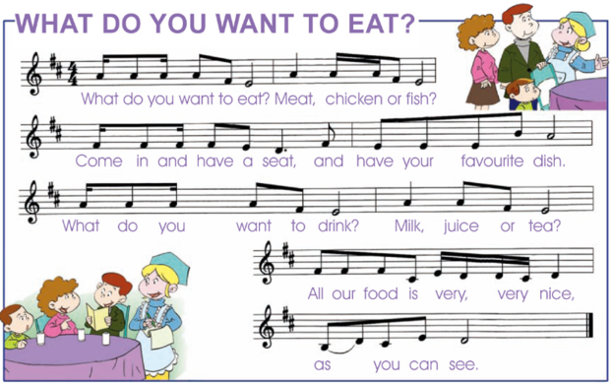
创设情境

Slide 3
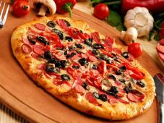
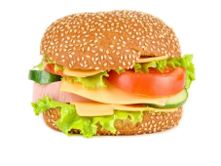
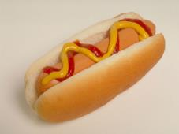
启发思考
What do you want to eat?
pizza
hamburger
hot dog

Slide 4
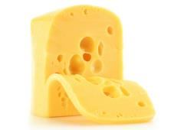
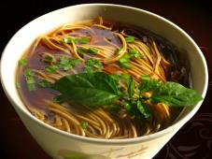
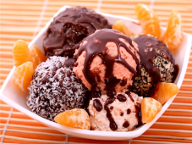
What do you want to eat?
cheese
noodles
ice cream

Slide 5
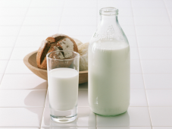
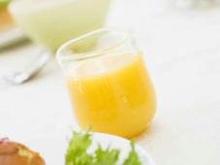
What do you want to drink?
cola
milk
juice

Slide 6
What else do you want to have?

Slide 7
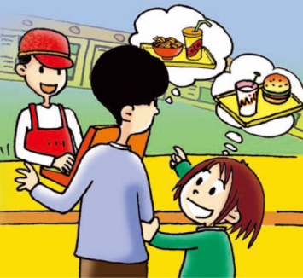
自主或小组探究
Lingling and Lingling’s dad go to a restaurant today.
Let’s have a look!

Slide 8
Ask and answer
1. What does Lingling want to eat?
She wants a hamburger.
2. What does Lingling want to drink?
She wants milk.
3. What does Lingling’s dad want to eat?
He wants noodles.
4. What does Lingling’s dad want to drink?
He wants a cola.

Slide 9
Listen and write
A hot dog
an ice cream

Slide 10
I want milk

Slide 11
four dollars and fifty cents

Slide 12
协作交流
Role-play

Slide 13
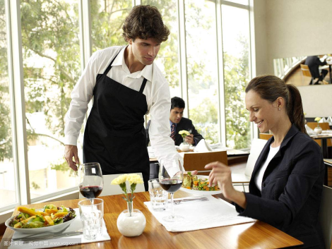
Let’s play guests and waiter!

Slide 14
总结提高
重点句型
Can I help you?
What do you want to eat/drink/have?
I want ...
It’s … dollars and … cents.

Slide 15
Homework
1.完成 配套练习。
2.记诵本单元单词句型。

