Slide 1
Module 3 Making plans
Unit 2 We are going to cheer the players
WWW.PPT818.COM

Slide 2
Warming up
What’s Daming going to do at the weekend ?
On Sunday ,what are Daming and his classmates going to do ?
Do you like having a picnic ?

Slide 3
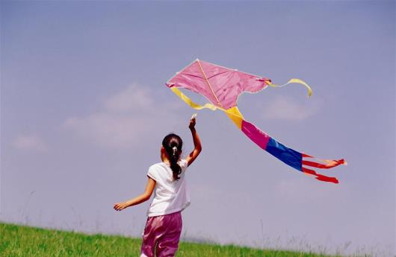
Look forward to (期待)
What are you looking forward to doing this weekend ?

Slide 4
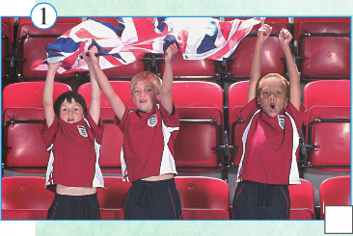
watch a football match
cheer the players
/tʃɪə/
为······ 喝彩
What are you going to do ?

Slide 5
go sightseeing
go on a summer camp
/kæmp/
营地，帐篷
What are you going to do ?

Slide 6
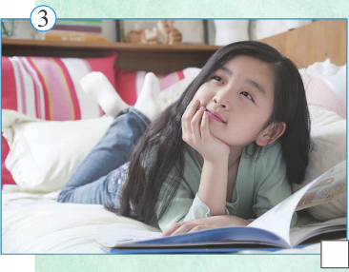
read a book
stay at home
What are you going to do ?

Slide 7
Don't forget the pictures!
Pictures always contain(包含) a lot of information(信息). They can help you understand the passages.

Slide 8
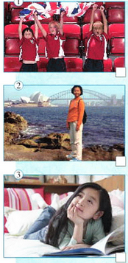
Match the people with the pictures
Fast Reading
Passage A Martin
Martin'S Plan
A
Passage C Lucy
Passage B Zhang Sijia
Lucy's plan
C
Passage C Lucy
Zhang Sijia's plan
Passage B Zhang Sijia
B

Slide 9
Careful Reading
Para A-Martin’s Plan
1.What's Martin looking forward to doing tomorrow?
2.What are Martin and his friends going to do during the match ?
3.What does Martin hope ?
meet other fans
2
1
3
watching
favourite football team
They are going to do
make some
new friends
The favourite football team wins
make some new friend
wear the team shirt
cheer the players

Slide 10
Careful Reading
Para B-Zhang Sijia’s May Day Holiday
When |  | be going to do
May Day holiday |  | _______ herself
May 1st | Morning | _____ ____ late and then _____ a book
 | Afternoon | ____ ____ with her ____ and ____, _____ a walk or go _____
May 2nd |  | ______ _____ in the park near her _____ ____
Feeling (感受) |  | a ______ holiday, ____ but _____ ____
During
enjoy
On
get
up
read
In
go
out
family
friends
take
swimming
On
collect
litter
friend’s
house
great
busy
good
fun

Slide 11
Careful Reading
Para C-Lucy’s summer holiday
After learning Passage A and Passage B,Can you imagine(想像)what Lucy may write in her composition?
Where
What
Who
When

Slide 13
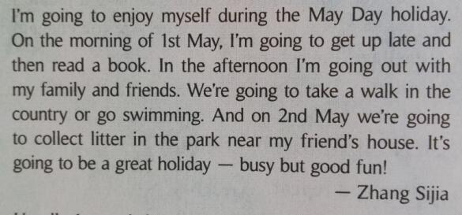
Para B

Slide 14
Retell the passage
2
meet other fans
are going to do
watching favourite football team
The favourite football team wins
make some new friend
wear the team shirt
1
3
make some new friends
cheer the players

Slide 15
Retell the passage
During
When |  | be going to do
May Day holiday |  | _______ herself
May 1st | Morning | _____ ____ late and then _____ a book
 | Afternoon | ____ ____ with her ____ and ____, _____ a walk or go _____
May 2nd |  | ______ _____ in the park near her _____ ____
Feeling (感受) |  | a ______ holiday, ____ but _____ ____
enjoy
On
get
up
read
In
go
out
family
friends
take
swimming
On
collect
litter
friend’s
house
great
busy
good
fun

Slide 16
The way of writing your own plans
开篇点题，简洁明了
What are youlooking forwrd to this weekend ?
总分总法写作
逐一描述，条理清楚
What are you going to do ?
总结收尾，提出希望
What is your feeling about this plan ?
Can you use the structure to write somthing about your coming weekend?结构

Slide 17
The way of writing your own plans
The weekend is coming , please write your plan!
开篇点题，简洁明了
What are youlooking forwrd to this weekend ?
总分总法写作
逐一描述，条理清楚
What are you going to do ?
总结收尾，提出希望
What is your feeling about this plan ?

Slide 18
Homework
A. Finish your composition.
B. Try to retell the passage.

