Slide 1
Unit7 It’s Tuesday 第3课时
陕旅版四年级上册
WWW.PPT818.COM

Slide 2
唱一唱There are seven days

Slide 3
Review
询问今天星期几，可以说：
What day is it day?
It’s…
谈及自己或他人一周内的安排说：
We have…on…

Slide 4
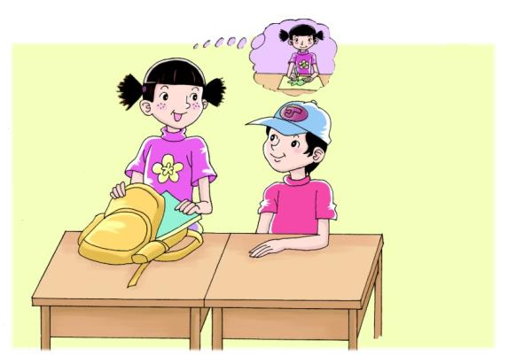
Let’s learn more
听录音，回答问题：
What day is it today?

Slide 5
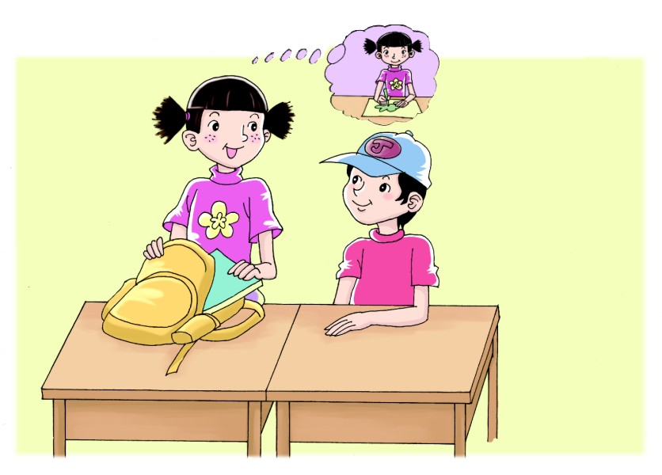
Is it Wednesday today?
Yes, it is. What do you do on Wednesday afternoon?
Oh! I draw some pictures!

Slide 6
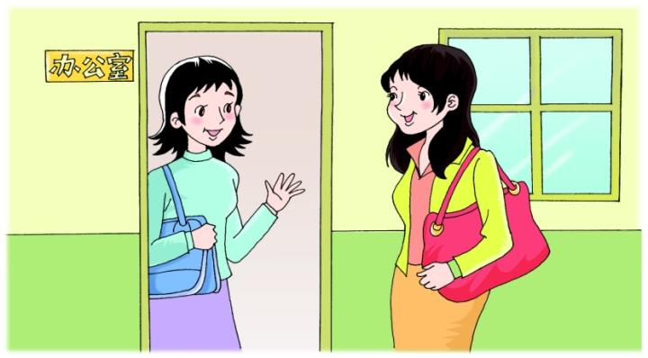
Let’s learn more
听录音，回答问题：
What does Liu Zhaoyang do on Sunday morning?

Slide 7
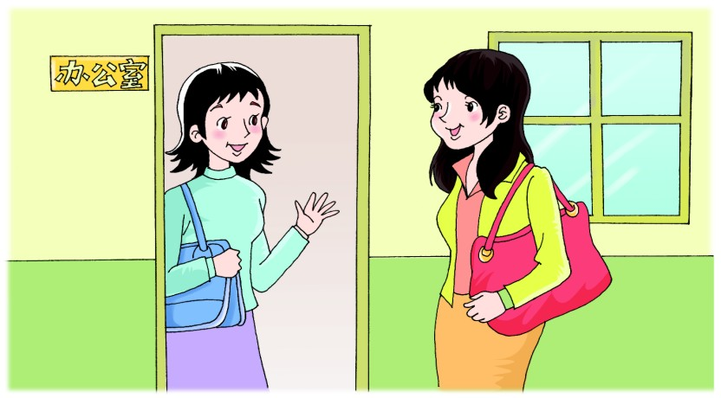
What does Liu Zhaoyang do on Sunday morning?
He likes to play games. What about Wu Chen?
She likes to watch TV.

Slide 8
Summary
讨论每天的活动安排时,运用疑问句:
Is it…today?
Yes, it is.
What do you do on…?
I…
What does Liu Zhaoyang do on…?
He likes to…

Slide 9
Look, ask and answer

Slide 10
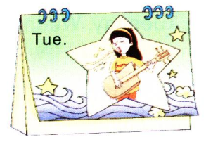
Look, ask and answer
What does Li Shan have on Tuesday?
She has Music class.

Slide 11
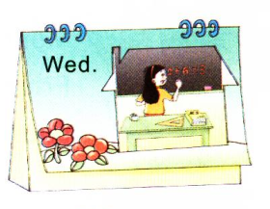
Look, ask and answer
What does Li Shan have on Wednesday?
She has Math class.

Slide 12
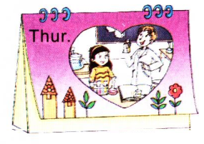
Look, ask and answer
What does Li Shan have on Thursday?
She has Science class.

Slide 13
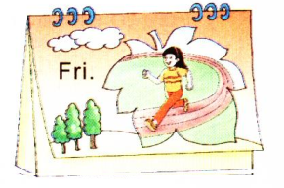
Look, ask and answer
What does Li Shan have on Friday?
She has PE class.

