Slide 1
Unit 1 Knowing me，knowing you
Part Ⅱ Using language——动词-ed形式作状语
WWW.PPT818.COM

Slide 2
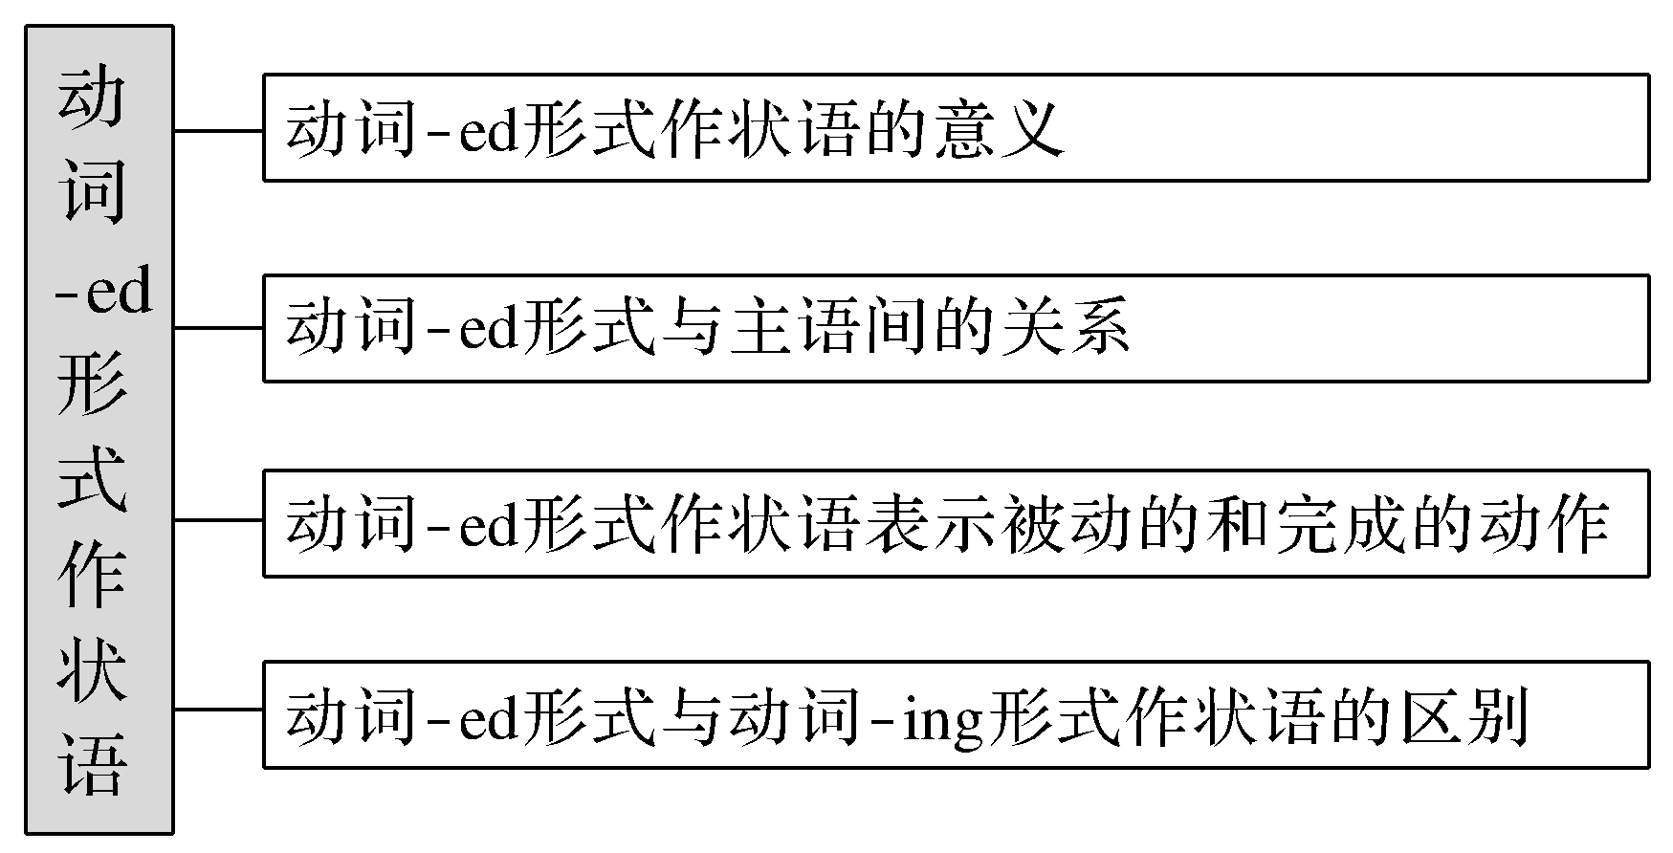
【思维导图】

Slide 3
名师提醒
动词－ed形式属于非谓语动词的一种。所谓非谓语动词，就是指在句子中不作谓语的动词。由于非谓语动词不能单独用作谓语，所以从理论上说，它也就没有实际意义上的主语。

Slide 4
1.动词-ed形式是分词的一种。规则动词的过去分词一般是由动词加-ed构成(规则见后)，不规则动词的过去分词见不规则动词表。
2.动词-ed形式作状语，相当于状语从句或并列句；通常情况下，其逻辑主语就是句子的主语，与主语间为被动关系；该动作表示被动、完成；分词可位于句首和句后；动词-ed形式与动词-ing形式在句中都可作状语，但有很大区别。

Slide 5
一、基础特征感悟
【感悟用法】
1.Satisfied with what he did，the teacher praised him in class.
2.Some medicines，wrongly taken，can kill a person.
3.Compared with you，I still have a long way to go.
4.Encouraged by his parents，he still has no confidence in overcoming the difficulties.
5.The patient got off the bed，supported by the nurse.
6.The cup fell down to the ground，broken.

Slide 6
【自我总结】
1.所有句子中动词-ed形式都作状语，其逻辑主语都是句子的主语，与主语间为被动含义。
2.动词-ed形式的位置可以在句子开头、中间和末尾。
3.以上句子中的动词-ed形式分别作____________、____________、____________、____________、____________、____________状语。
原因
时间
条件
让步
方式
结果

Slide 7
二、主要用法精讲
【重点归纳】
1.动词-ed形式作状语的意义
动词-ed形式作状语来源于状语从句或并列句。可以表示时间、原因、条件、让步、方式或伴随情况等。 表示时间、原因、条件、让步时，动词-ed形式可以拓展成相应的状语从句，表示方式、结果和伴随时可转化为并列分句。

Slide 8
(1)作时间状语时，相当于when或while等引导的从句。
Seen from the top of the hill (＝ When it is seen from the top of the hill)，the school looks like a big garden.
(2)作条件状语时，可转换为once，if或unless等引导的从句。
Given more attention (＝ If it was given more attention)，the fire could have been avoided.
(3)作原因状语时，可转换为because，as或since等引导的从句。
Encouraged (＝ As she was encouraged) by the teacher，the girl was very happy.

Slide 9
(4)作让步状语时，可转换为though，although 或even if引导的从句。
Left (＝ Although she was left) alone at home，Jenny didn’t feel afraid at all.
(5)作方式或伴随状语时，常可转换为并列分句，可位于句首或句末。
Surrounded by his students，the teacher went into the lab.(＝ The teacher was surrounded by his students and he went into the lab.)

Slide 10
2.动词-ed形式与主语间的关系
通常情况下，其逻辑主语必须与句子主语保持一致，也就是说，动词-ed形式与句子的主语之间是动宾关系，主语与动词间是被动含义。
Encouraged by their teacher，the students worked even harder.
受老师的鼓励，学生们学习更努力了。
由句子含义可看出，句子主语the students是动词encourage的宾语，即动作的承受者，encourage the students鼓励学生，故主语the students与encourage之间为被动含义。
Given another hour，I can also work out this problem.
再给我一个小时，我也能解这道题。
同样，句子主语I和分词动作give间为被动关系。

Slide 11
3.动词-ed形式作状语表示被动、完成的动作
(1)及物动词的动词-ed形式既表被动，也表完成。
Written in a hurry，this article was not so good!
因为写得匆忙，这篇文章不是很好。
(2)不及物动词的动词-ed形式只表完成，不表被动。
The boy is gathering fallen leaves(＝leaves that have fallen).
小男孩正在收集落叶。

Slide 12
4.动词-ing形式与动词-ed形式作状语的区别
动词-ing形式作状语与动词-ed形式作状语的最主要区别在于：两者与所修饰的主句的主语的逻辑关系不同。
(1)动词-ing形式作状语时，动词-ing形式所表示的动作与句子主语之间构成逻辑上的主动关系。
He went out，shutting the door behind him.他出去后将门随手关上。
Not knowing what to do，he went to his parents for help.
由于不知如何办是好，他去找父母帮忙。

Slide 13
(2)动词-ed形式作状语时，动词-ed形式所表示的动作与句子主语之间构成逻辑上的被动关系。
Given more encouragement，the boy could have behaved better.
如果多给这个男孩一些鼓励，他可能会表现得更好。
Asked why he did it，the monitor said it was his duty.
当被问及为什么做这件事时，班长说这是他的职责。

Slide 14
比较：
Used for a long time, the book looks old.
由于用了很长时间，这本书看上去很旧。
Using the book, I find it useful.
在使用的过程中，我发现这本书很有用。
【名师提醒】 选择动词-ing形式还是动词-ed形式，关键看主句的主语。如果分词的动作是主句的主语发出，分词就选用动词-ing形式，反之就用动词-ed形式。

Slide 15
即学即练1
用状语从句替换句中黑体部分
①Asked why he was late，he went red.
________________________________________________________________________
②United，we stand；divided，we fall.
________________________________________________________________________
③Inspired by what he said，we are determined to study hard.
________________________________________________________________________
When he was asked why he was late
If we are united；if we are divided
Since/Because we are inspired by what he said

Slide 16
④An old man entered，supported by a girl.
________________________________________________________________________
⑤Wounded，the brave soldier continued to fight.
________________________________________________________________________
⑥Given another chance，I’ll do it much better.
________________________________________________________________________
and he was supported by a girl
Though he was wounded
If I am given another chance

Slide 17
名师提醒
部分动词－ed形式来源于系表结构，作状语时不表示“被动关系”，其前不用being。
这类动词－ed形式及短语常见的有：lost in(陷入某种状态)，seated(坐着的)，hidden(躲着)，stationed(驻扎)，lost/absorbed in(沉溺于，专心于)，born in(出身于)，dressed in(穿着)，tired of(厌烦了)，faced with(面对……)等。
Lost/Absorbed in deep thought，he didn’t hear the sound.
因为专心于思考，所以他没有听到那个声音。
Born in this beautiful town，he hates to leave it.
出生于这个美丽的小镇，他不愿离开它。

Slide 18
名师提醒
动词－ed形式作状语的位置
动词－ed形式可放在主句前作状语，后面用逗号与主句隔开；也可放在主句后面，前面用逗号与主句隔开。
He stood there silently，moved to tears.＝ Moved to tears，he stood there silently.他静静地站在那里，被感动得热泪盈眶。

Slide 19
即学即练2
单句语法填空
Caught
①____________(catch) in a heavy rain，he was all wet.
②____________(fright) by the noise in the night，the girl didn’t dare to sleep in her room.
③The hunter walked slowly in the forest，____________(follow) by his wolf dog.
④____________(read) carefully，he found something he hadn’t known before.
⑤Not ____________(know) how to operate the machine，they went to the expert for help.
⑥____________(print) white，the house looks bigger.
⑦____________(lie) still in the grass，he heard the sound of the wild.
⑧____________(behave) yourself，you will get a nice award.
Frightened
followed
Reading
knowing
Printed
Lying
Behaving

