Slide 1
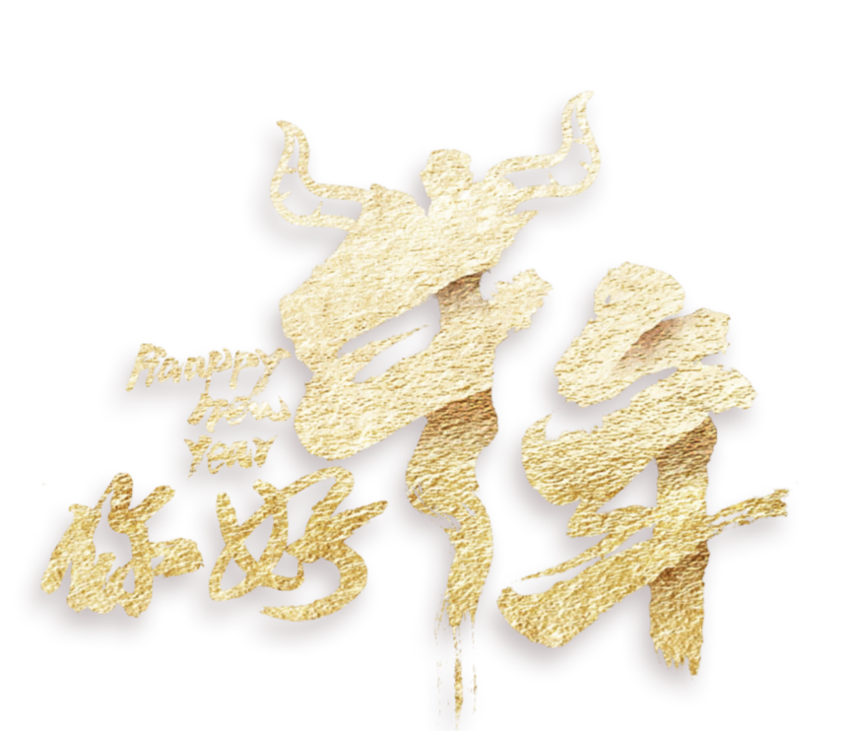
Synergistically utilize technically sound portals with frictionless chainsSynergistically
1PPT.COM
-红色大气年终总结-

Slide 2
Synergistically utilize technically sound portals with frictionless chainsSynergistically
1
目录
/单击此处添加标题/
/单击此处添加标题/
2
1PPT.COM
3
/单击此处添加标题/
/单击此处添加标题/
4

Slide 3
Synergistically utilize technically sound portals with frictionless chainsSynergistically
01
1PPT.COM
Synergistically utilize technically sound portals with, Synergistically utilize technically sound

Slide 4
1PPT.COM
1PPT.COM
Synergistically utilize technically sound portals with, Synergistically utilize technically sound, Synergistically
Synergistically utilize technically sound portals with, Synergistically utilize technically sound, Synergistically
Synergistically utilize technically sound portals with, Synergistically utilize technically sound, Synergistically，Synergistically utilize technically sound portals with, Synergistically utilize technically sound, Synergistically
1PPT.COM
1PPT.COM

Slide 5
1PPT.COM
Synergistically utilize technically sound portals with, Synergistically utilize technically sound, Synergistically
Synergistically utilize technically sound portals with, Synergistically utilize technically sound, Synergistically
Synergistically utilize technically sound portals with, Synergistically utilize technically sound, Synergistically

Slide 6
Synergistically utilize technically sound portals with, Synergistically utilize technically sound, Synergistically utilize
Synergistically utilize technically sound portals with, Synergistically utilize technically sound, Synergistically utilize
7 2
%
Synergistically utilize technically sound portals with, Synergistically utilize technically sound, Synergistically utilize
Synergistically utilize technically sound portals with, Synergistically utilize technically sound, Synergistically utilize
Synergistically utilize technically sound portals with, Synergistically utilize technically sound, Synergistically utilize

Slide 7
1PPT.COM
1PPT.COM
1PPT.COM
Synergistically utilize technically sound portals with, Synergistically utilize technically sound, Synergistically
Synergistically utilize technically sound portals with, Synergistically utilize technically sound, Synergistically
Synergistically utilize technically sound portals with, Synergistically utilize technically sound, Synergistically
1PPT.COM

Slide 8
Synergistically utilize technically sound portals with frictionless chainsSynergistically
02
1PPT.COM
Synergistically utilize technically sound portals with, Synergistically utilize technically sound

Slide 9
Synergistically utilize technically sound portals with, Synergistically
Synergistically utilize technically sound portals with, Synergistically
Synergistically utilize technically sound portals with, Synergistically
1PPT.COM
Synergistically utilize technically sound portals with, Synergistically utilize technically sound, Synergistically utilize technically sound. Synergistically utilize
Synergistically utilize technically sound portals with, Synergistically
Synergistically utilize technically sound portals with, Synergistically

Slide 10
Synergistically utilize technically sound portals with, Synergistically utilize technically sound, Synergistically
1PPT.COM
1PPT.COM
Synergistically utilize technically sound portals with, Synergistically utilize technically sound, Synergistically
Synergistically utilize technically sound portals with, Synergistically utilize technically sound, Synergistically
1PPT.COM

Slide 11
1PPT.COM
1PPT.COM
1PPT.COM
Synergistically utilize technically sound portals with, Synergistically utilize technically sound, Synergistically utilize technically sound. Synergistically utilize，Synergistically utilize technically sound portals with, Synergistically utilize technically sound, Synergistically utilize technically sound. Synergistically utilize
Synergistically utilize technically sound portals with, Synergistically utilize technically sound, Synergistically utilize technically sound. Synergistically utilize，Synergistically utilize technically sound portals with, Synergistically utilize technically sound, Synergistically utilize technically sound. Synergistically utilize
Synergistically utilize technically sound portals with, Synergistically utilize technically sound, Synergistically utilize technically sound. Synergistically utilize，Synergistically utilize technically sound portals with, Synergistically utilize technically sound, Synergistically utilize technically sound. Synergistically utilize

Slide 12
Synergistically utilize technically sound portals with, Synergistically utilize technically sound, Synergistically
Synergistically utilize technically sound portals with, Synergistically utilize technically sound, Synergistically
Synergistically utilize technically sound portals with, Synergistically utilize technically sound, Synergistically
Synergistically utilize technically sound portals with, Synergistically utilize technically sound, Synergistically

Slide 13
Synergistically utilize technically sound portals with, Synergistically, Synergistically utilize technically
Synergistically utilize technically sound portals with, Synergistically
Synergistically utilize technically sound portals with, Synergistically
Synergistically utilize technically sound portals with, Synergistically
Synergistically utilize technically sound portals with, Synergistically, Synergistically utilize technically

Slide 14
Synergistically utilize technically sound portals with frictionless chainsSynergistically
03
1PPT.COM
Synergistically utilize technically sound portals with, Synergistically utilize technically sound

Slide 15
Synergistically utilize technically sound portals with, Synergistically utilize technically sound, Synergistically
Synergistically utilize technically sound portals with, Synergistically utilize technically sound, Synergistically
Synergistically utilize technically sound portals with, Synergistically utilize technically sound, Synergistically

Slide 16
Synergistically utilize technically sound portals with, Synergistically utilize technically sound, Synergistically utilize technically sound. Synergistically utilize
1PPT.COM
Synergistically utilize technically sound portals with, Synergistically utilize technically sound, Synergistically utilize technically sound. Synergistically utilize
Synergistically utilize technically sound portals with, Synergistically utilize technically sound, Synergistically utilize technically sound. Synergistically utilize

Slide 17
Synergistically utilize technically sound portals with, Synergistically utilize technically sound, Synergistically
Synergistically utilize technically sound portals with, Synergistically utilize technically sound, Synergistically
2010
2018
Synergistically utilize technically sound portals with, Synergistically utilize technically sound, Synergistically
2015
Synergistically utilize technically sound portals with, Synergistically utilize technically sound, Synergistically
2020

Slide 18
Synergistically utilize technically sound portals with, Synergistically utilize technically sound, Synergistically utilize technically sound. Synergistically utilize
Synergistically utilize technically sound portals with, Synergistically utilize technically sound, Synergistically utilize technically sound. Synergistically utilize

Slide 19
Synergistically utilize technically sound portals with frictionless chainsSynergistically
04
1PPT.COM
Synergistically utilize technically sound portals with, Synergistically utilize technically sound

Slide 20
Synergistically utilize technically sound portals with, Synergistically utilize technically sound, Synergistically
Synergistically utilize technically sound portals with, Synergistically utilize technically sound, Synergistically
Synergistically utilize technically sound portals with, Synergistically utilize technically sound, Synergistically
Synergistically utilize technically sound portals with, Synergistically utilize technically sound, Synergistically

Slide 21
7 ,850
6 ,938
3 ,760
Synergistically utilize technically sound portals with
Synergistically utilize technically sound portals with
Synergistically utilize technically sound portals with

Slide 22
Synergistically utilize technically sound portals with, Synergistically utilize technically sound, Synergistically
01
Synergistically utilize technically sound portals with, Synergistically utilize technically sound, Synergistically
02
03
Synergistically utilize technically sound portals with, Synergistically utilize technically sound, Synergistically
04
Synergistically utilize technically sound portals with, Synergistically utilize technically sound, Synergistically

Slide 23
Synergistically utilize technically sound portals with, Synergistically utilize technically sound, Synergistically
Synergistically utilize technically sound portals with, Synergistically utilize technically sound, Synergistically
Synergistically utilize technically sound portals with, Synergistically utilize technically sound, Synergistically
2015
2016
2018
2019
2020
Synergistically utilize technically sound portals with, Synergistically utilize technically sound, Synergistically
Synergistically utilize technically sound portals with, Synergistically utilize technically sound, Synergistically

Slide 24
Synergistically utilize technically sound portals with, Synergistically utilize technically sound, Synergistically
Synergistically utilize technically sound portals with, Synergistically utilize technically sound, Synergistically
Synergistically utilize technically sound portals with, Synergistically utilize technically sound, Synergistically
Synergistically utilize technically sound portals with, Synergistically utilize technically sound, Synergistically

Slide 25
Synergistically utilize technically sound portals with frictionless chainsSynergistically
1PPT.COM
-红色大气年终总结-

