Slide 1
Unit 1 Topic 2
We should learn teamwork.
Section B
WWW.PPT818.COM

Slide 2
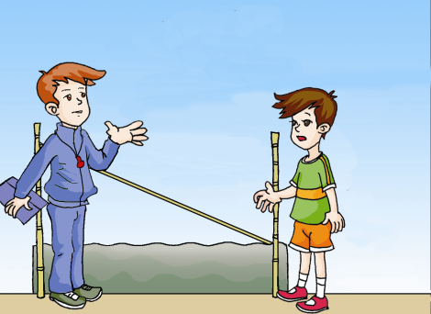
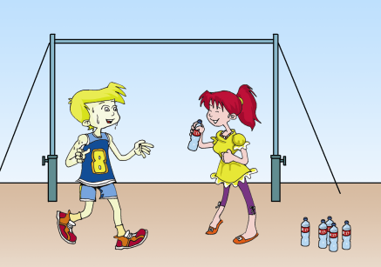
Let's talk!
Would you mind …?
Of course not./Certainly not.

Slide 3
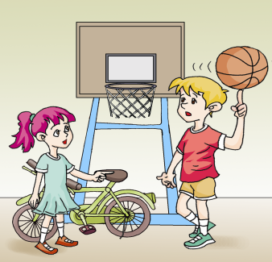
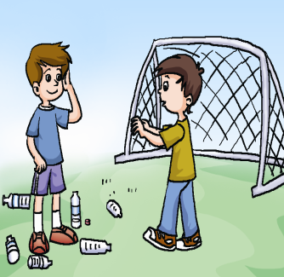
Let's talk!
Would you mind not …?
Sorry./ I’m sorry about that.

Slide 4
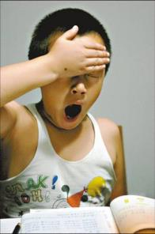
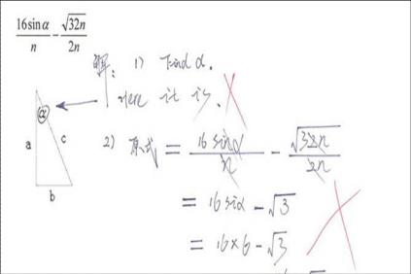
Li Lei did his best to study hard, but he didn’t pass the exam.
do one’s best 尽(某人）最大努力

Slide 5
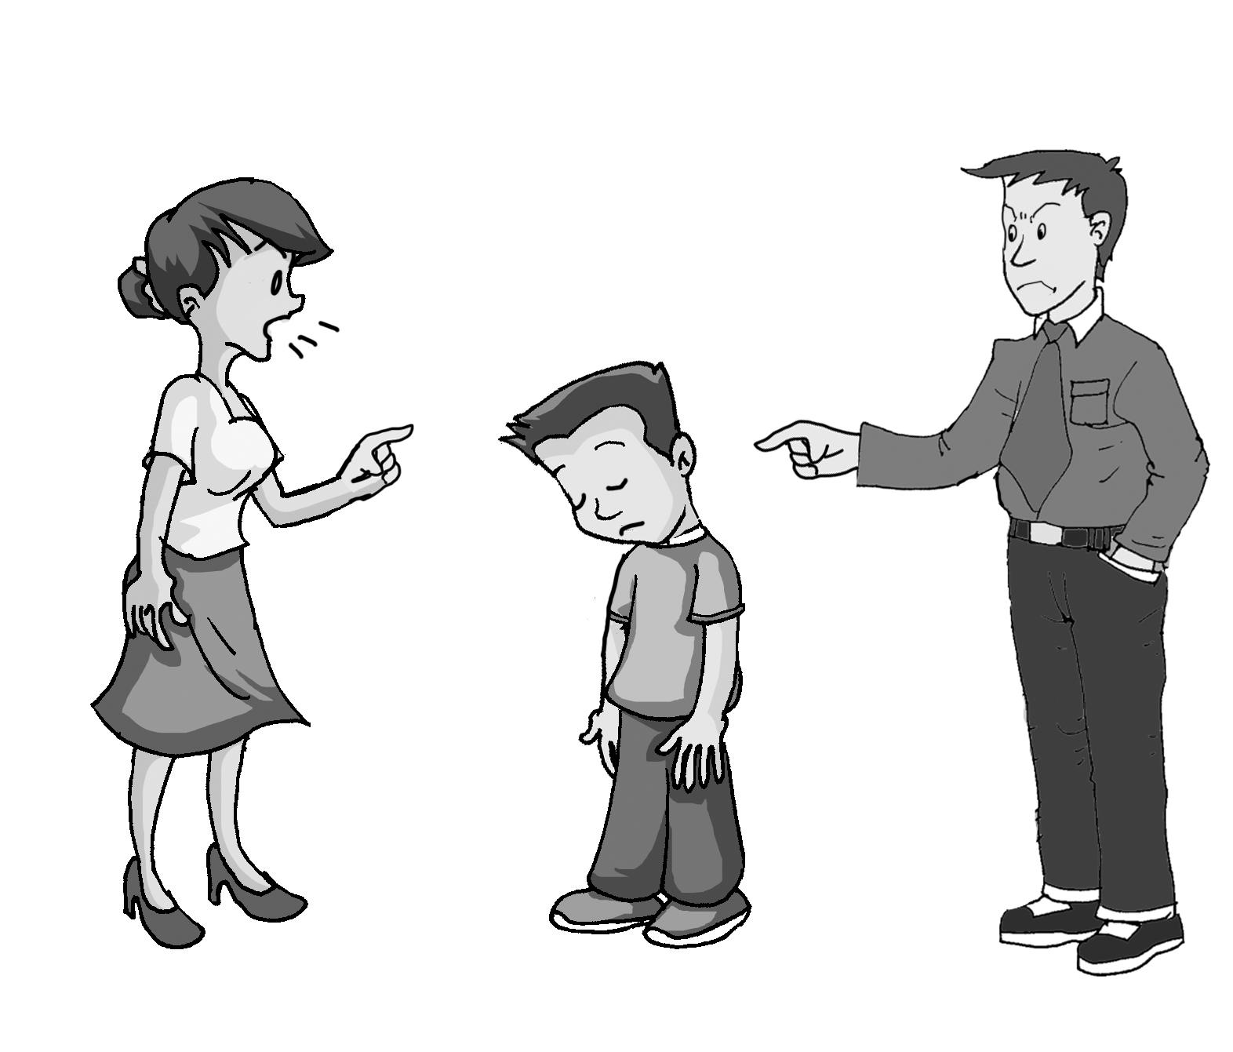
His father is angry with him.
His mother is shouting at him.
对某人生气
斥责某人

Slide 6
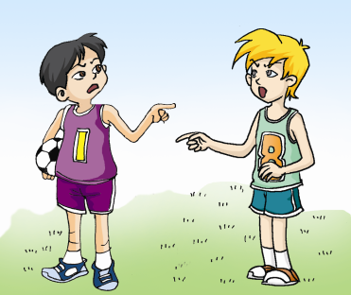
争论，打架
Kangkang is fighting with Michael.
Do you want to know why?

Slide 7
Listen to 1a and find out the answer.
Why is Kangkang fighting with Michael?
Because Michael didn’t pass the ball.

Slide 8
1a. Look, listen and say
Kangkang : Michael, we lost because you wouldn’t pass the ball.
Michael : what do you mean? Don’t shout at me like that. I didn’t want our team to lose.
Kangkang : but we did!
Maria : Kangkang, Michael, please don’t fight.
Michael doesn’t do well in soccer but he did his best.

Slide 9
Jane: Michael, you should learn teamwork, and pass the ball to your teammates more often. You know, one player doesn’t make a team. We should learn teamwork.
Maria : Kangkang, Michael, don’t be angry with each other. You two should talk more about the game before you play. Kangkang, what about saying sorry to Michael?
Kangkang: Michael, I am sorry for what I said.
Michael: it’s nothing.

Slide 10
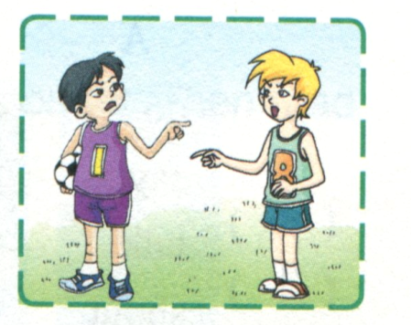
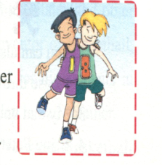
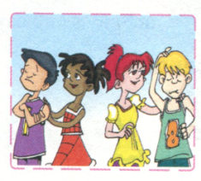
Jane: Michael, practice more and you will do
better next time.
Maria: right! Keep trying. You are sure to have
more fun.

Slide 11
1b Listen to 1a and mark T or F.
The word “fight” means “talk in an
angry way”. ( )
2. Michael and Kangkang are fighting because Michael didn’t pass the ball. ( )
3. Michael is good at soccer and he did his best.
( )
4. Jane and Maria are sure Michael will do better next time. ( )
T
T
F
T

Slide 12
1c Read 1a and fill in the blanks. Then retell the story.
Kangkang and Michael’s team lost the soccer game and
then they had a _________. Kangkang was angry with Michael and __________ at him because Michael wouldn’t ______ the ball to him. With the help of Maria and Jane, Kangkang said _______ to Michael, and they learned ___________ is very important. The girls were sure Michael will do better and have more ______ next time.
fight
shouted
pass
sorry
teamwork
fun
Try to repeat the information you have read in another way. It can help you learn English better.

Slide 13
Match the verbs in Box A with the words in Box B to make phrases.
2
A
do
say
talk
shout
be
have
try
B
angry with
fun
at
well in
about
one’s best
sorry to
Phrase
do well in
say sorry to
talk about
shout at
be angry with
have fun
try one’s best

Slide 14
Then use the correct forms of phrases to complete the sentences.
2
I’ll __________ to finish my homework on time.
They want to keep trying and __________ math next time.
She was angry and said, “Don’t __________ me!”
He was late again. His teacher _____________ him.
Mr. Smith is ____________ the football game with his teammates.
Kangkang should ____________ Michael.
We ______ a lot of ______ at Sally’s birthday party.
try my best
do better in
shout at
was angry with
talking about
say sorry to
had fun

Slide 15
3
Study the example and rewrite the following sentences.
Example:
Please give me the book. = Please give the book to me.
give + + = give + + to +
direct object
直接宾语
indirect object
间接宾语

Slide 16
3
Study the example and rewrite the following sentences.
You can also pass a teammate the ball.
Please throw me the ball.
My dad bought a basketball for my brother.
Bring Peter a present.
I made a big cake for my grandfather.
You can also pass the ball to a teammate.
Please throw the ball to me.
My dad bought my brother a basketball.
Bring a present for Peter.
I made my grandfather a big cake.

Slide 17
Read the pairs of words and pay attention to the difference between /e/ and /aI/.
4a
/e/-- /aI/
press----price
smell----smile
net----night
said----side

Slide 18
Listen and read the sentences aloud, paying attention to the pronunciation and incomplete plosion.
4b
She is going to ta(k)e part in the sports mee(t) nex(t) weekend.
A: Michael, we los(t) because you wouldn’(t) pass the ball.
B: Don’(t) shou(t) at me li(k)e that.

Slide 19
3. A: Would you min(d) no(t) throwing bottles around?
B: I’m sorry abou(t) that. I won’(t) do it again.
4. A: Sorry, I misse(d) the ball.
B: Never mind. Kee(p) trying, I’ll kic(k) you the ball again.
The consonants in brackets here are usually pronounced as stops like t, d, p, b, k and g.

Slide 20
Key points
1. Michael doesn’t do well in soccer but he did his best.
do one’s best = try one’s best 尽力，努力
Eg:我会尽力帮助你的。
I’ll ________________ help you.
do my best to
2.Don’t be angry with each other.
be angry with sb. 对某人生气
Eg:请不要总是生别人的气。
Don’t ________________________ others, please.
be always angry with

Slide 21
Key points
3.What about saying sorry to Michael?
say hello/sorry/thanks/goodbye to sb.
对某人问候/道歉/道谢/道别
4.Keep trying!
keep (sb.) doing sth. 使（某人）不停地做某事
5.You are sure to have more fun.你们一定会玩的更高兴！
be sure to do sth. 肯定要做某事

Slide 22
Key phrases
★ What do you mean by doing sth.?
你做某事是什么意思？
★ shout at sb. 对某人大喊大叫
★ fight with sb. 和某人打架
★ be angry with sb. 对某人生气
★ do one’s best = try one’s best
尽某人最大的努力
★ say sorry to sb. 对某人说对不起
★ be sorry for/about sth.
为某事感到遗憾、后悔、抱歉
★ keep doing sth. 一直/不停地做某事
★ be sure to do sth. 肯定要做某事

Slide 23
★ serve the food 上菜
★ turn down 调低音量
★ in a minute 过一会儿
★ on the phone 在电话里
★ at once = right away 马上；立刻
★ be important to sb. 对某人重要
★ take a seat = sit down 坐下
★ be busy with sth. 忙于某事
★ be busy doing sth. 忙于做某事

Slide 24
A. 用所给单词的正确形式填空：
1. She often makes mistakes. She is ________ (care).
2. Kangkang and Michael _______(fight) with each other last night.
3. I’m sure I will do _______(good) next time.
4. The words are small. I can’t see them ________(clear).
5. We should do our _____(good) to do more exercise. It’s good for our health.
careless
fought
better
clearly
best

Slide 25
B. 根据句意和首字母提示，完成句子。
1. You should wash your hands. They’re too d______.
2. Liu Gang is going to the USA. It’s a good c______ to practise English.
3. I ate n______ for breakfast this morning. I
am so hungry now.
4. – Michael! Supper is r_____. Please wash your hands at once.
– OK, Mom.
5. – Sorry, I don’t like this pen. Could you
pass me a________?
– No problem.
irty
hance
othing
eady
nother

Slide 26
按照汉语提示填空。
1. We are sure _______(获胜) next time.
2. Could you please do me a ________ (给……帮助)?
3. Would you mind ________(帮忙) me?
4. They’ll go somewhere _______(别的).
5. You missed a good ________(机会).
to win
favor
helping
else
chance

Slide 27
Translate the sentences.
1. 你对着我大喊大叫是什么意思啊？
2. 我们不应该互相打架。
What do you mean by shouting at me?
We shouldn’t fight with each other.

Slide 28
3. 我错过了一个好机会，所以我的队友对我生气了。
4. 我相信他已经尽力了。
5. 我为我所说的话感到很抱歉。
I missed a good chance, so my teammates were angry with me.
I believe (that) he did/tried his best.
I am sure (that) he did/tried his best.
I’m very sorry for what I said.

Slide 29
6. 他总是这么不小心。
7. 他没有向老师道歉。
8. 我们一直在读英语。
He is always so careless.
He didn’t say sorry to the teacher.
We keep reading English.

Slide 30
9. 我们肯定会进球的。
10. 在老师的帮助下，她的数学进步了。
We are sure to get a goal.
With the teacher’s help, her maths is better.
11. — 你介意马上上菜吗？ — 当然不。
— Would you mind serving the food at once?
— Of course not.

Slide 31
12. — 你介意把收音机的音量调低吗？
— 真的很对不起。
13. 对不起我弄丢了你的钢笔。
14. 我昨天忙于打扫房间。
15. 你介意在电话里告诉她那个消息吗？那对她很重要。
— Would you mind turning down the radio?
— I’m really sorry about that.
I’m sorry for losing your pen.
I was busy cleaning the room yesterday.
Would you mind telling her the news on the phone? It’s very important to her.

Slide 32
单项选择
1. – Mary, do you know what this word means?
– Oh, sorry. I don’t know, _____.
A. also B. too C. either D. as well
2. He always watches TV for a long time after school. His mother is ____.
A. so happy B. angry with him
C. kind to him D. friendly
3. Studying English well is _____ us.
A. important for B. important to
C. important of D. important with
C
B
B

Slide 33
D
4. – It’s too noisy. Would you mind ____?
– Sorry. I’ll do it right now.
A. turning it up B. turn it off
C. turn down it D. turning it down
5. Don’t keep the children ______ TV all the time. It’s bad for their health.
A. watching B. watch
C. watched D. watches
6. You lied to your mother yesterday. You must say _____ her.
A. hello to B. sorry for
C. sorry to D. sorry
A
C

Slide 34
A
7. You shouldn’t ____ him. He is only a child.
A. shout at B. angry with
C. be kind to D. shout for
8. ____ my English teacher’s help, I learn English well now.
A. Under B. With C. In D. For
9. – I’m sorry I broke your pen.
– _____. I have another one.
A. You’re welcome B. That’s right
C. It’s nothing D. Too bad
10. What did she mean _____ so early?
A. by leaving B. by leave
C. of leaving D. by left
B
C
A

Slide 35
Homework
Work in pairs or in groups.
Make a short play about problems,
complaints, apologies and answers.
For example: one student made the
other students wait for a long time,
or broke others’ pens, and so on.

